Slide 1

Carlton Comprehensive Public High School
Today’s Class Times
Period 1 | 8:55 – 9:58
Period 2 | 10:03 – 11:08
Period 3 | 11:13 – 12:16
Period 4 | 1:05 – 2:08
Period 5 | 2:13 – 3:16

Slide 2



Drivers Education Sign Up
Summer Drivers Ed Class:
July 2 - 11, 2019
10am - 2:30pm
Must be 15 on or
Before August 31
Please text
306-961-3447
To Register.
Feb. 21

Slide 4
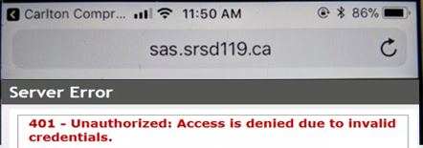


Problems signing into Students Achieve?
Check
address
Refresh and log in again.
**Forgot your password? See the Learning Commons Staff.

Slide 5
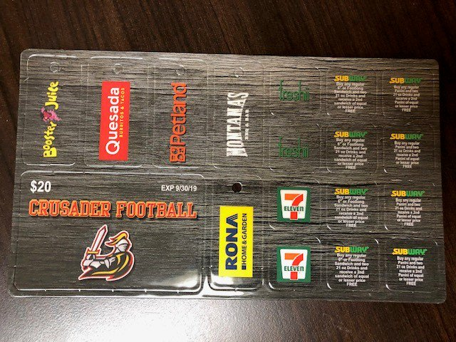
Support our Sader Football program and buy Sader Cards! $20.00 in the General Office. There is well over $100 worth of savings and free merch!

Slide 6
If you usually throw away your old school supplies, please donate them to carlton pantry instead.
Collection boxes are located by the pantry (near B220). Thanks for helping your fellow crusaders!

Slide 7
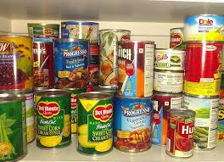
Carlton Pantry
Hi, Crusaders!
Carlton Pantry is excited to share the news that Prince Albert will soon be the new home of many new refugee families. 80 of the refugees are children and youth. If you have children's or youth clothing, toys or other donations, please bring them to Carlton so we can show them what a loving and welcoming community we are.
Thank you to everyone who has donated to our Pantry! We are helping many students every day.

Slide 8


