Slide 1
Carlton Comprehensive Public High School
Today’s Class Times
Period 1 | 8:55 – 9:58
Period 2 | 10:03 – 11:08
Period 3 | 11:13- 12:16
Period 4 | 1:05 -2:08
Period 5 | 2:13 – 3:16

Slide 2
The cafetorium will be closed to students
on Wednesday, April 17th due to the
Elementary School Concerts
taking place that day.

Slide 3
Wednesday, April 17, 2019
Breakfast | Eggs Benny (8:00 – 9:00 a.m.) | $4.50
Lunch | Burger, Pop & Cookie | $5.00
 | **Lunch will be served in the Rotunda**

Slide 4
Applications for Grade 12 Scholarships Now Open!
Deadline May 6, 2019 @ 3:30 p.m. (NO EXCEPTIONS)
Check out the Carlton website under STUDENTS,
STUDENT SERVICES and
SCHOOL/COMMUNITY SCHOLARSHIPS

Slide 5
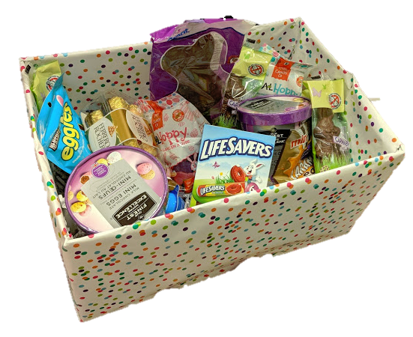
Student Services Easter Basket Draw
$.25 per ticket
Draw Wed after lunch.
All proceeds go to a local charity.
Happy
Easter

Slide 6
Drivers Education Sign Up
Next two classes coming up:
Last After School Class -
April 29
Summer Class -
July 2 - 11
Please text
(306) 961-3447
to register.
Feb. 15

Slide 7
Attention Grad!!
Get your grad application in
as soon as possible.
Grad Pictures are April 15 – 18, 2019.

Slide 8
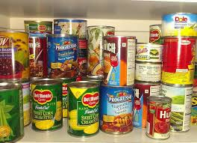
Carlton Pantry
Hi, Crusaders!
If you need food, clothing, hygiene items or school supplies, please talk to Mrs. Amy in B223A or another staff member.
This month our wish list includes: hygiene items (toothpaste, toothbrushes, deodorant, body wash, shampoo); sweat pants for males and females, binders and backpacks.
Thank you to everyone who has donated! We appreciate your support.

Slide 9
CARLTON'S OPEN MIC NIGHT
Do you have a talent you want to share?
Tuesday, April 30th at 7pm in the Learning Commons. Students need to pre-register in Y100 before the Easter break.
There will be an opportunity for one act to move on to the Saskatchewan Rivers Public School Division Talent Show in May.

Slide 10
2019 Carlton Football Spring Camp May 2 @ 12:20p.m. – CPAC If you cannot make meeting, see Strachan.

Slide 11
Congratulations to the MHTC Incident at San Bajo production for winning the Spirit of the Festival Award at the SDA Region 7 drama festival this past weekend in Melfort. Skylar German won one of four acting medallions for her excellence in characterization and Will Straf won one of four medallions for technical excellence for his set design. Shannan Spademan and Aidan Quinton won certificates of excellence in technical theatre for stage management and carpentry. Nykola Oleksyn won a certificate of excellence in acting for his interpretation of the role of Giles Ferguson and Caitlyn Greenwood won a certificates of excellence for directing. Heidi Lundell received the student recognition award for dedication and ensemble spirit. This brings to a close our very successful dramatic season. In the words of Katelynn Bird - " you guys made this the best school year that I have had in a long time"! The positive spirit, artistic endeavor and dedication is what makes the MHTC the premier club of this school! Theatre builds community and good theatre builds great communities - that is what WE DO every year!

Slide 13
Badminton
Reminder:
All badminton players are meeting in the CPAC at lunch for pictures.

