Slide 1
Carlton Comprehensive Public High School
Today’s Class Times
Period 1 | 8:55 – 9:58
Period 2 | 10:03 – 11:08
Period 3 | 11:13- 12:16
Period 4 | 1:05 -2:08
Period 5 | 2:13 – 3:16

Slide 2
The cafetorium will be closed to students
on Wednesday, April 17th due to the
Elementary School Concerts
taking place that day.

Slide 3
Monday, April 15, 2019
Breakfast | Kaiser with Hashbrowns | $4.50
Lunch | Greek Souvlaki with Wedges or Soup or Salad | $6.50
Soup & Salad | Chicken Rice Tossed Green Salad | $5.75
Dessert | Rice Pudding | $2.00

Slide 4
Applications for Grade 12 Scholarships Now Open!
Deadline May 6, 2019 @ 3:30 p.m. (NO EXCEPTIONS)
Check out the Carlton website under STUDENTS,
STUDENT SERVICES and
SCHOOL/COMMUNITY SCHOLARSHIPS

Slide 5
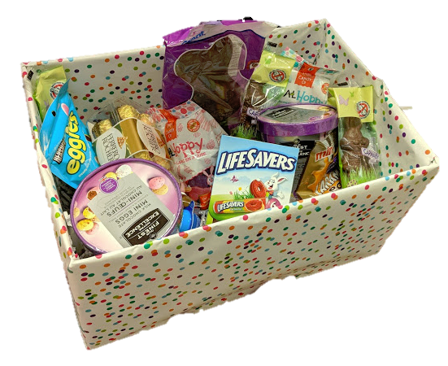
Student Services Easter Basket Draw
$.25 per ticket
Draw Wed after lunch.
All proceeds go to a local charity.
Happy
Easter

Slide 6
Drivers Education Sign Up
Next two classes coming up:
Last After School Class -
April 29
Summer Class -
July 2 - 11
Please text
(306) 961-3447
to register.
Feb. 15

Slide 7
Attention Grad!!
Get your grad application in
as soon as possible.
Grad Pictures are April 15 – 18, 2019.

Slide 8
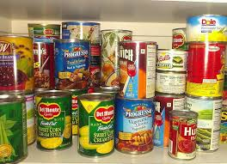
Carlton Pantry
Hi, Crusaders!
If you need food, clothing, hygiene items or school supplies, please talk to Mrs. Amy in B223A or another staff member.
This month our wish list includes: hygiene items (toothpaste, toothbrushes, deodorant, body wash, shampoo); sweat pants for males and females, binders and backpacks.
Thank you to everyone who has donated! We appreciate your support.

Slide 9
CARLTON'S OPEN MIC NIGHT
Do you have a talent you want to share?
Tuesday, April 30th at 7pm in the Learning Commons. Students need to pre-register in Y100 before the Easter break.
There will be an opportunity for one act to move on to the Saskatchewan Rivers Public School Division Talent Show in May.

Slide 10
Carlton Outdoor Ed Club Trivia
Outdoor Ed Club Trivia question #4:
What is the name of the waterfall that flows from Iskwatikan Lake into Nistowiak Lake, on the Churchill system?
First correct answer in to Mrs. Ackerman or Mr. Huddlestone wins a prize, and will be entered for the grand prize now on display in the Runtunda.

Slide 11
2019 Carlton Football Spring Camp May 2 @ 12:20p.m. – CPAC If you cannot make meeting, see Strachan.

