Slide 1
Carlton Comprehensive Public High School
Today’s Class Times
Period 1 | 8:55 – 9:58
Period 2 | 10:03 – 11:08
Period 3 | 11:13- 12:16
Period 4 | 1:05 -2:08
Period 5 | 2:13 – 3:16

Slide 2
Friday, April 5, 2019
Breakfast | Mini Breakfast | $4.50
Lunch | Dry Ribs and Fries or Soup or Salad or Onion Rings | $6.50
Soup & Salad | Beef Barley Spinach Berry | $5.75
Dessert | Fresh Daily | $2.00

Slide 3
Girls of Greatness
Next meeting:
April 9, 2019
Period 4
Student Lounge
Open to Grades 9-12

Slide 4
Applications for Grade 12 Scholarships Now Open!
Deadline May 6, 2019 @ 3:30 p.m. (NO EXCEPTIONS)
Check out the Carlton website under STUDENTS,
STUDENT SERVICES and
SCHOOL/COMMUNITY SCHOLARSHIPS

Slide 5
The Model UN Club invites you to a Round Table Conversation on Thursday April 4 in Room B117 at lunch with Carlton students from multiple backgrounds that will share their "Life Story". This is a great opportunity to learn more about each other and our Carlton community. All staff and students are invited. Please bring your own lunch.

Slide 6
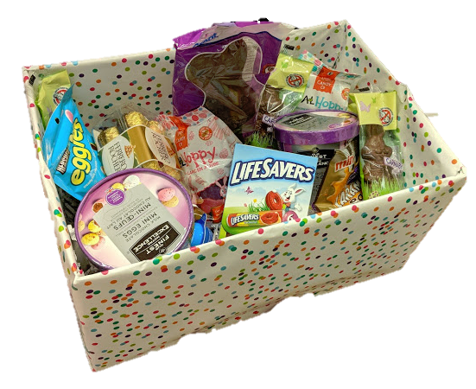
Student Services Easter Basket Draw
$.25 per ticket
Draw Wed after lunch.
All proceeds go to a local charity.
Happy
Easter

Slide 7
Drivers Education Sign Up
Next two classes coming up:
Last After School Class -
April 29
Summer Class -
July 2 - 11
Please text
(306) 961-3447
to register.
Feb. 15

Slide 8
Attention Grad!!
Get your grad application in
as soon as possible.
Grad Pictures are April 15 – 18, 2019.

Slide 9
Green Shirt Day
Wear a green shirt or your favourite team jersey this Friday to support and honour the victims of the Bronco’s accident.
Official Green Shirt day is this Sunday April 7th
#Humboldtstrong

