Slide 1
Carlton Comprehensive Public High School
Today’s Class Times
Period 1 | 8:55 – 9:58
Period 2 | 10:03 – 11:08
Period 3 | 11:13- 12:16
Period 4 | 1:05 -2:08
Period 5 | 2:13 – 3:16

Slide 2
Tuesday, April 9, 2019
Breakfast | South-west Egg Benny with Hash Browns | $4.50
Lunch | Szechuan Chicken with Vegetable Stir-fry on Noodles | $6.50
Soup & Salad | Wonton Soup Mr. Lokinger’s Morroco Salad | $5.75
Dessert | Bread Pudding | $2.00

Slide 3
Applications for Grade 12 Scholarships Now Open!
Deadline May 6, 2019 @ 3:30 p.m. (NO EXCEPTIONS)
Check out the Carlton website under STUDENTS,
STUDENT SERVICES and
SCHOOL/COMMUNITY SCHOLARSHIPS

Slide 4
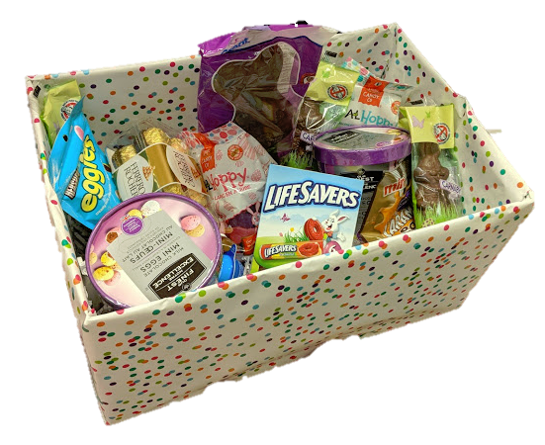
Student Services Easter Basket Draw
$.25 per ticket
Draw Wed after lunch.
All proceeds go to a local charity.
Happy
Easter

Slide 5
Drivers Education Sign Up
Next two classes coming up:
Last After School Class -
April 29
Summer Class -
July 2 - 11
Please text
(306) 961-3447
to register.
Feb. 15

Slide 6
Attention Grad!!
Get your grad application in
as soon as possible.
Grad Pictures are April 15 – 18, 2019.

Slide 7
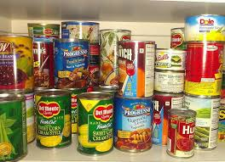
Carlton Pantry
Hi, Crusaders!
If you need food, clothing, hygiene items or school supplies, please talk to Mrs. Amy in B223A or another staff member.
This month our wish list includes: hygiene items (toothpaste, toothbrushes, deodorant, body wash, shampoo); sweat pants for males and females, binders and backpacks.
Thank you to everyone who has donated! We appreciate your support.

Slide 8
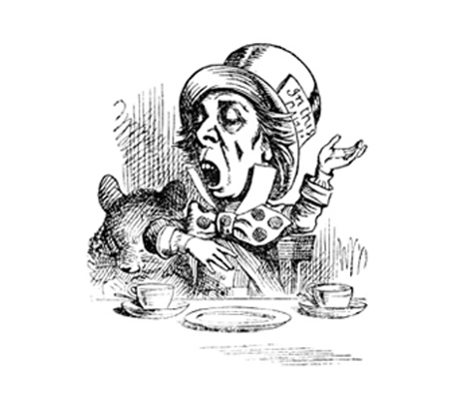
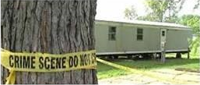
Imagine a mass murder at a trailer park and only seven people survive! The MHTC proudly presents the dark comedy An Incident at San Bajo on Wednesday April 10 at 7:30 pm in the cafetorium. Admission is at the door and all seats are $5. Plan now to celebrate Carlton excellence in the performing arts! If someone offers you the magic elixir . . . drink it!
Mad Hatter Theatre Company

Slide 9
CARLTON'S OPEN MIC NIGHT
Do you have a talent you want to share?
Tuesday, April 30th at 7pm in the Learning Commons. Students need to pre-register in Y100 before the Easter break.
There will be an opportunity for one act to move on to the Saskatchewan Rivers Public School Division Talent Show in May.

Slide 10
Wrestlers, don't forget the year end on Friday. It will be in the commercial cooking classroom at lunch. Wear red, we will be taking a picture.

Slide 11
Are you adventurous? Do you like to get outside and try new things? The Carlton Outdoor Ed
Club would like to invite you to come canoeing this spring. No previous experience necessary.
For more information come to G106 at lunch on Thursday.
Outdoor Trivia Question #2: Approximately how many lakes and rivers does Saskatchewan have?
First correct answer to Mrs. Ackerman or Mr. Huddlestone wins a prize!

