Slide 1
Carlton Comprehensive Public High School
Today’s Class Times
Period 1 | 8:55 – 9:58
Period 2 | 10:03 – 11:08
Period 3 | 11:13- 12:16
Period 4 | 1:05 -2:08
Period 5 | 2:13 – 3:16

Slide 2
Monday, April 1, 2019
Breakfast | Kaiser with Hash Browns | $4.50
Lunch | Chicken Tetrazzini | $6.50
Soup & Salad | Cream of Tomato Garden Salad | $5.75
Dessert | Chocolate Brownie | $2.00

Slide 3
Girls of Greatness
Next meeting:
April 9, 2019
Period 4
Student Lounge
Open to Grades 9-12

Slide 4
Track and Field Sign Up
April 8th @ 3:30 p.m.
CPAC
Bring some friends - get some info
No experience necessary!
We Run, Jump and Throw so there is something for everyone!

Slide 5
Carlton Pantry Do you have the luck of a leprechaun? Anyone who donates to our Pantry will receive a ticket for a chance to win a Pot of Gold! Please bring donations to B223A and enter the draw!

Slide 6
Thank you to Gene’s for the generous donations for our King Trapper prizes!

Slide 7
Dec. 1

Slide 8
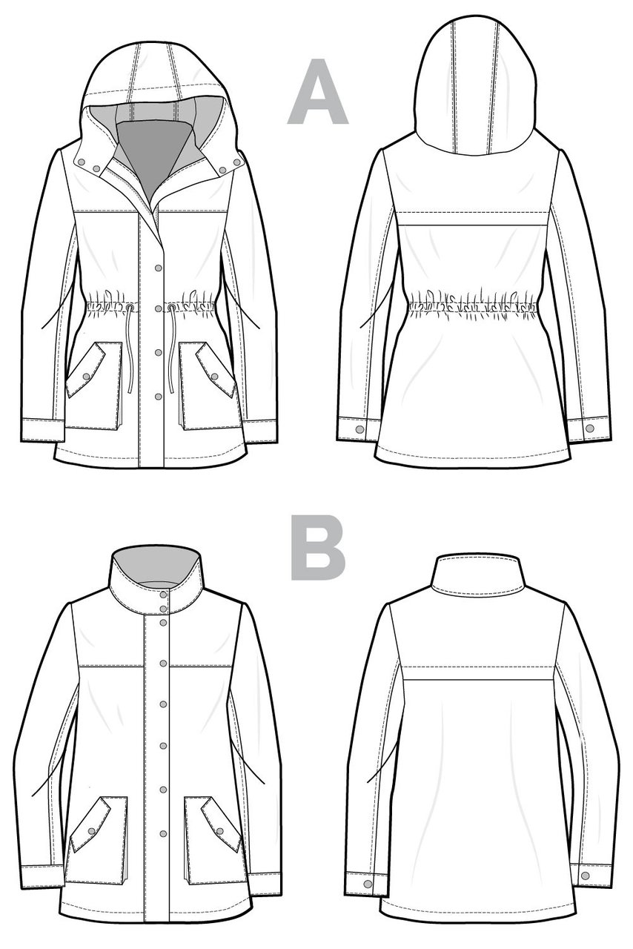
‘SEW’CIAL CLUB
MONDAYS
LUNCH
B230
MX. LAEWETZ
no experience required
*Sew-bead-knit-crochet-cross stitch and more

Slide 9
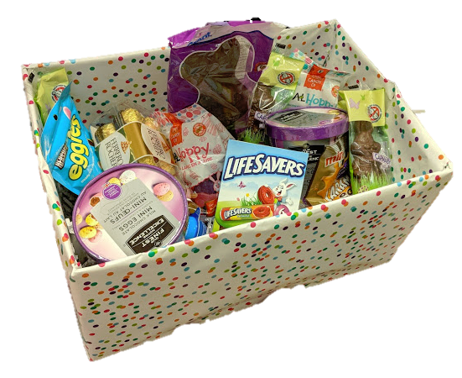
Student Services Easter Basket Draw
$.25 per ticket
Draw Thurs after lunch.
All proceeds go to a local charity.
Happy
Easter

Slide 10
Drivers Education Sign Up
Next after school
class starts
April 1, 2019 (no joke).
Please text
306-961-3447
To Register.
Feb. 15

Slide 11
Attention Grad!!
Get your grad application in
as soon as possible.
Grad Pictures are April 15 – 18, 2019.

Slide 12
Congratulations to all delegates in this years Model UN hosted by Carlton on March 21. Special congratulations to Jarica Gooding and Sanjana Brijlall who were voted top delegates this year. They will represent Prince Albert at Model United Nations Assembly in Winnipeg on May 9-11 as the Chinese delegation. Good luck ladies.

