Slide 1
Carlton Comprehensive Public High School
Today’s Class Times
Period 1 | 8:55 – 9:58
Period 2 | 10:03 – 11:08
Period 3 | 11:13- 12:16
Period 4 | 1:05 -2:08
Period 5 | 2:13 – 3:16

Slide 2
Caf Limited Hours
March 4: Regular Hours
March 5 – March 8
Breakfast: 8:00 – 9:00 AM
Lunch: 12:16 – 12:45 PM

Slide 3
Monday, March 4, 2019
Breakfast | Kaiser with Hash browns | $4.50
Lunch | Monte Cristo with Wedges or Soup or Salad | $6.50
Soup & Salad | Chicken Orzo Tossed Green Salad w/ Breast of Chicken | $5.75
Dessert | Assorted Desserts | $2.00

Slide 4
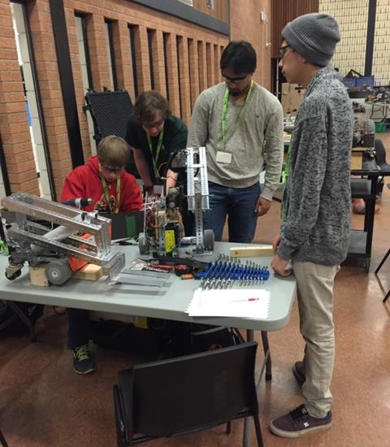
Anyone wanting to be part of the team this year please contact Mr. Amy in the Electrical Shop!
Feb. 27

Slide 5
Donate FOOD items to Carlton Pantry B223A and receive a ticket for a chance to win a fabulous prize! granola bars cup of soup canned goods fruit cups pudding snack foods
It’s KINDNESS month at Carlton
Feb. 28

Slide 6
GRADE 12 STUDENTS WITH 19 CREDITS OR MORE
YOU MUST APPLY FOR GRAD ASAP!!!
Go to Carlton Homepage
Print application off the website
Complete it
Meet with a school counsellor
Mar. 8

Slide 7
Please see Student Services
Crusaders!!!
Do you have a locker
you are NOT using???
Mar. 8

Slide 8
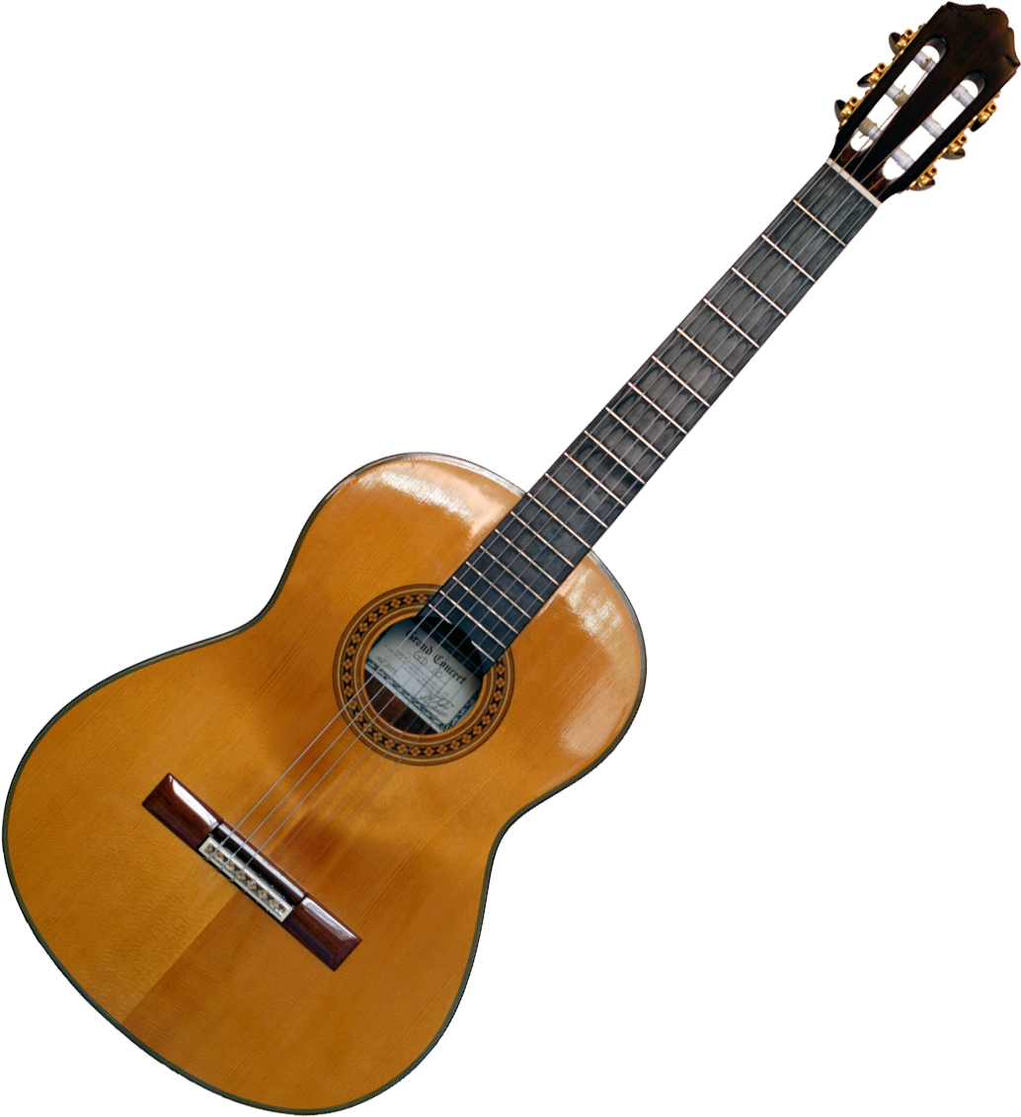
Crusader Music Club
Everyone welcome!
Mondays
3:20-4:30 p.m.
B223A
Come check out our new guitars and amps!

Slide 9
Learn how to communicate in French!
Next year, Carlton with be offering
Core French 10/20/30.
Core French will teach you to communicate with basic skills in French.
See Mme Morton in R211 or Mme Minielly in SS
for more information.

Slide 10
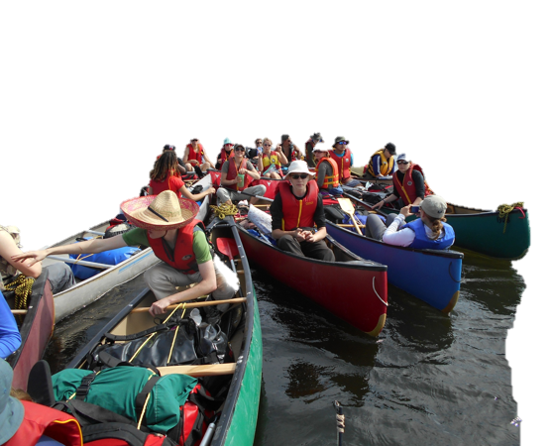
Outdoor Ed meeting at lunch
Construction Shop classroom
March 6. Those interested in going on the ice fishing trip or the other winter activities should attend.

Slide 11
The Heart of the Youth Community Pow Wow Committee is looking for dancers to volunteer some of their time by joining alongside the Wonska drum group to do presentations at various schools throughout Prince Albert during the months of March and April.
If you are a dancer in Pow Wow and are interested in helping out, please go see Ms. Tibbs in Room 108 (morning time only) for more information on dates/times/details.
We really would love to see students from Carlton get involved!

Slide 12
Girls of Greatness
Next meeting:
March 12, 2019
Period 3
Student Lounge
Open to Grades 9-12

Slide 13
Carlton Pantry Do you have the luck of a leprechaun? Anyone who donates to our Pantry will receive a ticket for a chance to win a Pot of Gold! Please bring donations to B223A and enter the draw!

Slide 14
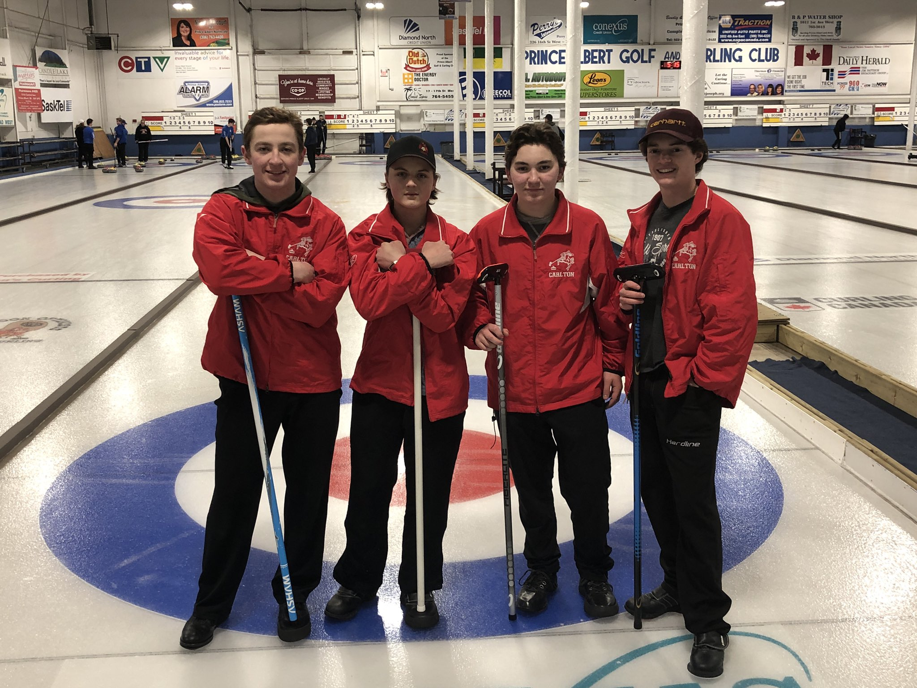
Congratulations to the Carlton boys curling team - Rowen Greene, Theron Chamberlain, Stephen Acorn and Matthew Acorn for their great performance at the regional playoffs in Nipawin. They did a great job representing our school and were competitive right to the final shot. Way to go guys!

Slide 15
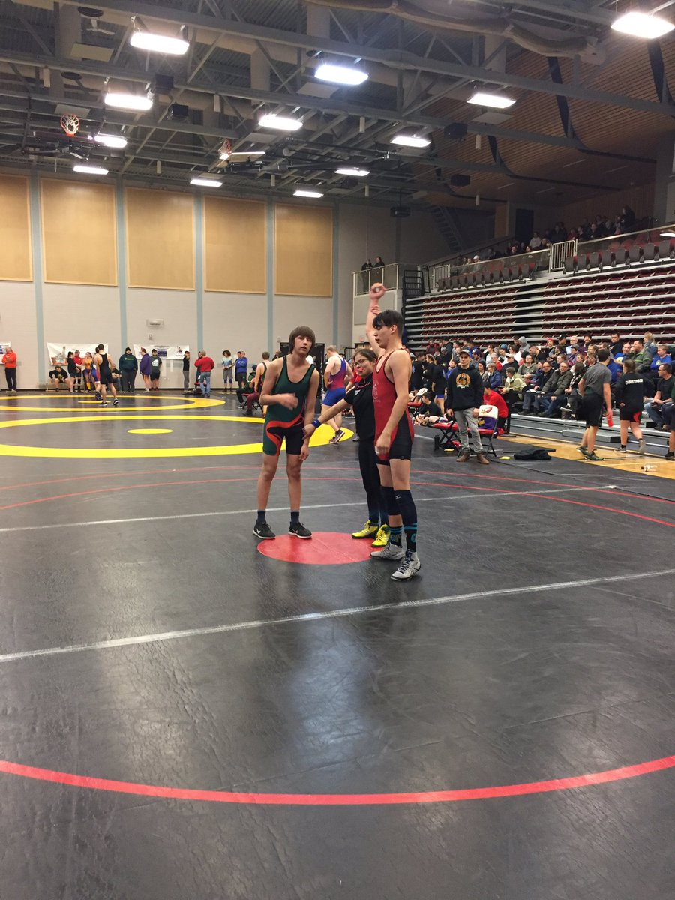
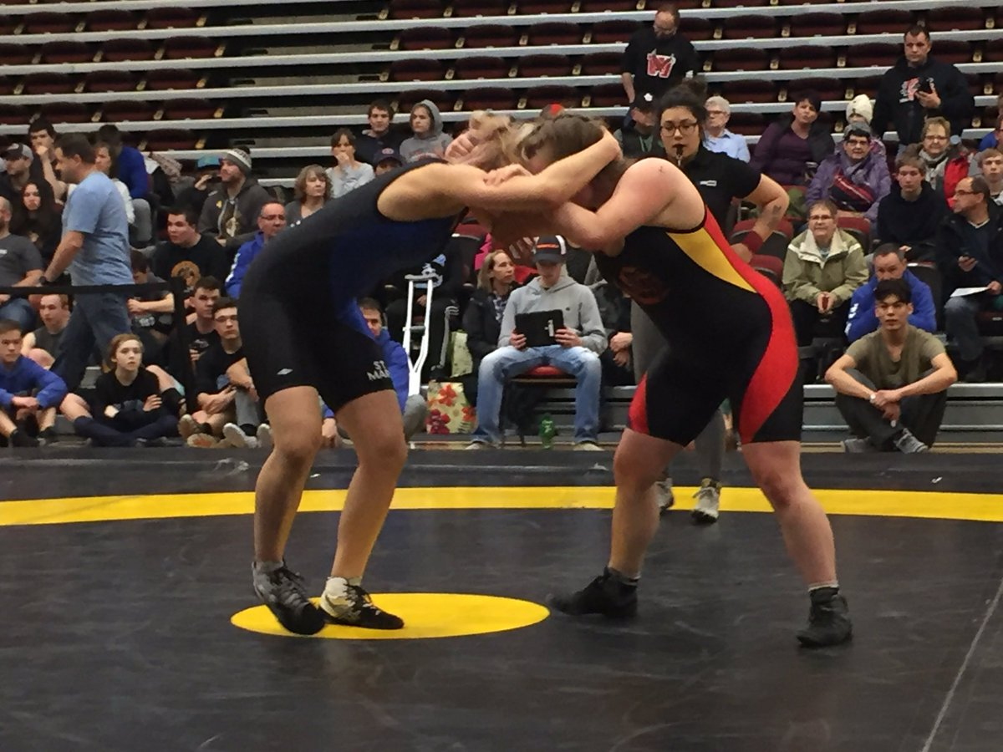
A special congratulations to the following wrestlers who will be competing for Provincial Gold next weekend...Abby Tiessen, Kalyn Anderson, Josee Trzaskowski, Elijah McPherson, Maddison Bird, Jesse Fehr, Connor Elphistone.

