Slide 1
Carlton Comprehensive Public High School
Today’s Class Times
Period 1 | 8:55 – 9:58
Period 2 | 10:03 – 11:08
Period 3 | 11:13- 12:16
Period 4 | 1:05 -2:08
Period 5 | 2:13 – 3:16

Slide 2
Monday, March 25, 2019
Breakfast | Kaiser with Hash browns | $4.50
Lunch | Meatloaf with Mashed Potato and Vegetables | $6.50
Soup & Salad | Tomato Macaroni Tossed Salad with Chicken | $5.75
Dessert | Surprise | $2.00

Slide 3
Dec. 1

Slide 4
GRADE 12 STUDENTS WITH 19 CREDITS OR MORE
YOU MUST APPLY FOR GRAD ASAP!!!
Go to Carlton Homepage
Print application off the website
Complete it
Meet with a school counsellor
Mar. 8

Slide 5
Girls of Greatness
Next meeting:
April 9, 2019
Period 4
Student Lounge
Open to Grades 9-12

Slide 6
Carlton Pantry Do you have the luck of a leprechaun? Anyone who donates to our Pantry will receive a ticket for a chance to win a Pot of Gold! Please bring donations to B223A and enter the draw!

Slide 7
All Carlton Skills competitors
must attend a meeting at the
start of lunch
Wednesday, March 27
in the Electrical Shop.

Slide 8
Grad Plan
Grade 9, 10, and 11 students need to meet with a counselor in Student Services to go over their 3-year grad plan and to choose classes for next year.
Stop by any time that works for you - we are open from 8:15 am - 3:15 pm.
After school appointments are available with Mrs. Minielly by request.

Slide 10
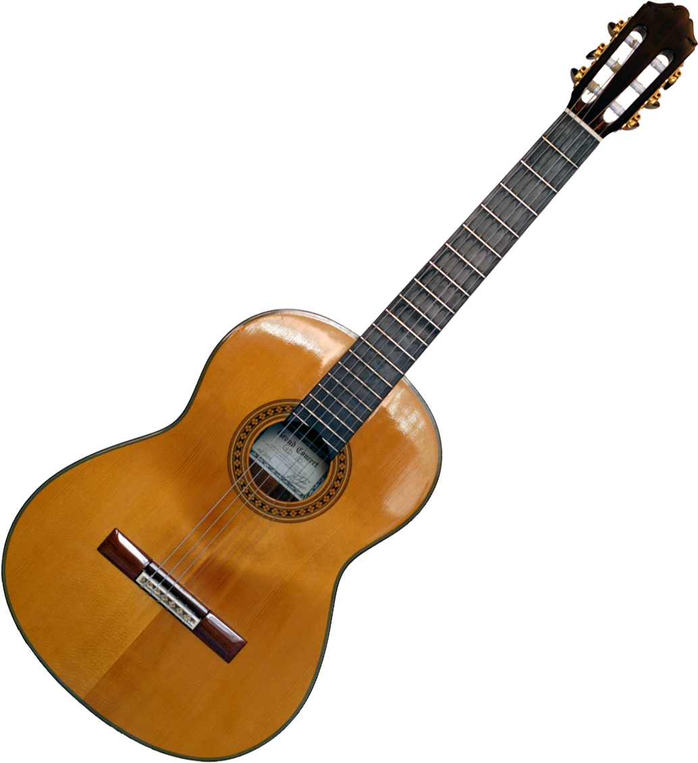
Crusader Music Club
Thursdays
Lunch time
B223A

Slide 11
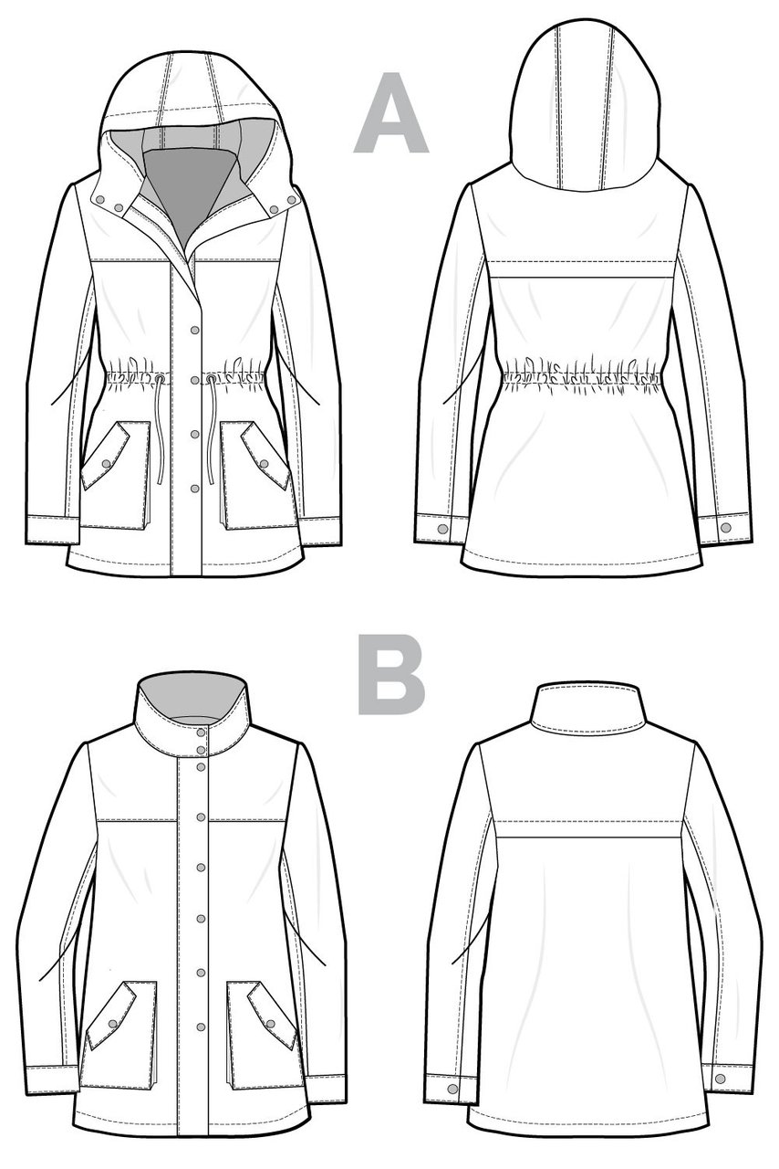
‘SEW’CIAL CLUB
MONDAYS
LUNCH
B230
MX. LAEWETZ
no experience required
*Sew-bead-knit-crochet-cross stitch and more

Slide 12
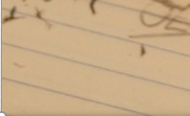
Fridays
Lunch
B101
Check the door of B101 for a full schedule.
Everyone welcome.
Bring your lunch.

Slide 13
Voting for ALL GRADS will take place on March 27 in the library at NOON. Mr. Court will be there to answer any questions students may have regarding Grad day. If you can not attend, you can still cast your ballot in the main office on Thursday or Friday.

Slide 14
Drivers Education Sign Up
Next after school
class starts
April 1, 2019 (no joke).
Please text
306-961-3447
To Register.
Feb. 15

Slide 15
Attention Grad!!
Get your grad application in
as soon as possible.
Grad Pictures are April 15 – 18, 2019.

Slide 16
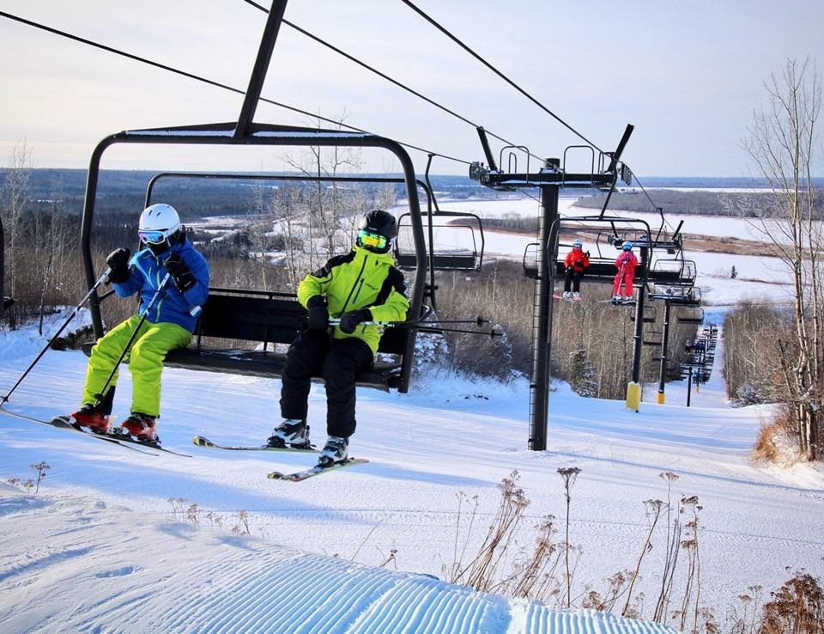
Outdoor Ed Downhill Skiing Meeting March 27 @ Noon Construction Shop

Slide 17
Congratulations to all delegates in this years Model UN hosted by Carlton on March 21. Special congratulations to Jarica Gooding and Sanjana Brijlall who were voted top delegates this year. They will represent Prince Albert at Model United Nations Assembly in Winnipeg on May 9-11 as the Chinese delegation. Good luck ladies.

