Slide 1
Carlton Comprehensive Public High School
Today’s Class Times
Period 1 | 8:55 – 9:58
Period 2 | 10:03 – 11:08
Period 3 | 11:13- 12:16
Period 4 | 1:05 -2:08
Period 5 | 2:13 – 3:16

Slide 2
Wednesday, March 20, 2019
Breakfast | South-west Egg Benny with Hash Browns | $4.50
Lunch | Chicken Tetrazzini with Salad | $6.50
Soup & Salad | Beef Barley Strawberry Romaine with Chicken | $5.75
Dessert | Death By Chocolate | $2.00

Slide 3
Dec. 1

Slide 4
GRADE 12 STUDENTS WITH 19 CREDITS OR MORE
YOU MUST APPLY FOR GRAD ASAP!!!
Go to Carlton Homepage
Print application off the website
Complete it
Meet with a school counsellor
Mar. 8

Slide 5
Learn how to communicate in French!
Next year, Carlton with be offering
Core French 10/20/30.
Core French will teach you to communicate with basic skills in French.
See Mme Morton in R211 or Mme Minielly in SS
for more information.

Slide 6
Girls of Greatness
Next meeting:
April 9, 2019
Period 4
Student Lounge
Open to Grades 9-12

Slide 7
The Heart of the Youth Community Pow Wow Committee is looking for dancers to volunteer some of their time by joining alongside the Wonska drum group to do presentations at various schools throughout Prince Albert during the months of March and April.
If you are a dancer in Pow Wow and are interested in helping out, please go see Ms. Tibbs in Room 108 (morning time only) for more information on dates/times/details.
We really would love to see students from Carlton get involved!

Slide 8
Carlton Pantry Do you have the luck of a leprechaun? Anyone who donates to our Pantry will receive a ticket for a chance to win a Pot of Gold! Please bring donations to B223A and enter the draw!

Slide 9
Grad Plan
Grade 9, 10, and 11 students need to meet with a counselor in Student Services to go over their 3-year grad plan and to choose classes for next year.
Stop by any time that works for you - we are open from 8:15 am - 3:15 pm.
After school appointments are available with Mrs. Minielly by request.

Slide 11
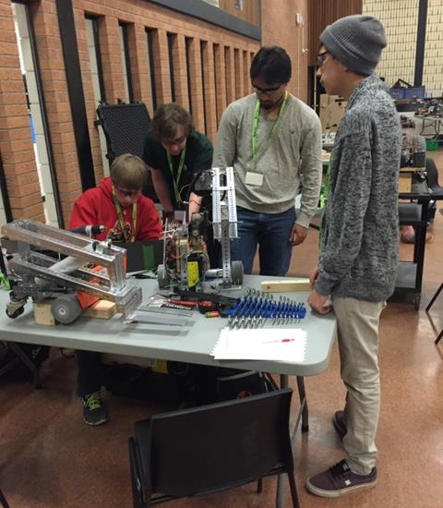
Love Building Robots? Trying new things? Carlton is now offering ROBOTICS 10, 20, 30 as a Credit Class in the Fall.
See Mr. Amy for More Details!!
Feb. 27

Slide 12
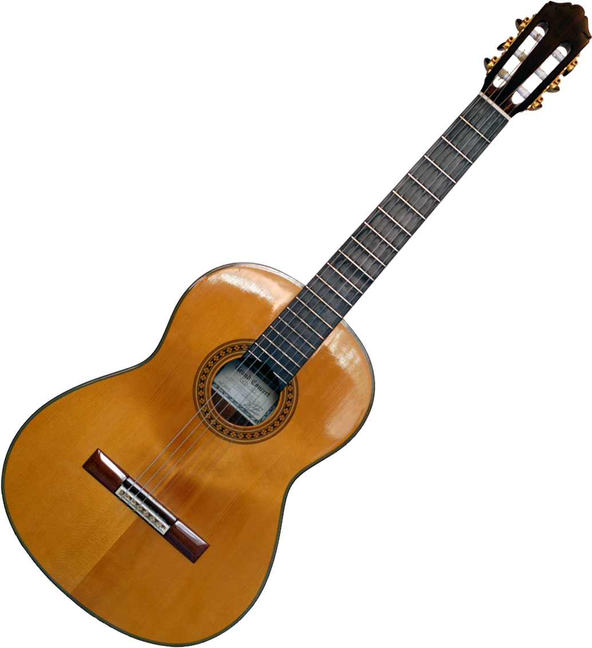
Crusader Music Club
Thursdays
Lunch time
B223A

Slide 13
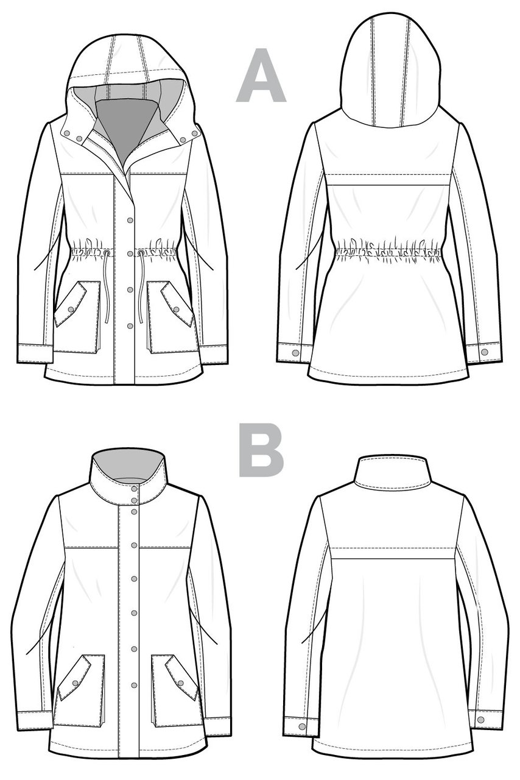
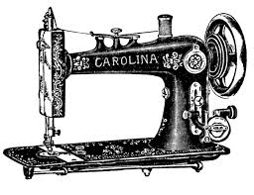
‘SEW’CIAL CLUB
MONDAYS
LUNCH
B230
MX. LAEWETZ
no experience required
*Sew-bead-knit-crochet-cross stitch and more

Slide 14
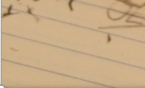
Fridays
Lunch
B101
Check the door of B101 for a full schedule.
Everyone welcome.
Bring your lunch.

Slide 15
Voting for ALL GRADS will take place on March 27th in the library at NOON. Mr. Court will be there to answer any questions students may have regarding Grad day. If you can not attend, you can still cast your ballot in the main office on Thursday or Friday.

Slide 16
Drivers Education Sign Up
Next after school
class starts
April 1, 2019 (no joke).
Please text
306-961-3447
To Register.
Feb. 15

