Slide 1
Carlton Comprehensive Public High School
Today’s Class Times
Period 1 | 8:55 – 9:58
Period 2 | 10:03 – 11:08
Period 3 | 11:13- 12:16
Period 4 | 1:05 -2:08
Period 5 | 2:13 – 3:16

Slide 2
Thursday, March 14, 2019
Breakfast | Denver Sandwich With Hash Browns | $4.50
Lunch | Grilled Cheese Sandwich with Wedges or Soup or Salad | $6.50
Soup & Salad | Cream of Tomato and Dill Spinach and Blackberry | $5.75
Dessert | Baklava Slice | $2.00

Slide 3
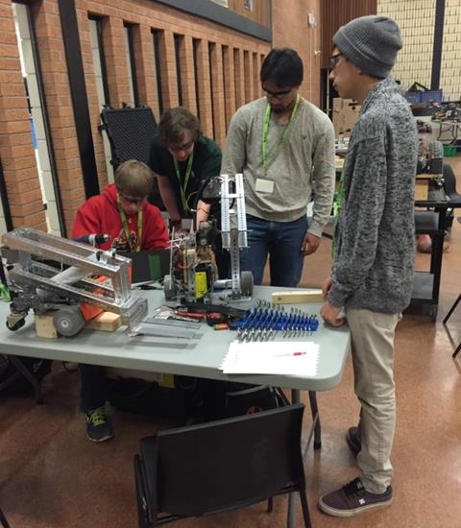
Love Building Robots? Trying new things? Carlton is now offering ROBOTICS 10, 20, 30 as a Credit Class in the Fall.
See Mr. Amy for More Details!!
Feb. 27

Slide 4
GRADE 12 STUDENTS WITH 19 CREDITS OR MORE
YOU MUST APPLY FOR GRAD ASAP!!!
Go to Carlton Homepage
Print application off the website
Complete it
Meet with a school counsellor
Mar. 8

Slide 5
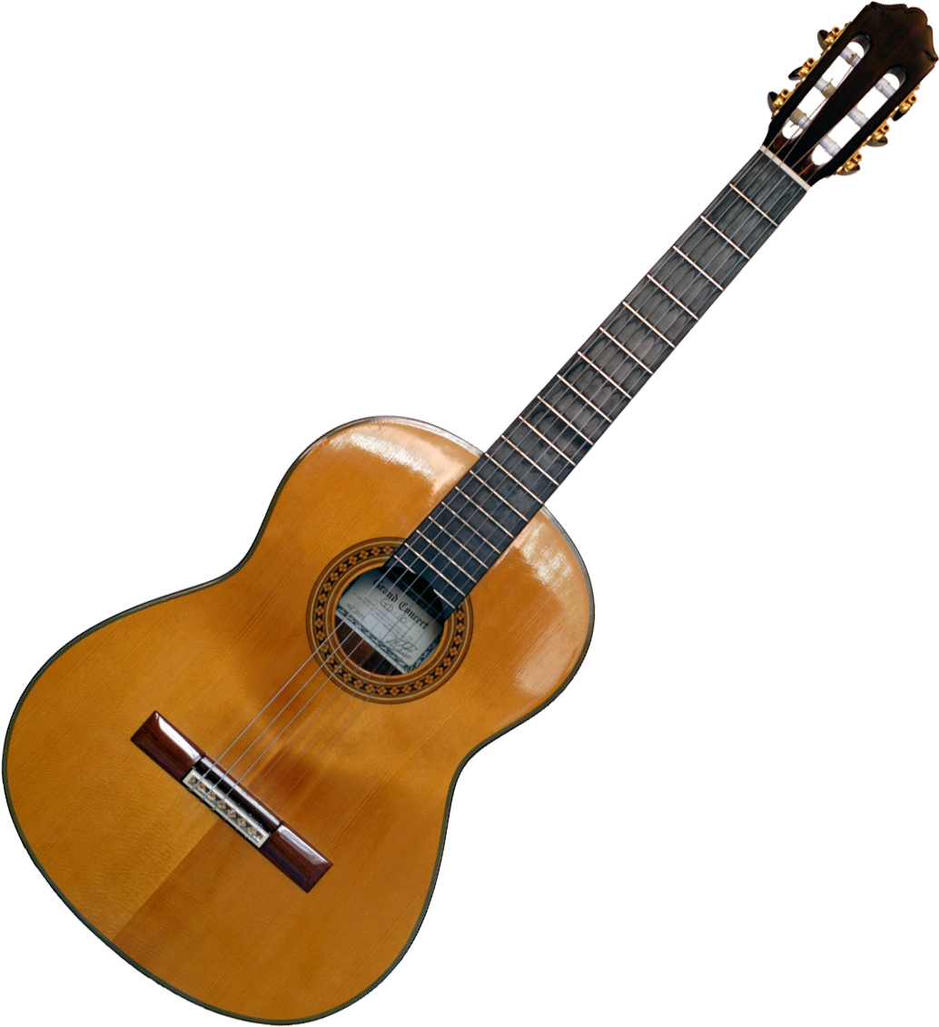
Crusader Music Club
Everyone welcome!
Thursdays
3:20-4:30 p.m.
B223A
Come check out our new guitars and amps!

Slide 6
Learn how to communicate in French!
Next year, Carlton with be offering
Core French 10/20/30.
Core French will teach you to communicate with basic skills in French.
See Mme Morton in R211 or Mme Minielly in SS
for more information.

Slide 7
The Heart of the Youth Community Pow Wow Committee is looking for dancers to volunteer some of their time by joining alongside the Wonska drum group to do presentations at various schools throughout Prince Albert during the months of March and April.
If you are a dancer in Pow Wow and are interested in helping out, please go see Ms. Tibbs in Room 108 (morning time only) for more information on dates/times/details.
We really would love to see students from Carlton get involved!

Slide 8
Carlton Pantry Do you have the luck of a leprechaun? Anyone who donates to our Pantry will receive a ticket for a chance to win a Pot of Gold! Please bring donations to B223A and enter the draw!

Slide 9
Grad Plan
Grade 9, 10, and 11 students need to meet with a counselor in Student Services to go over their 3-year grad plan and to choose classes for next year.
Stop by any time that works for you - we are open from 8:15 am - 3:15 pm.
After school appointments are available with Mrs. Minielly by request.

Slide 10
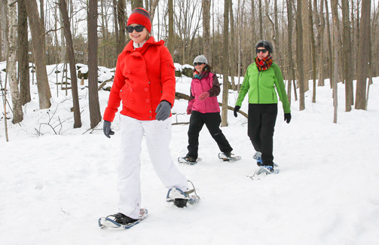
FREE Outdoor Ed Activities!!
For permission forms OR more info see Mrs Ackerman B102
March 14 – Snowshoeing
March 12 – X Country Skiing

Slide 11
Wrestlers, we want to have our year end wind-up, so get your clean singlets and $10.00 in to Mr. LaVallee ASAP.

Slide 13
Attention Class of 2019:
Grad Hoodies are in. If you ordered a hoodie you can pick it up at lunch time in the rotunda March 12, March 14, and March 15. If you missed ordering, you can go to the General Office.

Slide 14
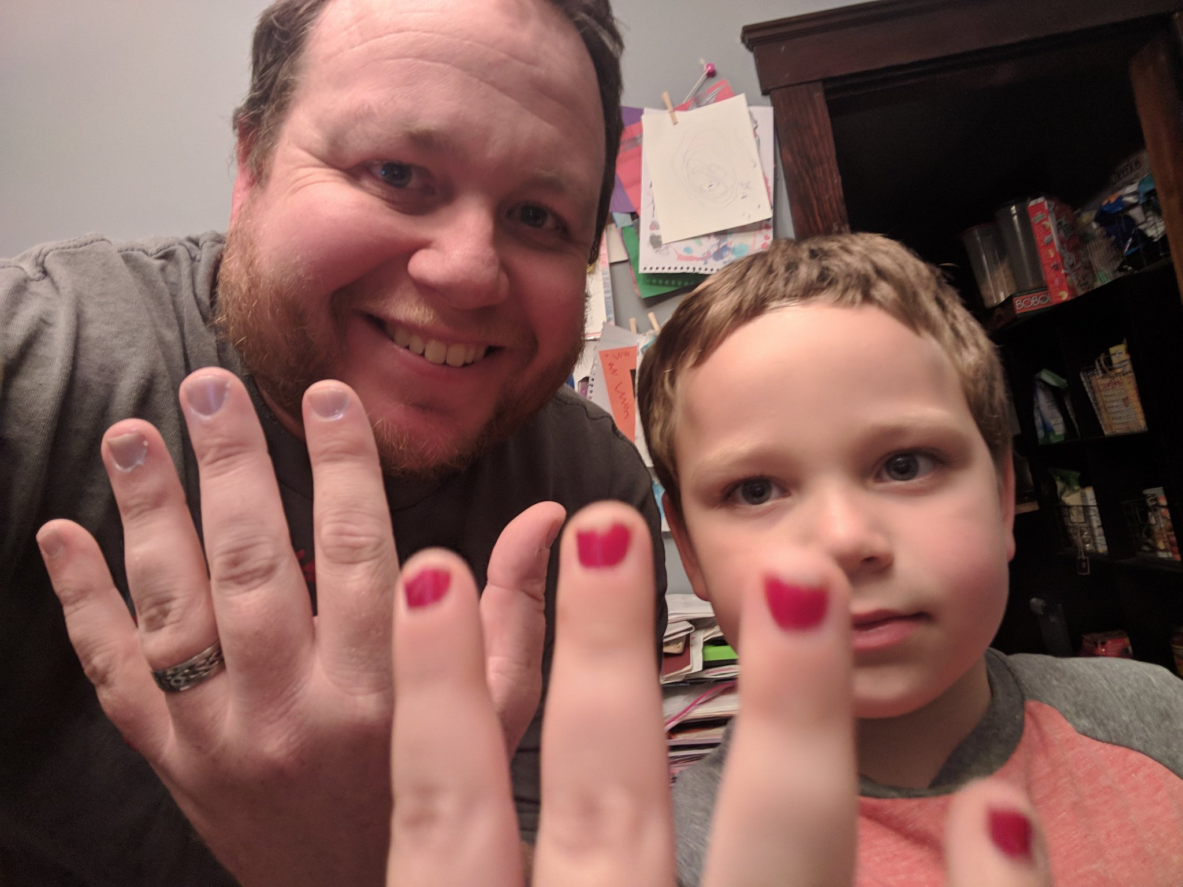
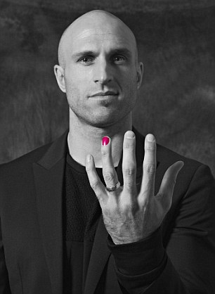
Sader Spirit Club
wants to
#polishoffbullying
Meeting in B108 on Thursday THIS WEEK! Please join us!

