Slide 1

Carlton Comprehensive Public High School
Today’s Class Times
Tuesday, Feb. 5, 2019
Period 1 | 8:55 – 9:58
Period 2 | 10:03 – 11:08
Period 3 | 11:13- 12:16
Period 4 | 1:05 -2:08
Period 5 | 2:13 – 3:16

Slide 2


Tuesday, Feb. 5
Breakfast | Breakfast Skillet with Scrambled Egg | $4.50
Lunch | Citrus Ham with Mashed Potatoes and Vegetables | $6.50
Soup & Salad | Weekday Hamburger Southwest Chicken Pasta Salad | $5.75
Dessert | Chocolate Layer Cake | $2.00

Slide 3
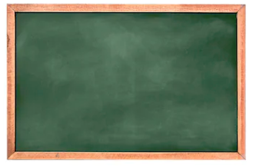
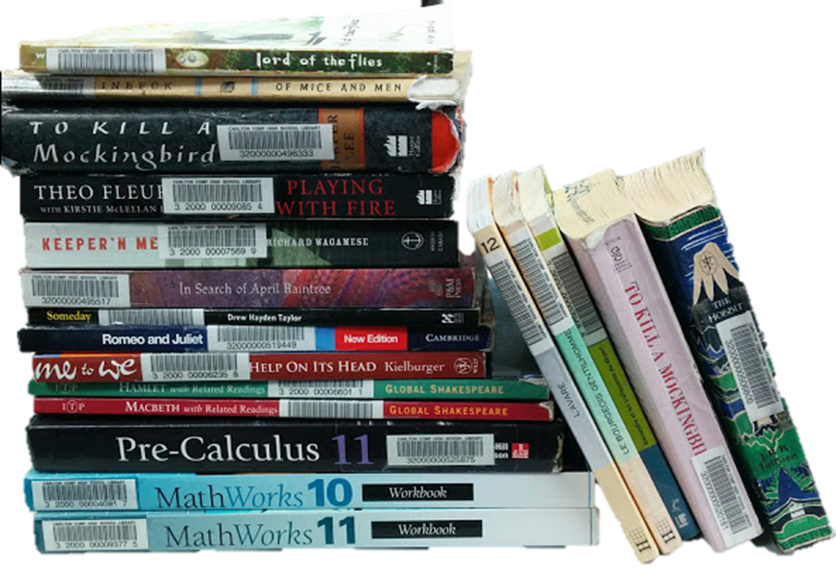

Please Return ALL Textbooks
Semester ll students need them.

Slide 4

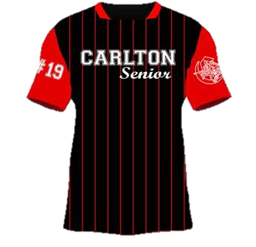
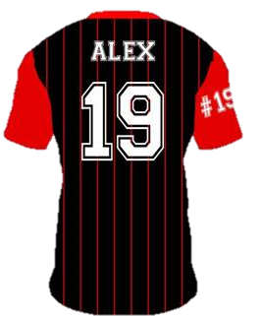


**Attention Class of 2019**
Ball Shirts -$66.00 (tax inc.)
Grad Hoodies -$50.00 (tax inc.)
Order yours:
Mon. Feb. 4 – Fri. Feb. 15
Noon @ the Rotunda

Slide 5

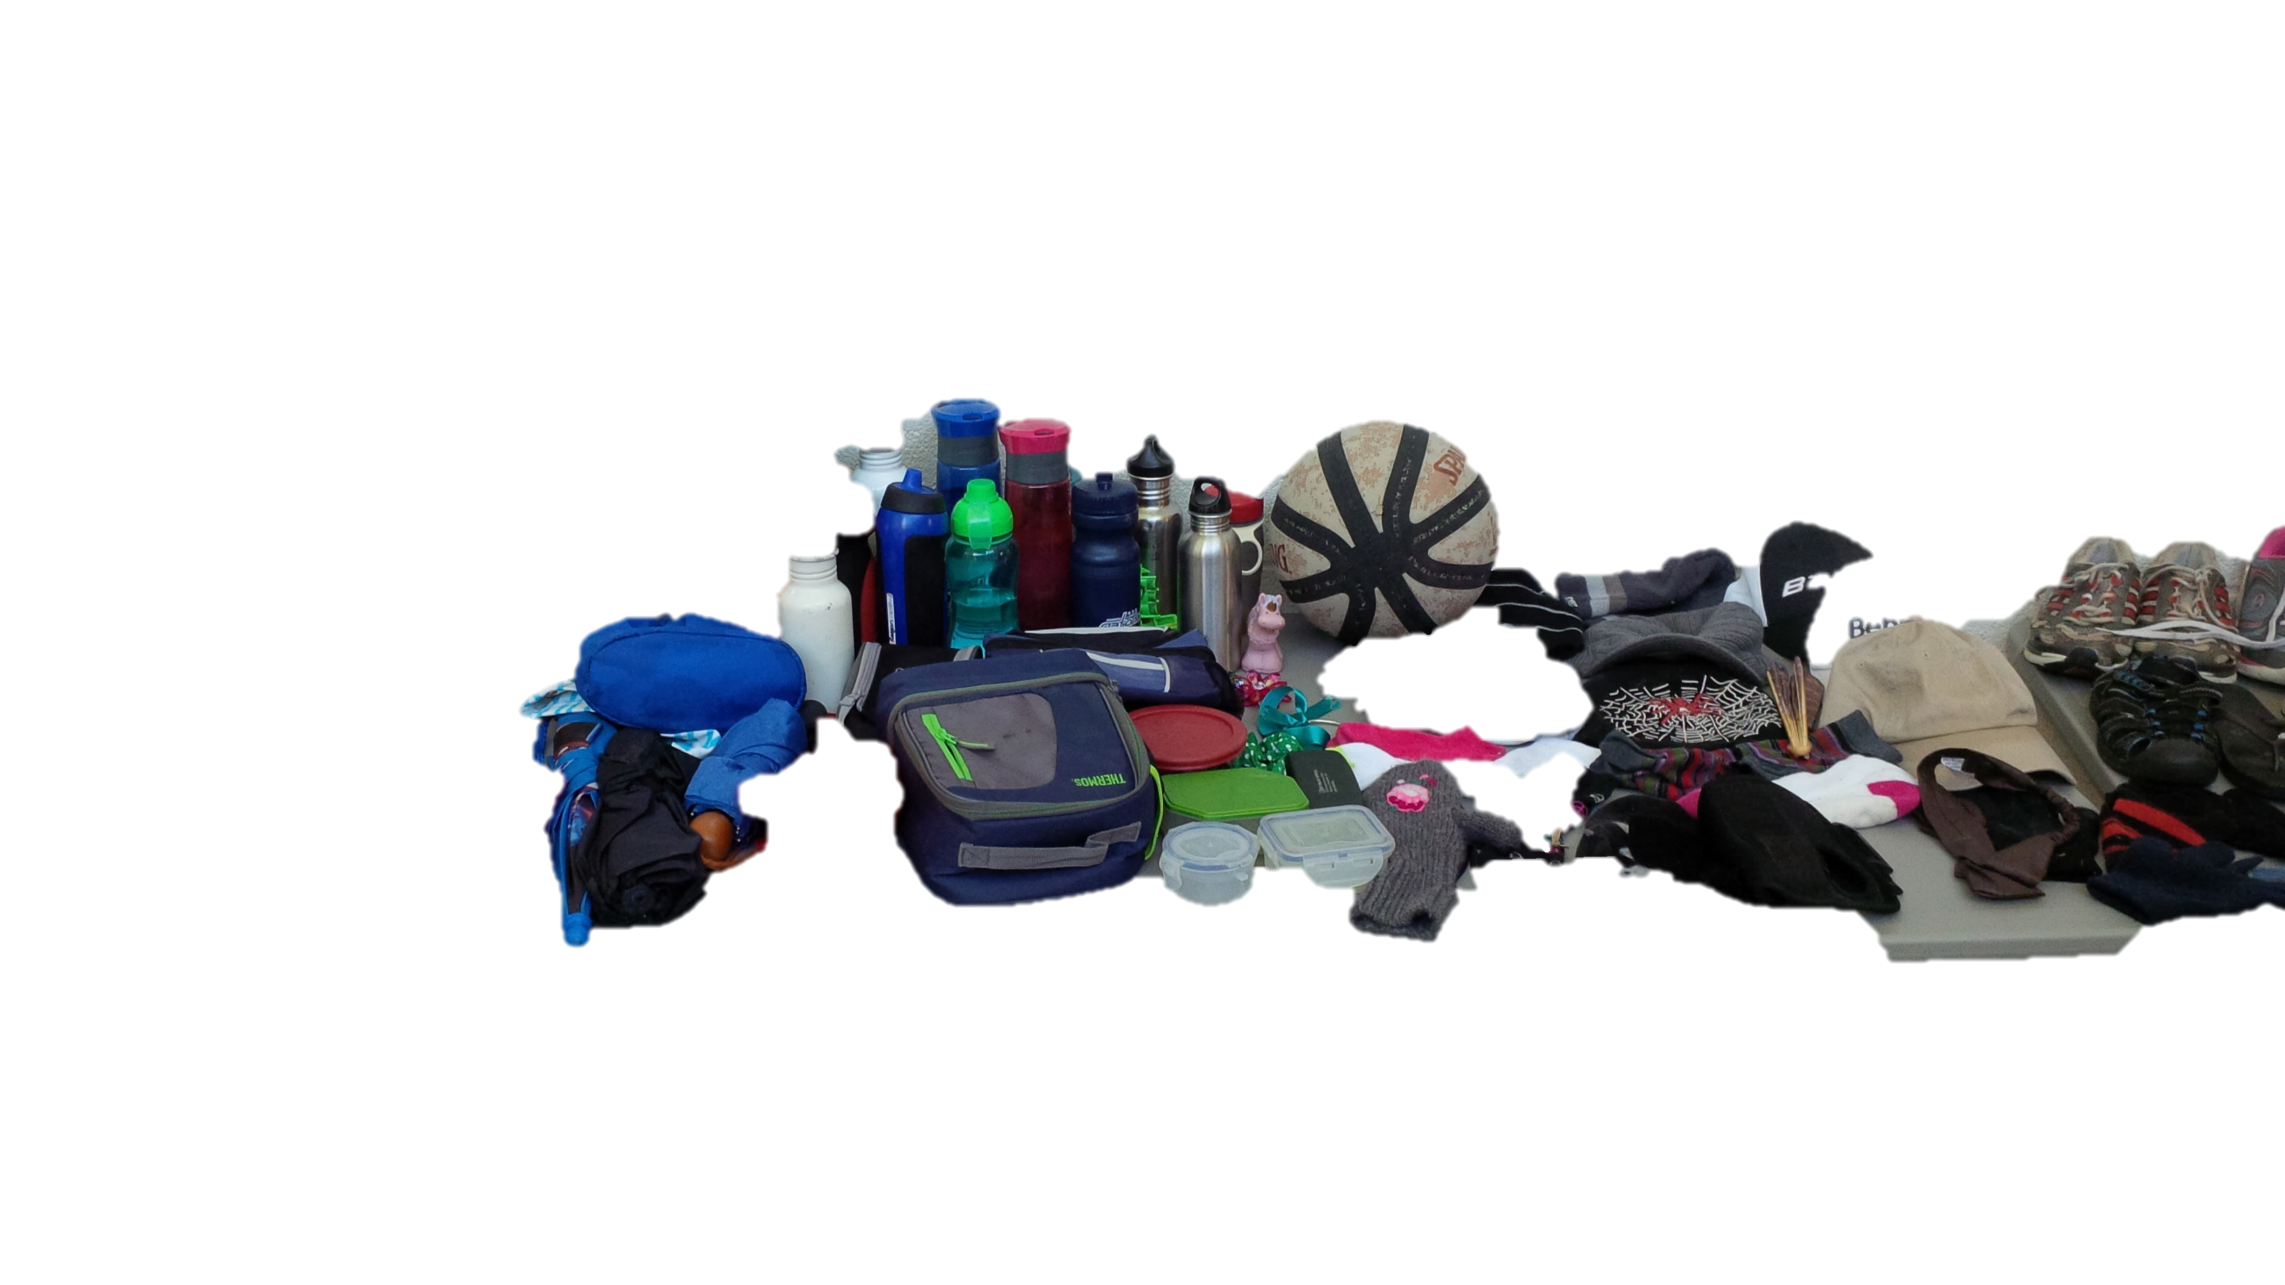
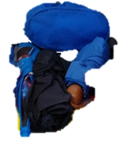
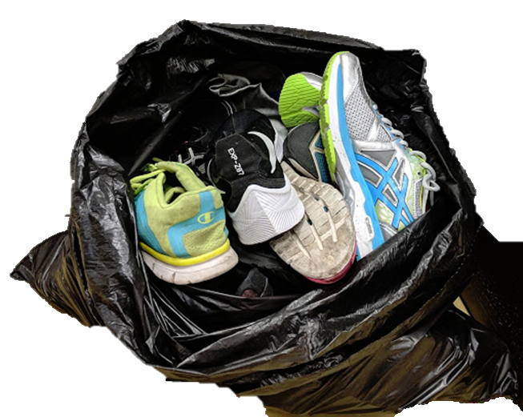

Check the General Office
Unclaimed items will be donated
to
CARLTON PANTRY
Friday Feb. 15th

Slide 6


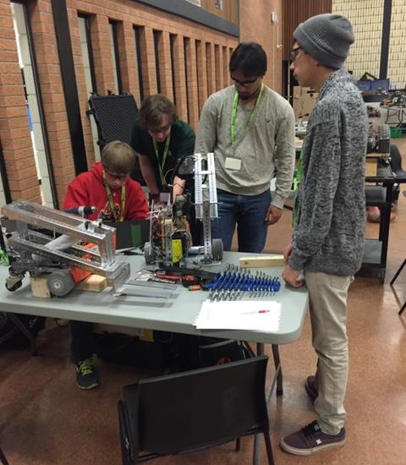
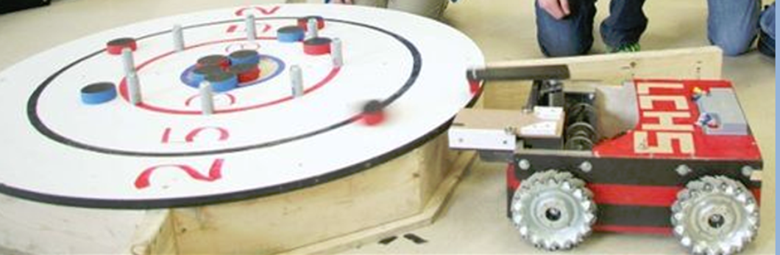
Anyone wanting to be part of the team this year please contact Mr. Amy in the Electrical Shop!

Slide 7


Donate FOOD items to Carlton Pantry B223A and receive a ticket for a chance to win a fabulous prize! granola bars cup of soup canned goods fruit cups pudding snack foods
It’s KINDNESS month at Carlton

Slide 8
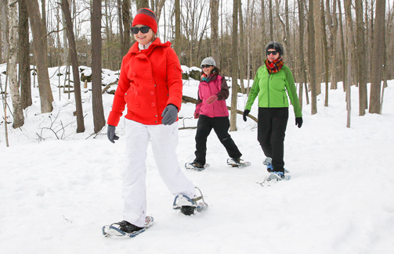
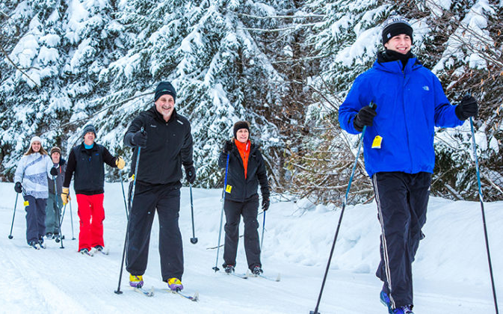
Outdoor Ed Activities!!
For permission forms OR more info see:
Mr. Huddlestone or Mrs. Ackerman
SNOWSHOEING- TBA
FEB 11 – X COUNTRY SKIING

Slide 9
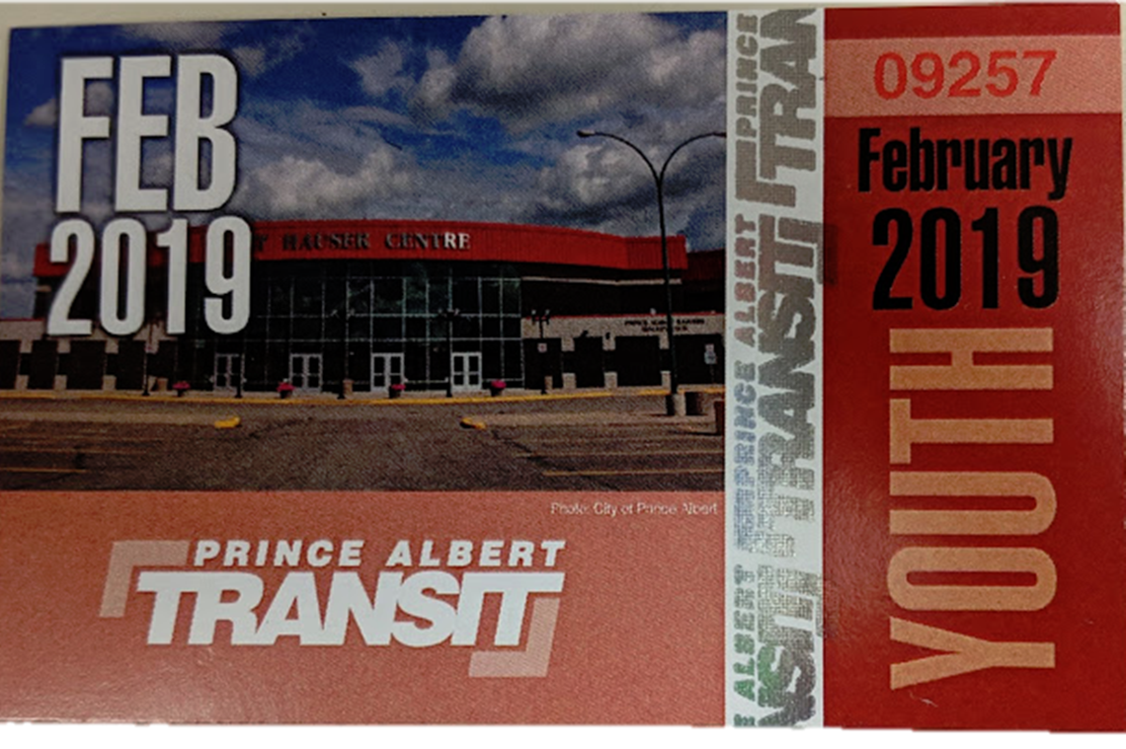
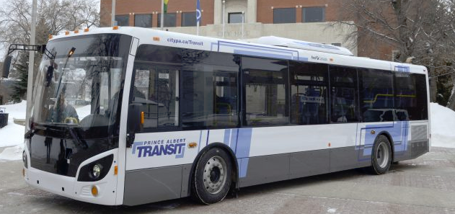
February Student Bus Passes are available at the General Office for $20
Feb. passes available until
Feb. 15th

Slide 10


in
ADVENTURES 1
TECHNOLOGY
4 1/2 days in Saskatoon
Open to Grade 11 & 12 Students
Applications Due Feb. 21
See Student Services

Slide 11



Drivers Education Sign Up
Next after school
class starts
Monday, Feb. 25.
Please text
306-961-3447
To Register.
Feb. 21

Slide 12

Carlton offers a YOGA 10 class!
No experience required
Great for:
- athletes who want to improve their flexibility,
those looking to reduce stress,
those who already love yoga and want more of it.
Find this elective class on myBlueprint under Phys Ed.
Feb. 23/19

Slide 13



Model UN
Looking for new members
for the March event!
No experience necessary!
Thursdays
B 117 – lunch
For more info see Mr. Klassen
Current events
World diplomacy
International affairs
Negotiation / debate

