Slide 1

Carlton Comprehensive Public High School
Today’s Class Times
Monday, Feb. 4, 2019
Period 1 | 8:55 – 9:58
Period 2 | 10:03 – 11:08
Period 3 | 11:13- 12:16
Period 4 | 1:05 -2:08
Period 5 | 2:13 – 3:16

Slide 2



Monday, Feb. 4, 2019
Breakfast | Kaiser with Hash Browns | $4.50
Lunch | Baked Ham with Scalloped Potato and Steamed Broccoli | $5.50
Soup & Salad | Corn Chowder German Sausage w/ Barley BLT Pasta Salad | $5.25
Dessert | Raspberry Trifle | $2.00
See the Café for todays
menu selections.

Slide 3



Please Return ALL Textbooks
Semester ll students need them.

Slide 4

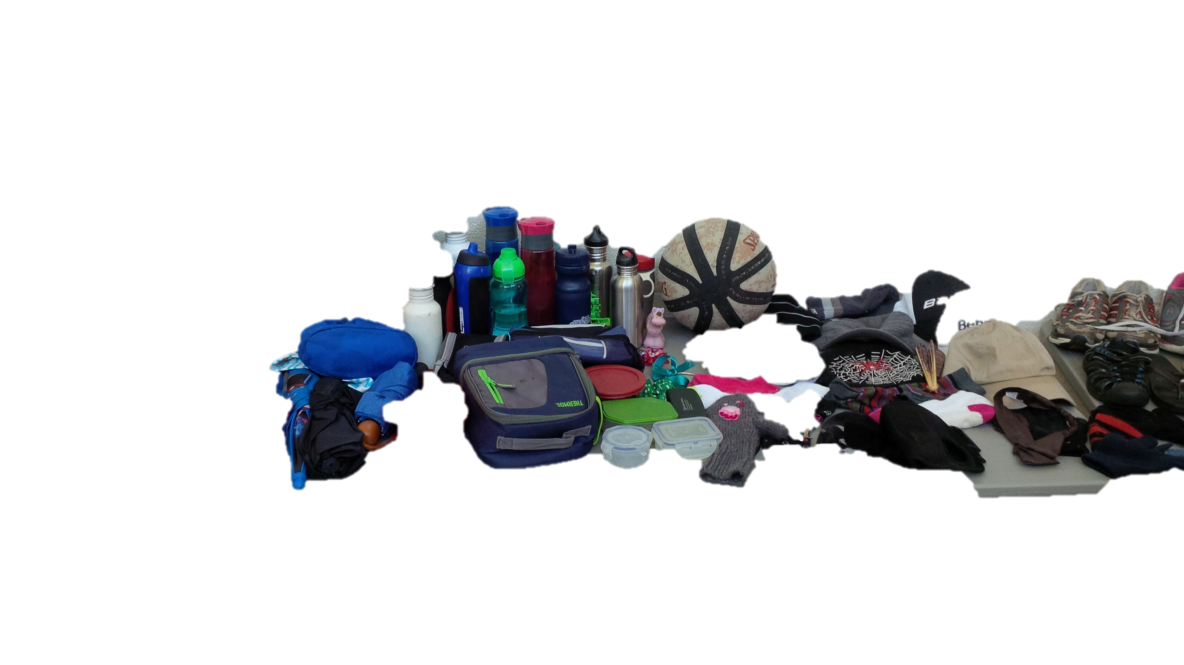

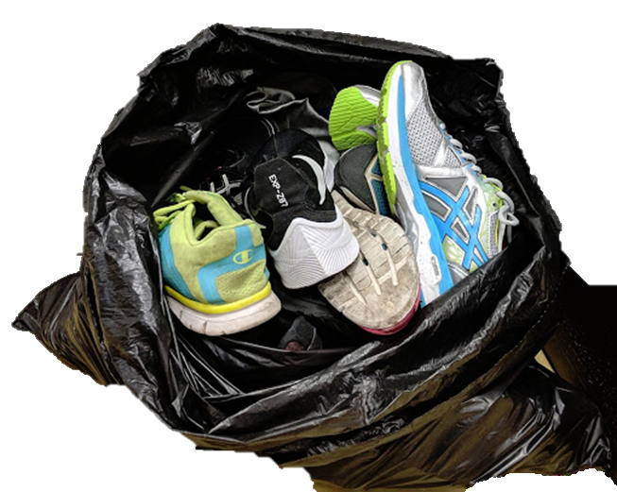

Check the General Office
Unclaimed items will be donated
to
CARLTON PANTRY
Friday Feb. 15th

Slide 5


**Attention Class of 2019**
Order your:
Ball Shirts -$66.00 (tax inc.)
Grad Hoodies -$50.00 (tax inc.)
Mon. Feb. 4 – Fri. Feb. 15
Noon @ the Rotunda

Slide 6
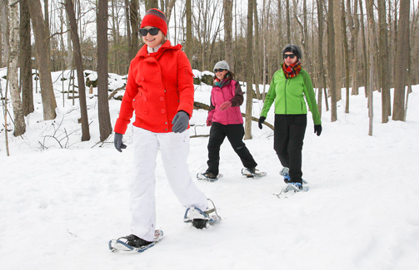
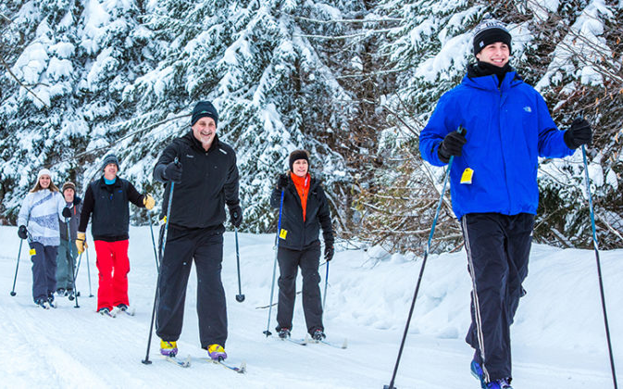
Outdoor Ed Activities!!
For permission forms OR more info see:
Mr. Huddlestone or Mrs. Ackerman
FEB. 4 SNOWSHOEING
FEB 11 – X COUNTRY SKIING

Slide 7
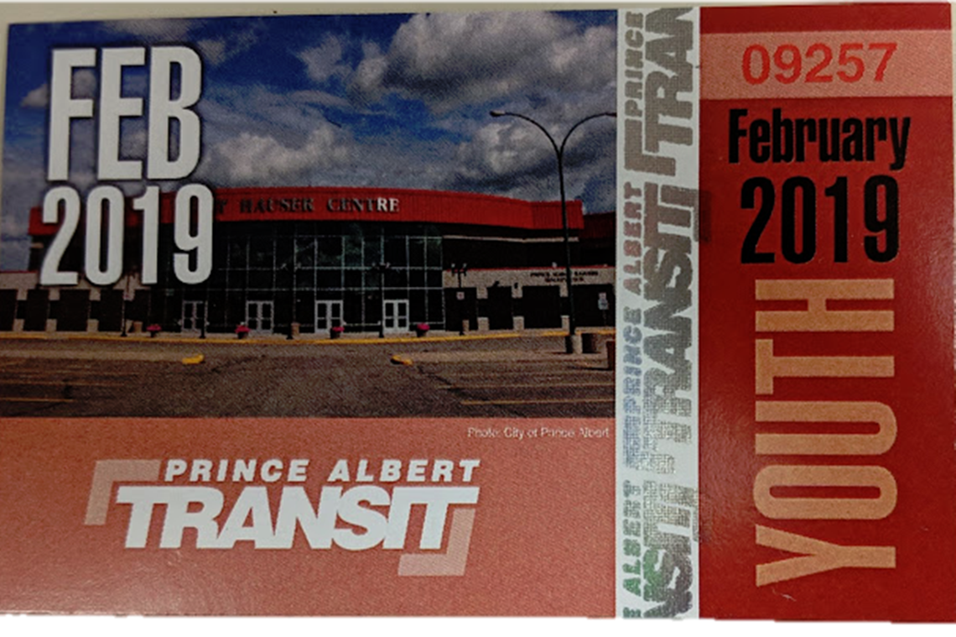
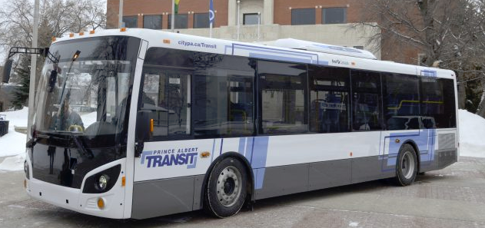
February Student Bus Passes are available at the General Office for $20
Feb. passes available until
Feb. 15th

Slide 8


in
ADVENTURES 1
TECHNOLOGY
4 1/2 days in Saskatoon
Open to Grade 11 & 12 Students
Applications Due Feb. 21
See Student Services

Slide 9

Carlton offers a YOGA 10 class!
No experience required
Great for:
- athletes who want to improve their flexibility,
those looking to reduce stress,
those who already love yoga and want more of it.
Find this elective class on myBlueprint under Phys Ed.
Feb. 23/19

Slide 10



Model UN
Looking for new members
for the March event!
No experience necessary!
Thursdays
B 117 – lunch
For more info see Mr. Klassen
Current events
World diplomacy
International affairs
Negotiation / debate

Slide 11



Drivers Education Sign Up
Next after school
class starts
Monday, Feb. 25.
Please text
306-961-3447
To Register.
Feb. 21

