Slide 1
Carlton Comprehensive Public High School
Today’s Class Times
Period 1 | 8:55 – 9:58
Period 2 | 10:03 – 11:08
Period 3 | 11:13- 12:16
Period 4 | 1:05 -2:08
Period 5 | 2:13 – 3:16

Slide 2
Thursday, February 28
Breakfast | Denver Sandwich with Hash Browns | $4.50
Lunch | Grilled Cheese Sandwich with Wedges or Soup or Salad | $6.50
Soup & Salad | Cream of Tomato Buffalo Chicken Caesar | $5.75
Dessert | Death By Chocolate | $2.00

Slide 3
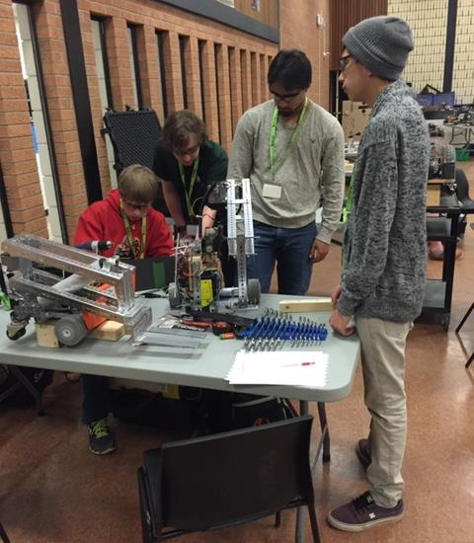
Anyone wanting to be part of the team this year please contact Mr. Amy in the Electrical Shop!
Feb. 27

Slide 4
ATTENTION GRADS!!!
Are you interested in being part of the Student Grad Committee?
There will be a meeting to discuss:
Grand March, Theme & Decorations
Feb. 28 at noon
Learning Commons

Slide 5
Donate FOOD items to Carlton Pantry B223A and receive a ticket for a chance to win a fabulous prize! granola bars cup of soup canned goods fruit cups pudding snack foods
It’s KINDNESS month at Carlton
Feb. 28

Slide 6
GRADE 12 STUDENTS WITH 19 CREDITS OR MORE
YOU MUST APPLY FOR GRAD ASAP!!!
Go to Carlton Homepage
Print application off the website
Complete it
Meet with a school counsellor
Mar. 8

Slide 7
Please see Student Services
Crusaders!!!
Do you have a locker
you are NOT using???
Mar. 8

Slide 8
Model UN
Looking for new members
for the March event!
No experience necessary!
Thursdays
B 117 – lunch
For more info see Mr. Klassen
Current events
World diplomacy
International affairs
Negotiation / debate
Mar. 14

Slide 9
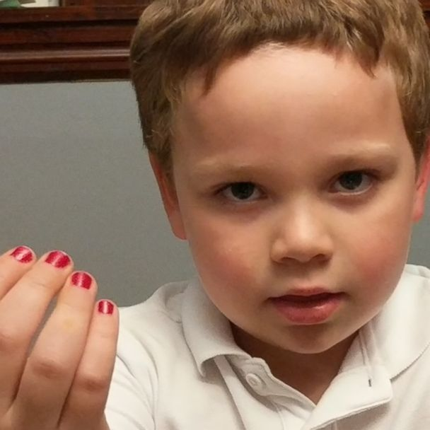
Sader Spirit Club
wants to
#polishoffbullying
Meeting in B108, Tues, Wed, Thurs - THIS WEEK! Please join us!

Slide 10
Crusader Music Club
Everyone welcome!
Mondays
3:20-4:30 p.m.
B223A
Come check out our new guitars and amps!

Slide 11
Learn how to communicate in French!
Next year, Carlton with be offering
Core French 10/20/30.
Core French will teach you to communicate with basic skills in French.
See Mme Morton in R211 or Mme Minielly in SS
for more information.

