Slide 1


Carlton Comprehensive Public High School
Wednesday Jan. 9, 2019
Period 1 | 8:55 – 9:55
Period 2 | 10:00 – 11:00
 | Homeroom 11:05 – 11:20
Period 3 | 11:25 – 12:25
Period 4 | 1:15 – 2:15
Period 5 | 2:20 – 3:
Today’s
Class Times
Schedule

Slide 2


Wednesday, Jan. 9
Breakfast | South-west Egg Benny with Hash browns | $4.50
Lunch | Hot Beef Sandwich with Wedges or Soup or Salad | $6.50
Soup & Salad | Jalapeno Popper Crunchy Detox Salad on Greens | $5.75
Dessert | Cherry Cracker Jack Cake | $2.00

Slide 3





HOMEROOM TODAY!
11:05-11:20
LEARN VALUABLE LIFE SKILLS
EARN CREDITS IN
Life Transitions 20 & 30

Slide 4

Dec. 1

Slide 5
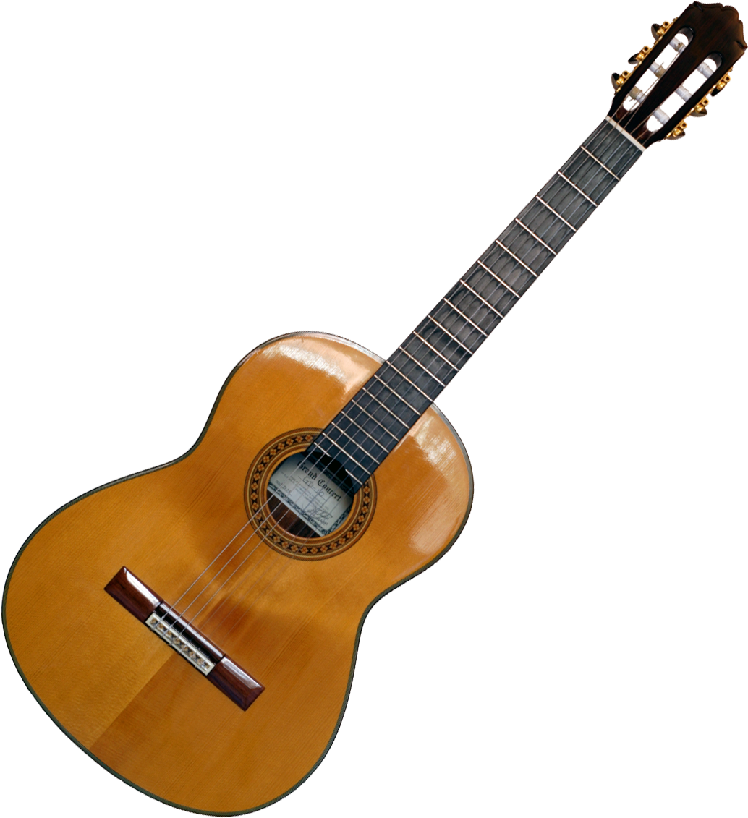


Crusader Music Club
Thursdays
Lunch time
B223A
New Location
Jan. 17/19

Slide 6




Game Night
Mintos vs Battlefords Stars
Thurs. Jan. 10
7:00 pm
Tickets $5 at the General Office

Slide 7

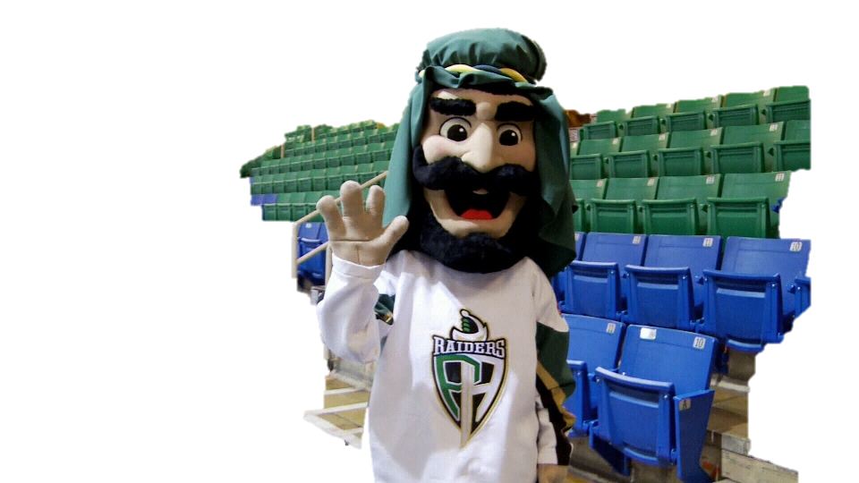
PA Raiders
Vs.
Seattle Thunderbirds
Wed. Jan. 9
Portland Winterhawks
Fri. Jan. 11
7pm

Slide 8


Girls of Greatness
Next meeting:
Jan. 16, 2019
Period 4
Student Lounge
Open to Grades 9-12

Slide 9
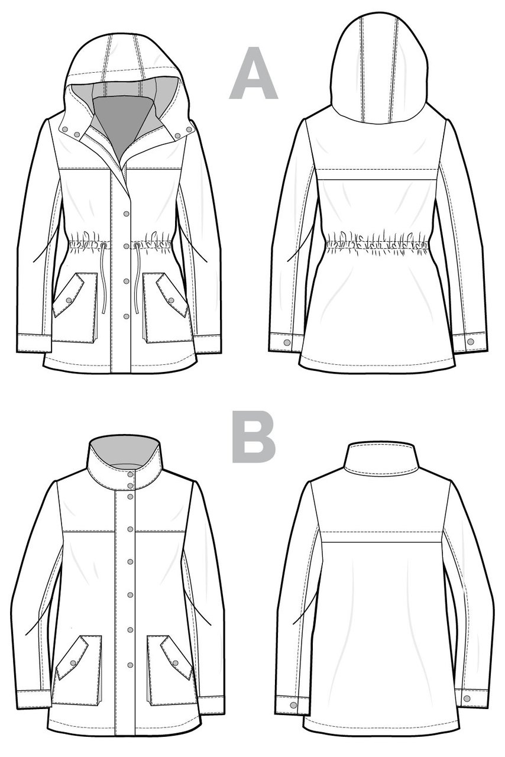


‘SEW’CIAL CLUB
MONDAYS
LUNCH
B230
MX. LAEWETZ
no experience required
*Sew-bead-knit-crochet-cross stitch and more

Slide 10




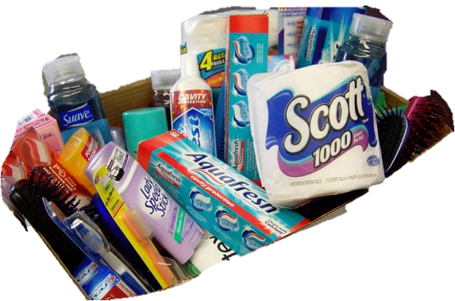
Carlton Pantry
Why a Pantry?
So all students can access food, clothing, hygiene items and school supplies.
Who Donates to the Pantry?
- students
- families
- staff members
- community members
How can I get something from the Pantry?
Please talk to Mrs. Amy (B223A) or any staff member.
.
Jan. 18/19

Slide 11

Carlton offers a YOGA 10 class!
No experience required
Great for:
- athletes who want to improve their flexibility,
those looking to reduce stress,
those who already love yoga and want more of it.
Find this elective class on myBlueprint under Phys Ed.
Feb. 23/19

Slide 12
Crusader Music Club
Thursdays
Lunch time
B223A
New Location
Jan. 17/19

Slide 13
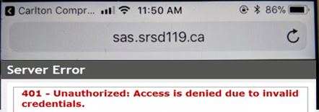


Problems signing into Students Achieve?
Check
address
Refresh and log in again.
**Forgot your password? See the Learning Commons Staff.

