Slide 1
Carlton Comprehensive Public High School
Todays Class Times
Friday, Dec. 7, 2018
Period 1 | 8:55 – 9:58
Period 2 | 10:03 – 11:08
Period 3 | 11:13- 12:16
Period 4 | 1:05 -2:08
Period 5 | 2:13 – 3:16

Slide 2
Friday, Dec. 7
Breakfast | Single Mini | $4.50
Lunch | Dry Ribs and Fries or Soup or Salad or Onion Rings | $6.50
Soup & Salad | Clam Chowder Southwestern Pasta Salad | $5.75
Dessert | Bannana Split Cheescake | $2.00

Slide 3
WHOS HUNGRY?
DON'T WORRY!!
THERE'S A BAKE SALE
IT'S CHRISTMAS!
GET READY FOR…...
Thurs. Dec. 6, Fri. Dec. 7
@LUNCH
IN ROTUNDA
ALL PROCEEDS GO TO CARLTON PANTRY
BAKE SALE
HAPPENING ON DEC 6-7
IN THE ROTUNDA
@LUNCH

Slide 4
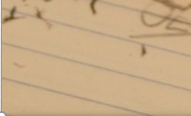
Fridays
Lunch
B101
Check the door of B101 for a full schedule.
Everyone welcome.
Bring your lunch.

Slide 5
Carlton Band and Choir Christmas Concert
Tues December 11
Carlton Cafetorium
7:00 pm

Slide 6
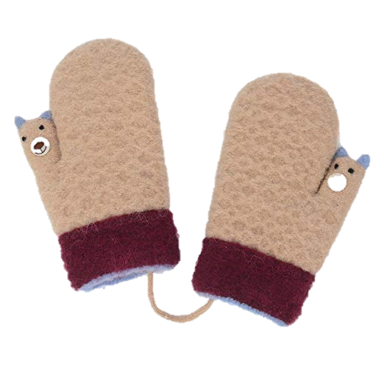
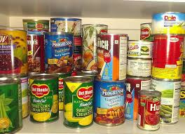
Carlton Pantry
Thank you to all the Crusaders who have donated to Carlton Pantry!
If you or a friend need food, clothing, books, or personal items, like shampoo or a tooth brush, please talk to Mrs. Amy in B223A or any staff member.

Slide 7
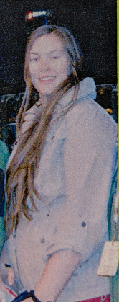
Win a chance to cut
Ms. Peet’s Hair!!!!
Bring a donation for the Carlton Pantry
to your Homeroom teacher.
-Get a ticket.
-Bring the filled out ticket to R207.
Hair cut to will take place Dec. 19th.
The hair will be donated to make a wig for someone in need.

Slide 8
Girls of Greatness
Next meeting:
Dec. 11, 2018
Period 4
Student Lounge
Open to Grades 9-12

Slide 9
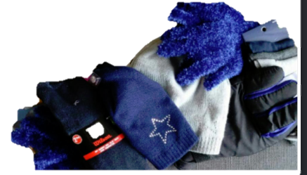
Donations to: Our House, The Gate & Gifts for Guys

Slide 10
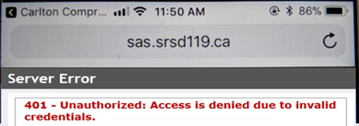
Problems signing into Students Achieve?
Check
address
Refresh and log in again.
**Forgot your password? See the Learning Commons Staff.

Slide 11
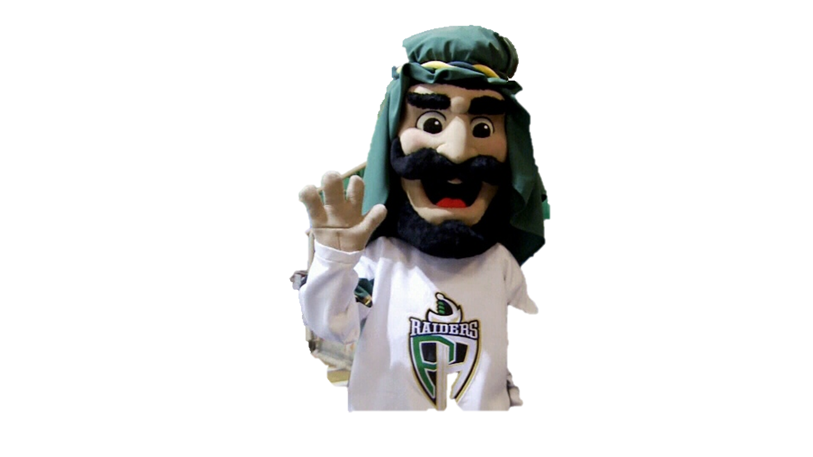
Next Game
Sat. Dec. 8th
VS.
Brandon
Wheat Kings

Slide 12
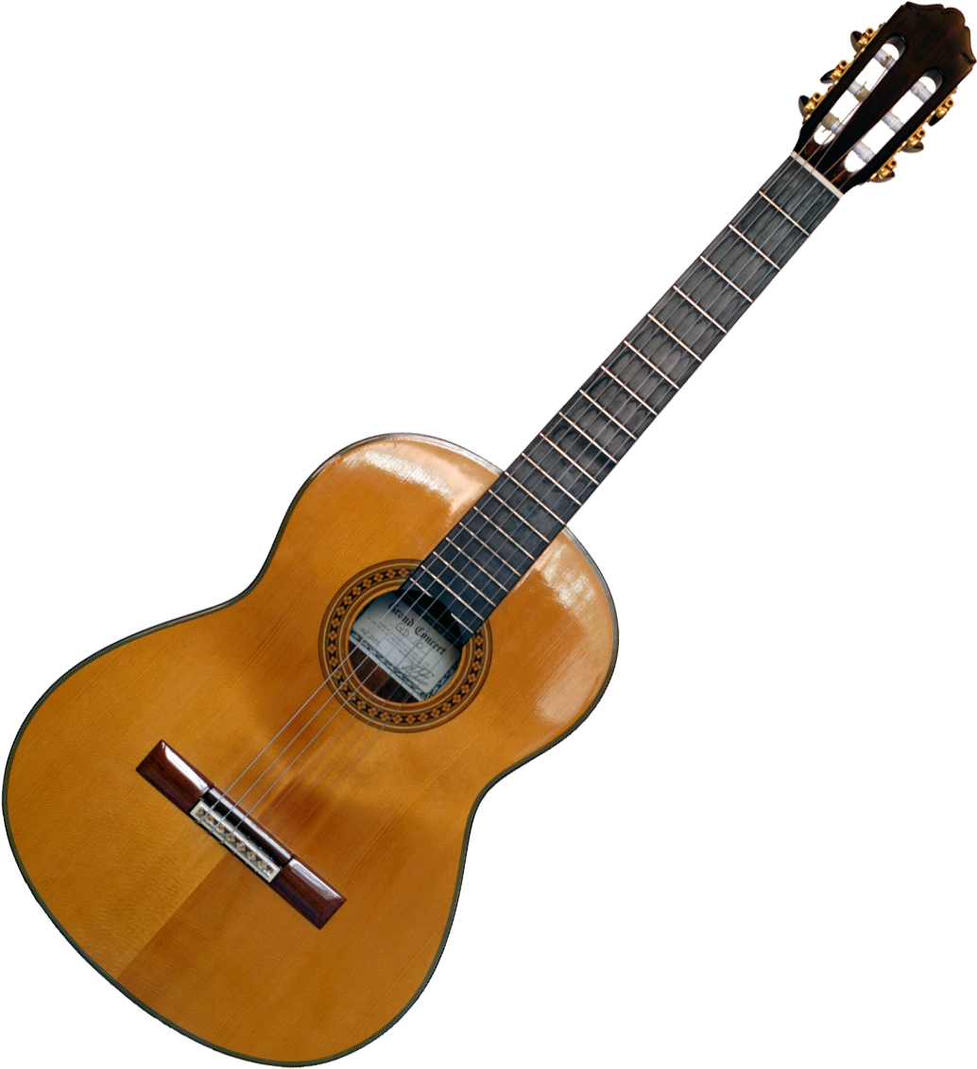
Crusader Music Club
Thursdays
Lunch time
B223A
New Location
Dec. 6

Slide 13
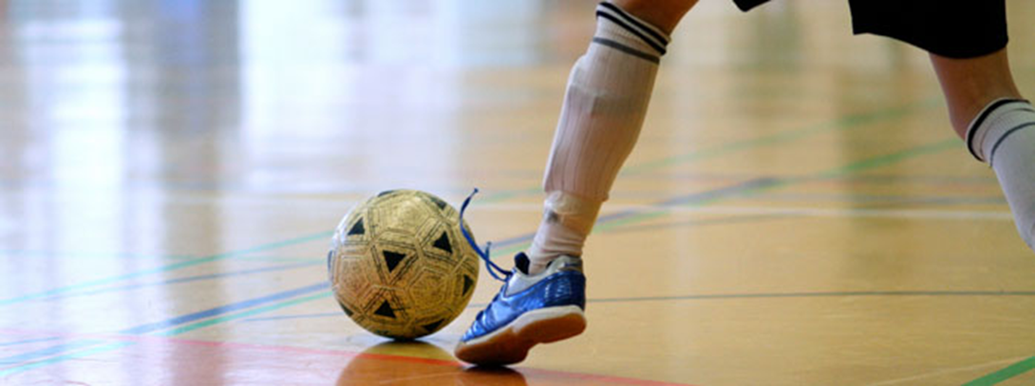
FUTSAL!!!
Gold Gym
Thursdays
3:30- 4:45
*For more info see: Mr. Correa in the SWIS Office Mr. Odnokon in CPAC
Dec. 21

Slide 14
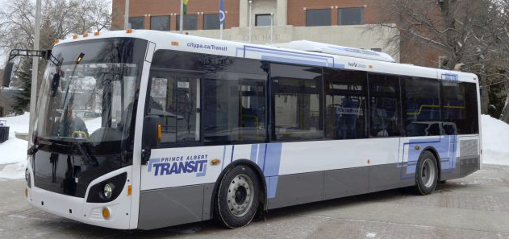
December Student Bus Passes are available at the General Office for $20
Dec. passes available until
Dec. 20th

Slide 15
Monday to Friday
Lunch time
B214
16 player spots
Everyone welcome
*Bring your lunch and your game face!
Dec. 21

