Slide 1

Carlton Comprehensive Public High School
Todays Class Times
Friday Dec. 21, 2018
Period 1 | 8:55 – 9:58
Period 2 | 10:03 – 11:08
Period 3 | 11:13- 12:16
Period 4 | 1:05 -2:08
Period 5 | 2:13 – 3:16

Slide 2


Friday, Dec. 21
Breakfast | Single Mini | $4.50
Lunch | Cheddar Burger and Fries or Soup or Salad or Onion Rings | $6.50
Soup & Salad | Country Vegetable Buffalo Chicken Caesar | $5.75
Dessert | Final Festive Fare | $2.00

Slide 3



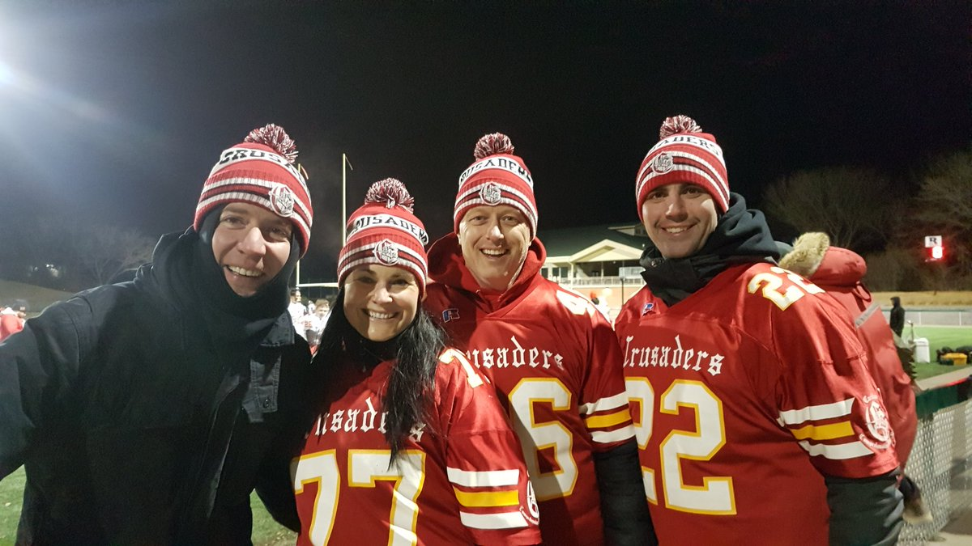


Dec 17-21 Spirit Week
WEDNESDAY:
HOLIDAY HEADGEAR DAY
THURSDAY:
SWEATER - or
RED & GREEN DAY
FRIDAY:
PJ DAY
MONDAY:
JERSEY DAY
TUESDAY:
TWIN DAY

Slide 4

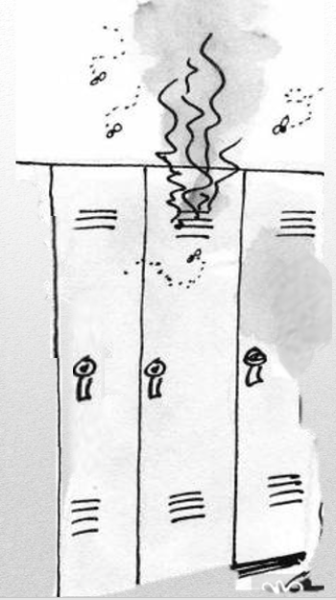




Please!!
Remove all garbage and food from your locker today.

Slide 5

Carlton offers a YOGA 10 class!
No experience required
Great for:
- athletes who want to improve their flexibility,
those looking to reduce stress,
those who already love yoga and want more of it.
Find this elective class on myBlueprint under Phys Ed.

Slide 6




Mrs. Anderson’s Art 9
Please pick up your Bee Sculptures
in the art room before Fri. Dec. 21
Students who did Polar Bear / Penquin sculptures:
see Mrs. Anderson if you want to
take them home for Christmas.

Slide 7




CONGRATULATIONS !
CARLTON WRESTLING TEAM
on your outstanding performance in Saskatoon
Josee Trzaskowski Kaylyn Anderson Savannah Ruthven
Serenity Desjarlais Alexis Engel
Izabella Bear Dante Doell
Maddison Bird Logan Bair
Connor Elphinstone Jessie Fehr
Abbie Tiessen

Slide 8
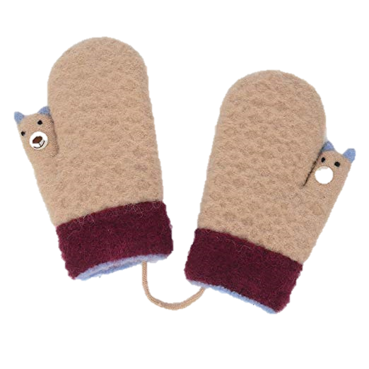



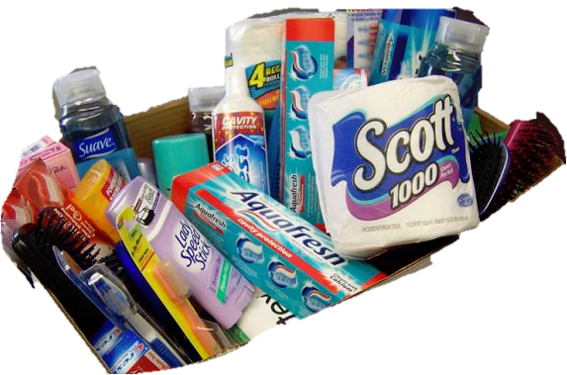
Carlton Pantry
Why a Pantry?
So all students can access food, clothing, hygiene items and school supplies.
Who Donates to the Pantry?
- students
- families
- staff members
- community members
How can I get something from the Pantry?
Please talk to Mrs. Amy (B223A) or any staff member.
.

Slide 9
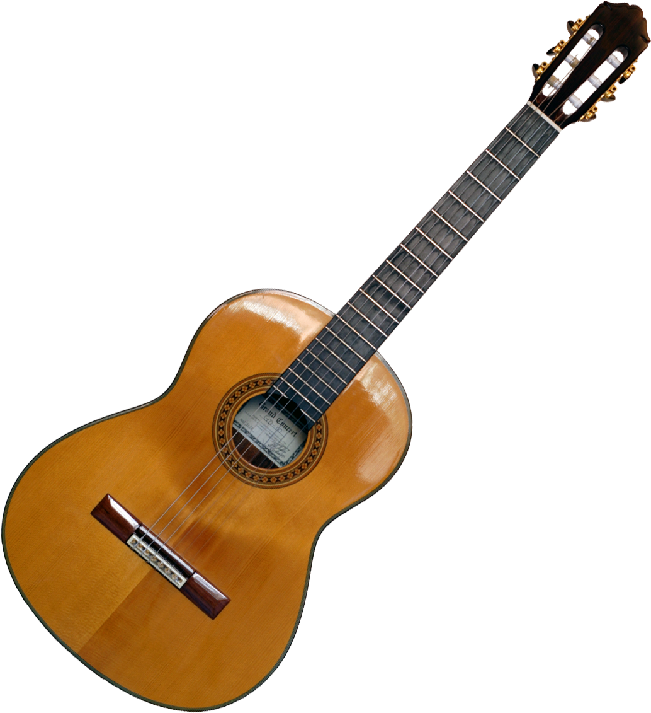


Crusader Music Club
Thursdays
Lunch time
B223A
New Location

Slide 10
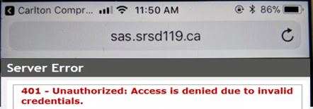


Problems signing into Students Achieve?
Check
address
Refresh and log in again.
**Forgot your password? See the Learning Commons Staff.

Slide 11

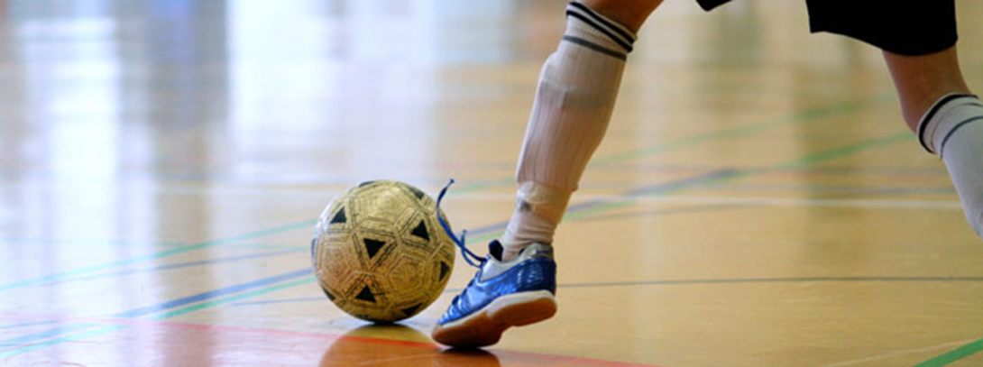
FUTSAL!!!
Gold Gym
Tuesdays &
Thursdays
3:30- 4:45
*For more info see: Mr. Correa in the SWIS Office Mr. Odnokon in CPAC
Dec. 21

Slide 12


Monday to Friday
Lunch time
B214
16 player spots
Everyone welcome
*Bring your lunch and your game face!
Dec. 21

