Slide 1

Carlton Comprehensive Public High School
Todays Class Times
Dec. 14, 2018
Period 1 | 8:55 – 9:58
Period 2 | 10:03 – 11:08
Period 3 | 11:13- 12:16
Period 4 | 1:05 -2:08
Period 5 | 2:13 – 3:16

Slide 2


Friday, Dec. 14
Breakfast | Single Mini | $4.50
Lunch | Chicken Fingers or Soup or Salad or Onion Rings | $6.50
Soup & Salad | Dutch Meatball Spinach Salad with Beets and Feta | $5.75
Dessert | Cherry Cheese Cake | $2.00

Slide 3




Put a smile on someone’s face!!!
Candy Cane Grams
Sold: Thursday 13th – Tuesday 18th in the rotunda during lunch
Delivered: December 19th
$1 - 1 Candy Cane
Buy your friend one!!!

Slide 4

Cancelled
until the new year!
Dec. 1

Slide 5

Carlton offers a YOGA 10 class!
No experience required
Great for:
- athletes who want to improve their flexibility,
those looking to reduce stress,
those who already love yoga and want more of it,
Find this elective class on myBlueprint under Phys Ed.

Slide 6

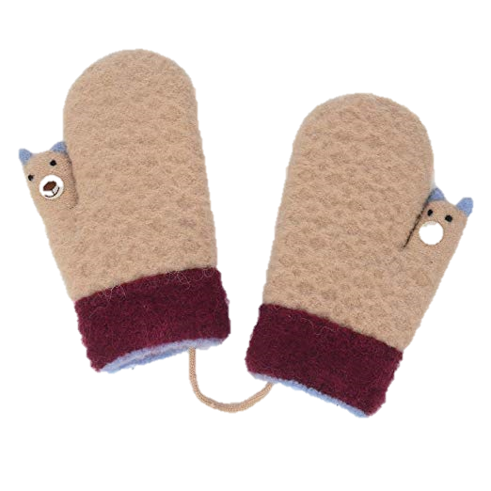
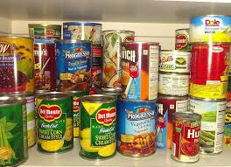
Carlton Pantry
Thanks to all the Crusaders who have donated to Carlton Pantry!
If you or a friend need food, clothing, books, or personal items, like shampoo or a tooth brush, please talk to Mrs. Amy in B223A or any staff member.

Slide 7

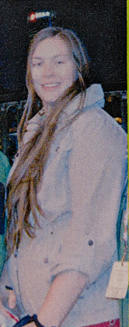
Win a chance to cut
Ms. Peet’s Hair!!!!
Bring a donation for the Carlton Pantry
to your Homeroom teacher.
-Get a ticket.
-Bring the filled out ticket to R207.
Hair cut to will take place Dec. 19th.
The hair will be donated to make a wig for someone in need.

Slide 8



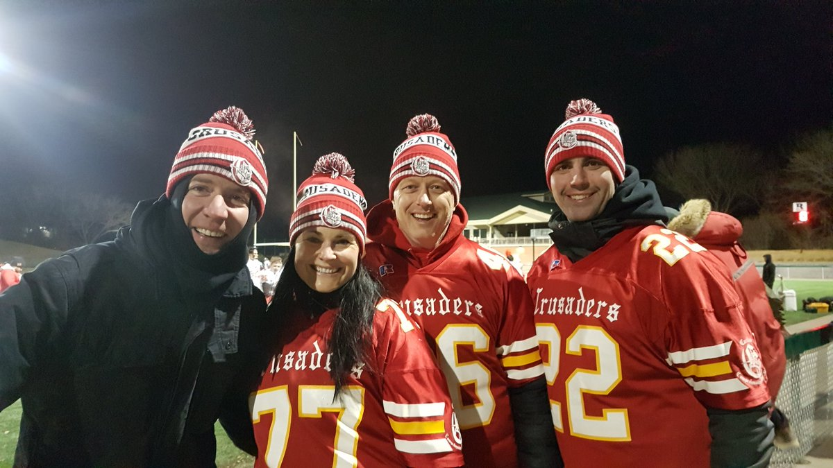
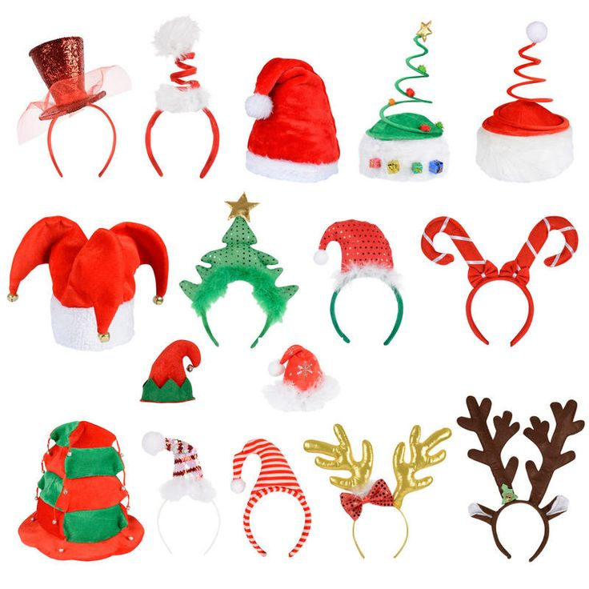

Dec 17-21 Spirit Week
WEDNESDAY:
HOLIDAY HEADGEAR DAY
THURSDAY:
SWEATER - or
RED & GREEN
DAY
FRIDAY:
PJ DAY
MONDAY:
JERSEY DAY
TUESDAY:
TWIN DAY

Slide 9




Game Night
Mintos vs Yorkton Maulers
Tonight – 7:00 PM
Notre Dame Hounds
Sun. Dec. 16 -1:30
Tickets $5 at the General Office

Slide 10

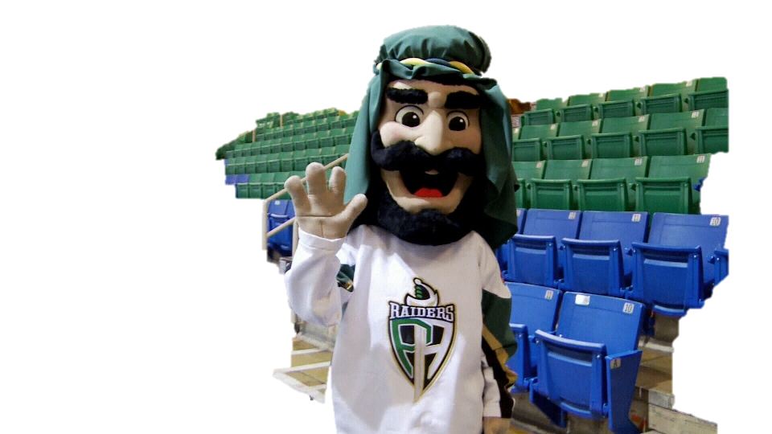
PA Raiders
Vs.
Swift Current Broncos
Sun. Dec. 15
7:00 pm

Slide 11
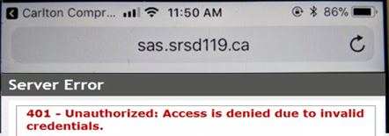


Problems signing into Students Achieve?
Check
address
Refresh and log in again.
**Forgot your password? See the Learning Commons Staff.

Slide 12

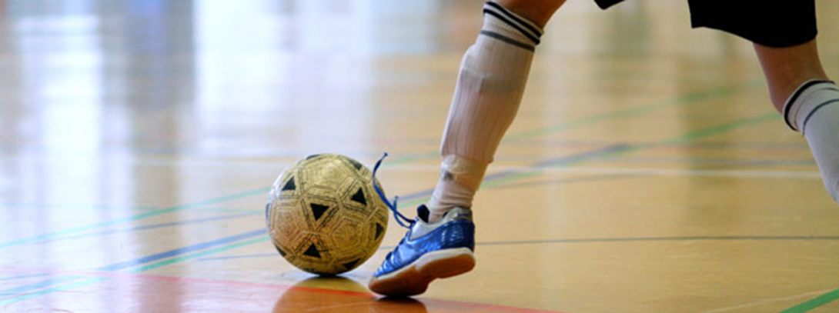
FUTSAL!!!
Gold Gym
Tuesdays &
Thursdays
3:30- 4:45
*For more info see: Mr. Correa in the SWIS Office Mr. Odnokon in CPAC
Dec. 21

Slide 13


Monday to Friday
Lunch time
B214
16 player spots
Everyone welcome
*Bring your lunch and your game face!
Dec. 21

