Slide 1
Carlton Comprehensive Public High School
Wednesday Dec. 12, 2018
Period 1 | 8:55 – 9:55
Period 2 | 10:00 – 11:00
 | Homeroom 11:05 – 11:20
Period 3 | 11:25 – 12:25
Period 4 | 1:15 – 2:15
Period 5 | 2:20 – 3:
Today’s
Class Times
Schedule

Slide 2
Wednesday, Dec. 12
Breakfast | South-west Egg Benny with Hash browns | $4.50
Lunch | Meatloaf with Mashed Potato and Vegetables | $6.50
Soup & Salad | Borscht Broccoli Salad | $5.75
Dessert | Egg Nog Trifle | $2.00

Slide 3
HOMEROOM TODAY!
11:05-11:20
LEARN VALUABLE LIFE SKILLS
EARN CREDITS IN
Life Transitions 20 & 30

Slide 4
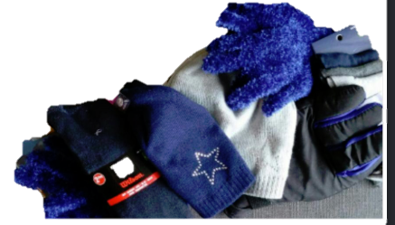
Donations before Dec. 14
-Homeroom Teacher
-Student Services
Donations to: Our House, The Gate & Gifts for Guys
Sponsored by the Girls of Greatness

Slide 5
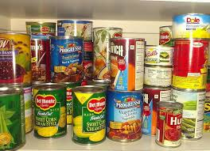
Carlton Pantry
Thanks to all the Crusaders who have donated to Carlton Pantry!
If you or a friend need food, clothing, books, or personal items, like shampoo or a tooth brush, please talk to Mrs. Amy in B223A or any staff member.

Slide 6
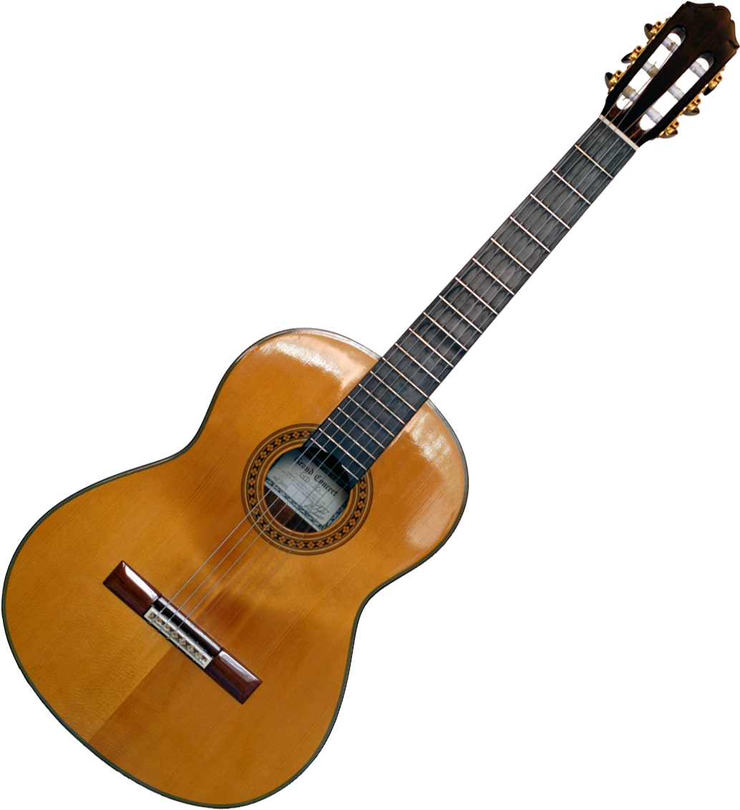
Crusader Music Club
Thursdays
Lunch time
B223A
New Location
Dec. 6

Slide 7
Game Night
Mintos vs Yorkton Maulers
Fri. Dec. 14
7:00 pm
Tickets $5 at the General Office

Slide 8
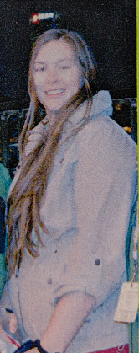
Win a chance to cut
Ms. Peet’s Hair!!!!
Bring a donation for the Carlton Pantry
to your Homeroom teacher.
-Get a ticket.
-Bring the filled out ticket to R207.
Hair cut to will take place Dec. 19th.
The hair will be donated to make a wig for someone in need.

Slide 9
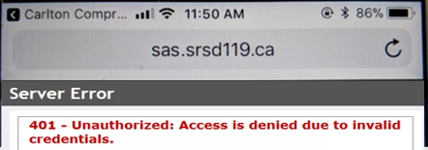
Problems signing into Students Achieve?
Check
address
Refresh and log in again.
**Forgot your password? See the Learning Commons Staff.

Slide 10
FUTSAL!!!
Gold Gym
Tuesdays &
Thursdays
3:30- 4:45
*For more info see: Mr. Correa in the SWIS Office Mr. Odnokon in CPAC
Dec. 21

Slide 11
Monday to Friday
Lunch time
B214
16 player spots
Everyone welcome
*Bring your lunch and your game face!
Dec. 21

