Slide 1

Carlton Comprehensive Public High School
Todays Class Times
Tuesday, Nov. 6, 2018
Period 1 | 8:55 – 9:58
Period 2 | 10:03 – 11:08
Period 3 | 11:13- 12:16
Period 4 | 1:05 -2:08
Period 5 | 2:13 – 3:16

Slide 2


Tuesday, Nov. 6
Breakfast | Breakfast Skillet with Scrambled Egg | $4.50
Lunch | Fried Chicken and Waffles with Coleslaw | $6.50
Soup & Salad | Cream of Broccoli Citrus Mint | $5.75
Dessert | Tempting Tuesday dessert | $2.00

Slide 3

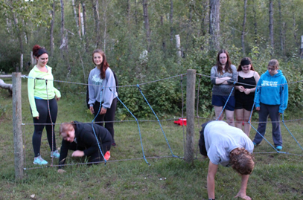
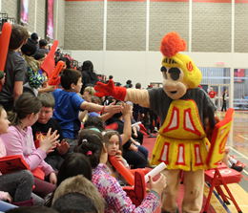

Carlton School Spirit Team
All students welcome .
Come plan some new spirit activities!
Wednesdays, Noon
B108
Learn Leadership
Skills!
Create a positive ‘Sader Community!
Create fun opportunities
at school!

Slide 4


















Stay Connected!
Carlton App
Carlton Comprehensive
High School

Slide 5


9/10 Girls Volleyball
League Playoffs
Date change
Ig
Thurs. Nov. 8th
Be at CPAC at 5pm
CPAC
Sept. 19

Slide 6

Dec. 1

Slide 7
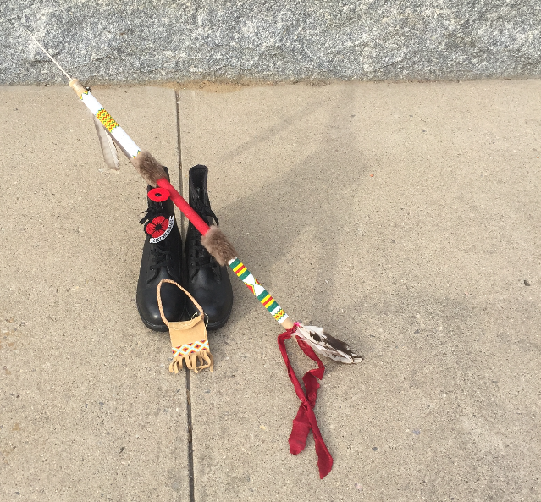



Remembrance Day Ceremony
Nov. 8 -10:00 -11:00 - Red Gym
All students welcome.
Anyone wishing to participate
in the ceremony see Mr. Klassen
B117 or B223A.

Slide 8
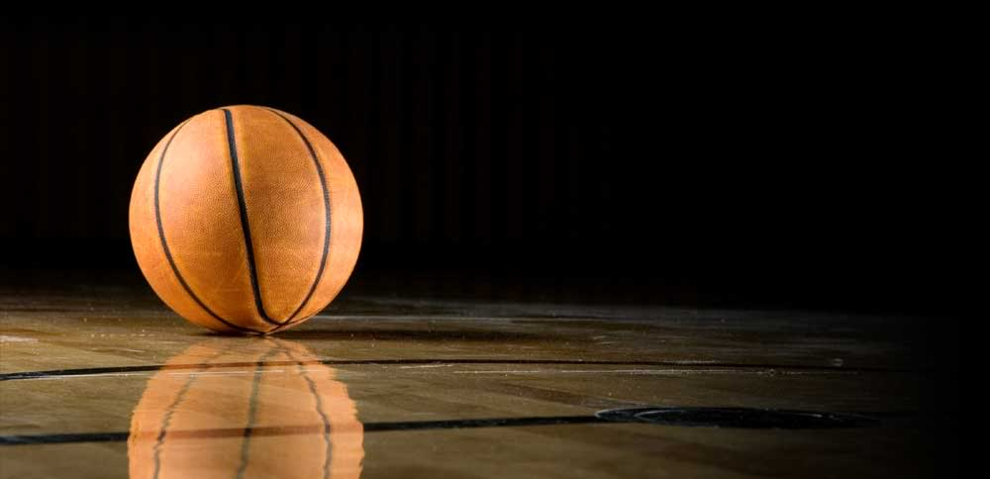
Basketball Sign – Up Meeting
For all girls and boys interested in playing
Thurs. Nov. 8th
Noon hour
Boys in Red Gym
Girls in CPAC

Slide 9

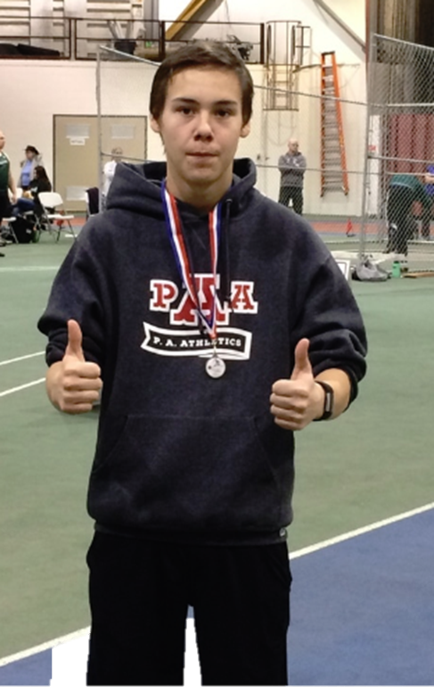



PA Athletics Track Club
Registration Night
Thurs. Nov. 13th & 15th
Alfred Jenkins Fieldhouse 3rd Floor
All ages welcome!
For more information visit:
www.paathletics.ca or
Facebook – pa athletics

Slide 10


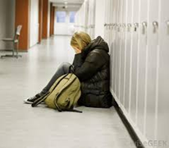
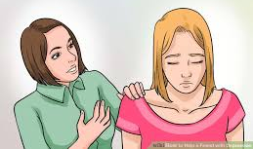
FALL SURVEY
✓ Collected mental health information
✓ Consult guidance counselors, mental health workers
✓ Guest speakers
✓ Informational campaigns

Slide 11


Girls of Greatness
Next meeting:
Tues Nov. 13
Period 3
Student Lounge
Open to Grades 9-12

Slide 12

The Mad Hatter Theatre Company Presents

Slide 13
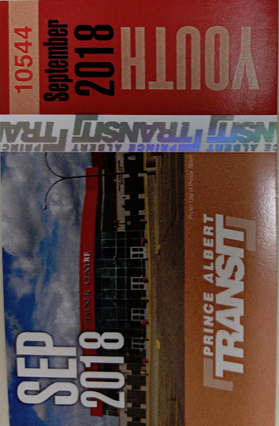

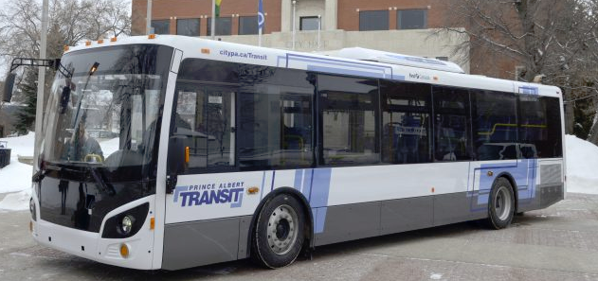
November Bus Passes are available at the General Office for $20
Passes will be available till the November 20th

Slide 14


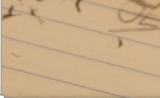
*New Date
Fridays
Lunch
B101
Check the door of B101 for a full schedule.
Everyone welcome.
Bring your lunch.

