Slide 1


Today’s Class Times
Wednesday Nov. 21 , 2018
Period 1 | 8:55 – 9:55
Period 2 | 10:00 – 11:00
 | Homeroom 11:05 – 11:20
Period 3 | 11:25 – 12:25
Period 4 | 1:15 – 2:15
Period 5 | 2:20 – 3:20

Slide 2


Wednesday, Nov. 21
Breakfast | South-west Egg Benny with Hash browns | $4.50
Lunch | Basil Mango Chicken Salad on A Kaiser with Wedges or Soup or Salad | $6.50
Soup & Salad | Country Vegetable Blueberry Chopped Chicken Salad | $5.75
Dessert | Raspberry Trifle | $2.00

Slide 3





HOMEROOM TODAY!
11:05-11:20
LEARN VALUABLE LIFE SKILLS
EARN CREDITS IN
Life Transitions 20 & 30

Slide 4

Wrestling Season is here!!
Practices Start
Nov. 19
3:30 pm
White Gym (upstairs)
Come check it out.
No experience required.
Nov. 21

Slide 5

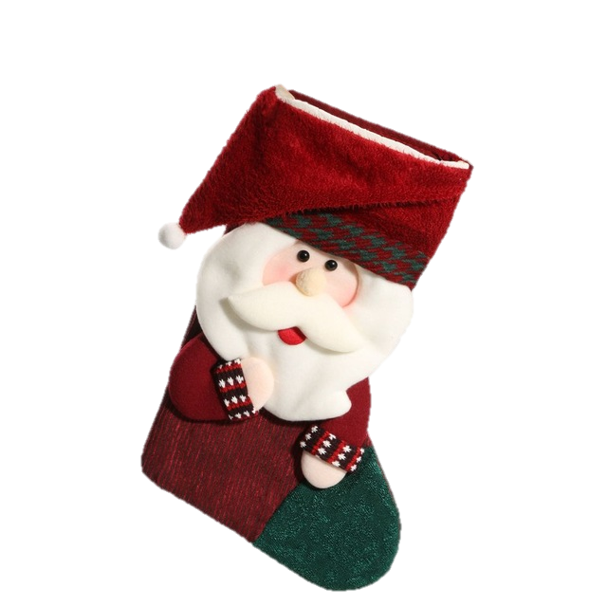


Carlton School Spirit Team
Create a positive ‘Sader Community!
Is planning some Christmas spirit activities!
Wednesday, Noon
B108
All students welcome
Learn Leadership
Skills!

Slide 6




Wednesday Nov. 21 | Thursday Nov. 22 | Facility | Time
Girls Group #1 (3:30-5:00) | Sr. Boys (top 20) | CPAC | 3:30-5:30
Sr. Boys (top 20) | Jr. Girls/ Sr B Girls | Red | 3:30-5:30
Girls Group #2 (5:00-6:30) | Sr. Girls | CPAC | 5:30-7:30
Jr. Boys Prospects |  | Red | 5:30-7:30
Girls Group #3 (6:30-8:30) |  | CPAC | 7:30-9:00

Slide 7

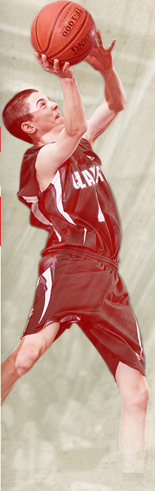
Sr. Boys Basketball Red Vs. White
Fri. Nov. 23
CPAC – 3:30
Come out and cheer on the top 20 players competing
for the Sr. Boys team.

Slide 8
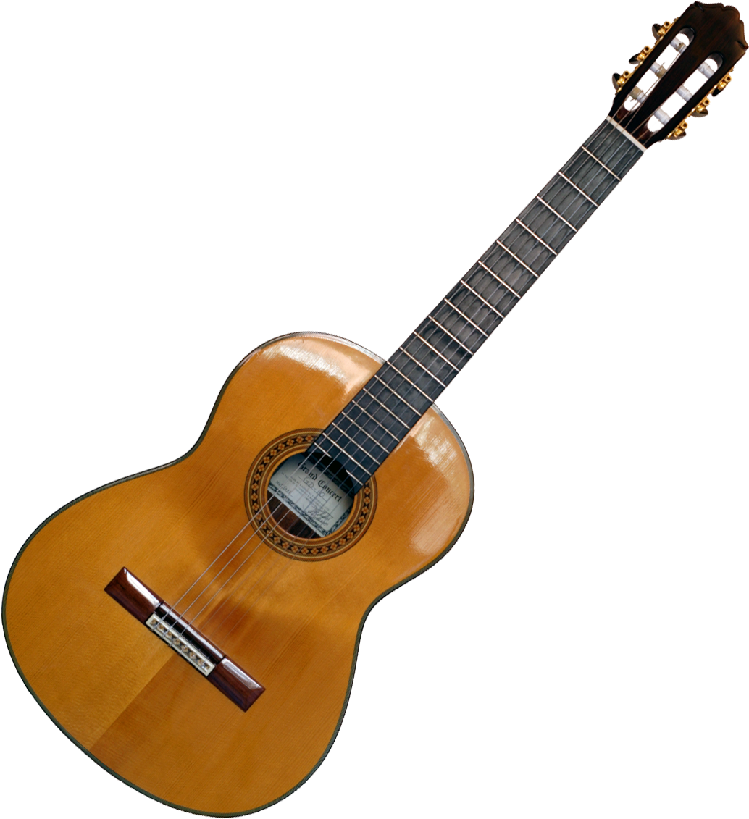


Crusader Music Club
Thursdays
Lunch time
Y101 (by the Band room)

Slide 9


















Stay Connected!
Carlton App
Carlton Comprehensive
High School

Slide 10
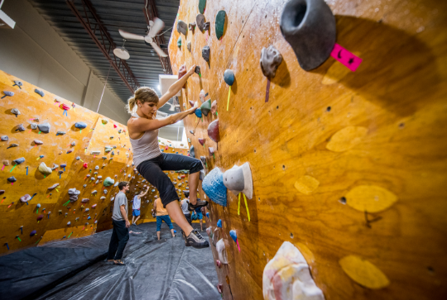

Grip it Climbing Saskatoon!!!
OUTDOOR ED
Join Mrs. Ackerman and
Mx. Laewetz for a day of climbing on Dec. 12!!!
First informational meeting is Nov. 29 in B102 at noon

Slide 11


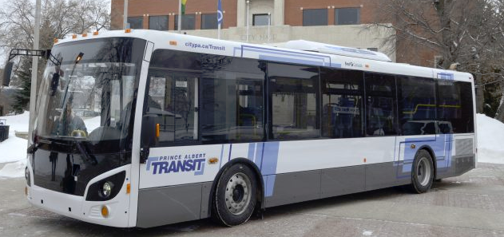
December Student Bus Passes are available at the General Office for $20
Dec. passes available until
Dec. 20th

Slide 12











Boys interested in club volleyball
Check out posters in CPAC
or see
Mr. Bender for
Information.
19-21

Slide 13


Girls of Greatness
Next meeting:
Nov. 27, 2018
Period 2
Student Lounge
Open to Grades 9-12

Slide 14



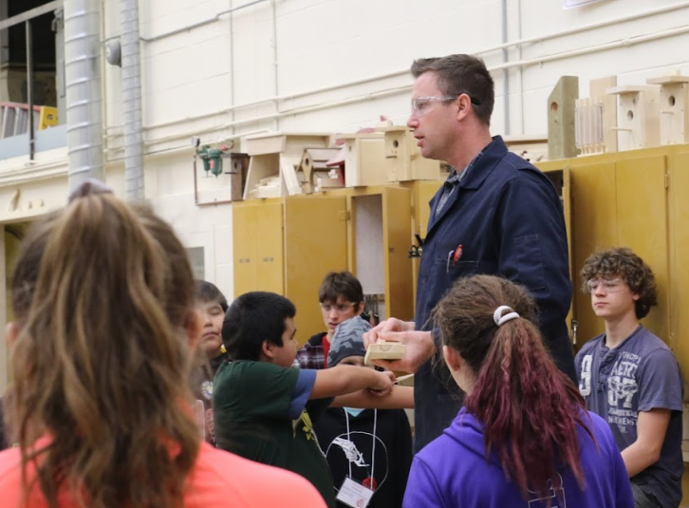
FALL SURVEY
Do you get along with your teacher?
67% of you said YES!
Follow Their Voices
Homeroom
SPRING SURVEY:
82% of Grade 11’s said YES!

Slide 15


Monday to Friday
Lunch time
B214
16 player spots
Everyone welcome
*Bring your lunch and your game face!
Dec. 21

Slide 16

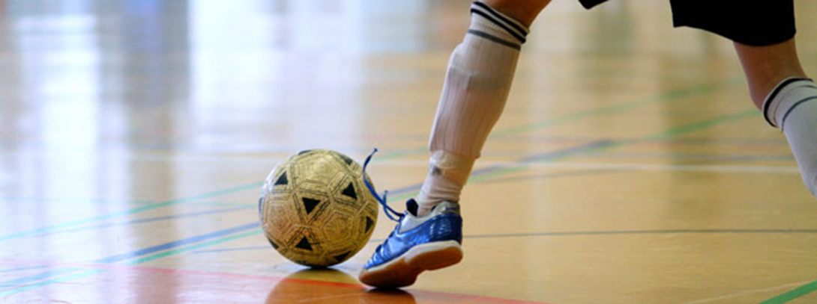
FUTSAL!!!
Gold Gym
Tuesdays
& Thursdays
3:30- 4:45
*For more info see: Mr. Correa in the SWIS Office Mr. Odnokon in CPAC
Dec. 21

