Slide 1
New Class Time Schedule
Thursday Oct 4, 2018
Period 1 | 8:55 – 9:58
Period 2 | 10:03 – 11:08
Period 3 | 11:13- 12:16
Period 4 | 1:05 -2:08
Period 5 | 2:13 – 3:16

Slide 2
Th
Thursday, Oct. 4
Breakfast | Buttermilk Pancakes with Sausage | $4.50
Lunch | Cheddar Burger and Fries or Soup or Salad or Onion Rings | $6.50
Soup & Salad | Salmon Chowder Thai Salad | $5.75
Dessert | Raspberry Lime Cheesecake | $2.00

Slide 3
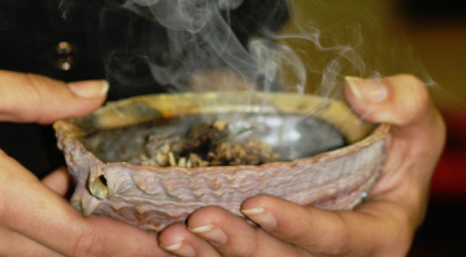
Smudging Ceremony Today
with Mr. Thunderchild
Meet at Mentor’s Office
2:45 pm
Ceremony in the
compound,
dress accordingly
(leave your books in your classroom)

Slide 4
Girls of Greatness
Tues. Oct. 16, 2018
Period 4
Student Lounge
Open to Grades 9-12

Slide 5
Mondays to Wednesdays & Fridays
*Except for Friday Oct. 19&26th
12-30 – 1:10
B214
Bring your lunch!
Oct. 31

Slide 6
4 NATIONS CUP
Pre-Tournament Game
Team Canada
Vs.
Team Finland
Sunday Nov. 4 - 6:00 pm
Art Hauser Centre
Tickets $15

Slide 7
United Nations Club
Current events
Word Diplomacy
International affairs
Negotiation / debate
Multi cultural awareness
Thursdays
B 117 - 12:30
For more info see Mr. Klassen or Mr. Fahie
Oct. 5

Slide 8
WANT TO WRITE A NOVEL?
Wrimo Rangers
is the club for you!
Thursdays at lunch in R212
Oct. 4

Slide 9
Thursdays
6-7:30pm
in the Learning Commons
Oct. 4

Slide 10
Oct. 19

