Slide 1
New Class Time Schedule
Oct 2, 2018
Period 1 | 8:55 – 9:58
Period 2 | 10:03 – 11:08
Period 3 | 11:13- 12:16
Period 4 | 1:05 -2:08
Period 5 | 2:13 – 3:16

Slide 2
T
Tuesday, Oct. 2
Breakfast | Breakfast Skillet with Scrambled Egg | $4.50
Lunch | Grilled Ham and Cheese Sandwich with Wedges or Soup or Salad | $6.50
Soup & Salad | Cream of Tomato Roasted Garlic Caesar with Chicken | $5.75
Dessert | Oreo Death by Chocolate | $2.00

Slide 3
Girls of Greatness
Tues. Oct. 16, 2018
Period 4
Student Lounge
Open to Grades 9-12

Slide 4
Mondays to Wednesdays & Fridays
*Except for Friday Oct. 19&26th
12-30 – 1:10
B214
Bring your lunch!
Sept.17

Slide 6
4 NATIONS CUP
Pre-Tournament Game
Team Canada
Vs.
Team Finland
Sunday Nov. 4 - 6:00 pm
Art Hauser Centre
Tickets $15

Slide 7
Game Night
Mintos vs Saskatoon Blazers
Oct. 3rd
7:00 pm

Slide 9
Like to argue a point?? Consider joining
The Carlton Debate Club
Tuesdays
Lunch time
Mr. Fahie’s - Room B109
*No previous debate
experience required
Sept. 28

Slide 10
United Nations Club
Current events
Word Diplomacy
International affairs
Negotiation / debate
Multi cultural awareness
Thursdays
B 117 - 12:30
For more info see Mr. Klassen or Mr. Fahie

Slide 11
Thursdays
6-7:30pm
in the Learning Commons

Slide 12
WANT TO WRITE A NOVEL?
Wrimo Rangers
is the club for you!
Thursdays at lunch in R212

Slide 13
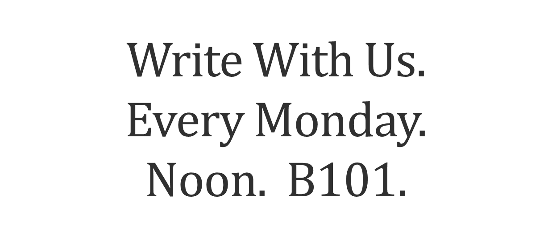
It might get gritty here.
Thanks to these websites for the images: http://expressingmotherhood.com/the-write-club/
http://www.popchix.com/write-club

