Slide 1
Carlton Comprehensive Public High School
Todays Class Times
Monday, Oct 29, 2018
Period 1 | 8:55 – 9:58
Period 2 | 10:03 – 11:08
Period 3 | 11:13- 12:16
Period 4 | 1:05 -2:08
Period 5 | 2:13 – 3:16

Slide 2
Monday, Oct. 29
Breakfast | Kaiser with Hash Browns | $4.50
Lunch | Spaghetti and Meatballs with Tossed Salad | $6.50
Soup & Salad | Carrot and Ginger Soup Tossed Green Salad with Breast of Chicken | $5.75
Dessert | Death by Butterscotch | $2.00

Slide 3
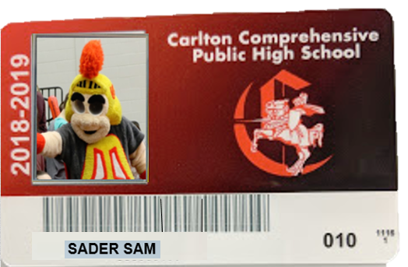
Retake Pictures
are now at the
GENERAL OFFICE
Student Cards are at the
LEARNING COMMONS

Slide 4
Halloween Costume Contest
Costume Contest
Lunch hour in the cafeteria!!
Wednesday Oct. 31st
Prizes awarded to the following categories:
Infant care
Grade 9
Grade 10
Grade 11
Grade 12

Slide 5
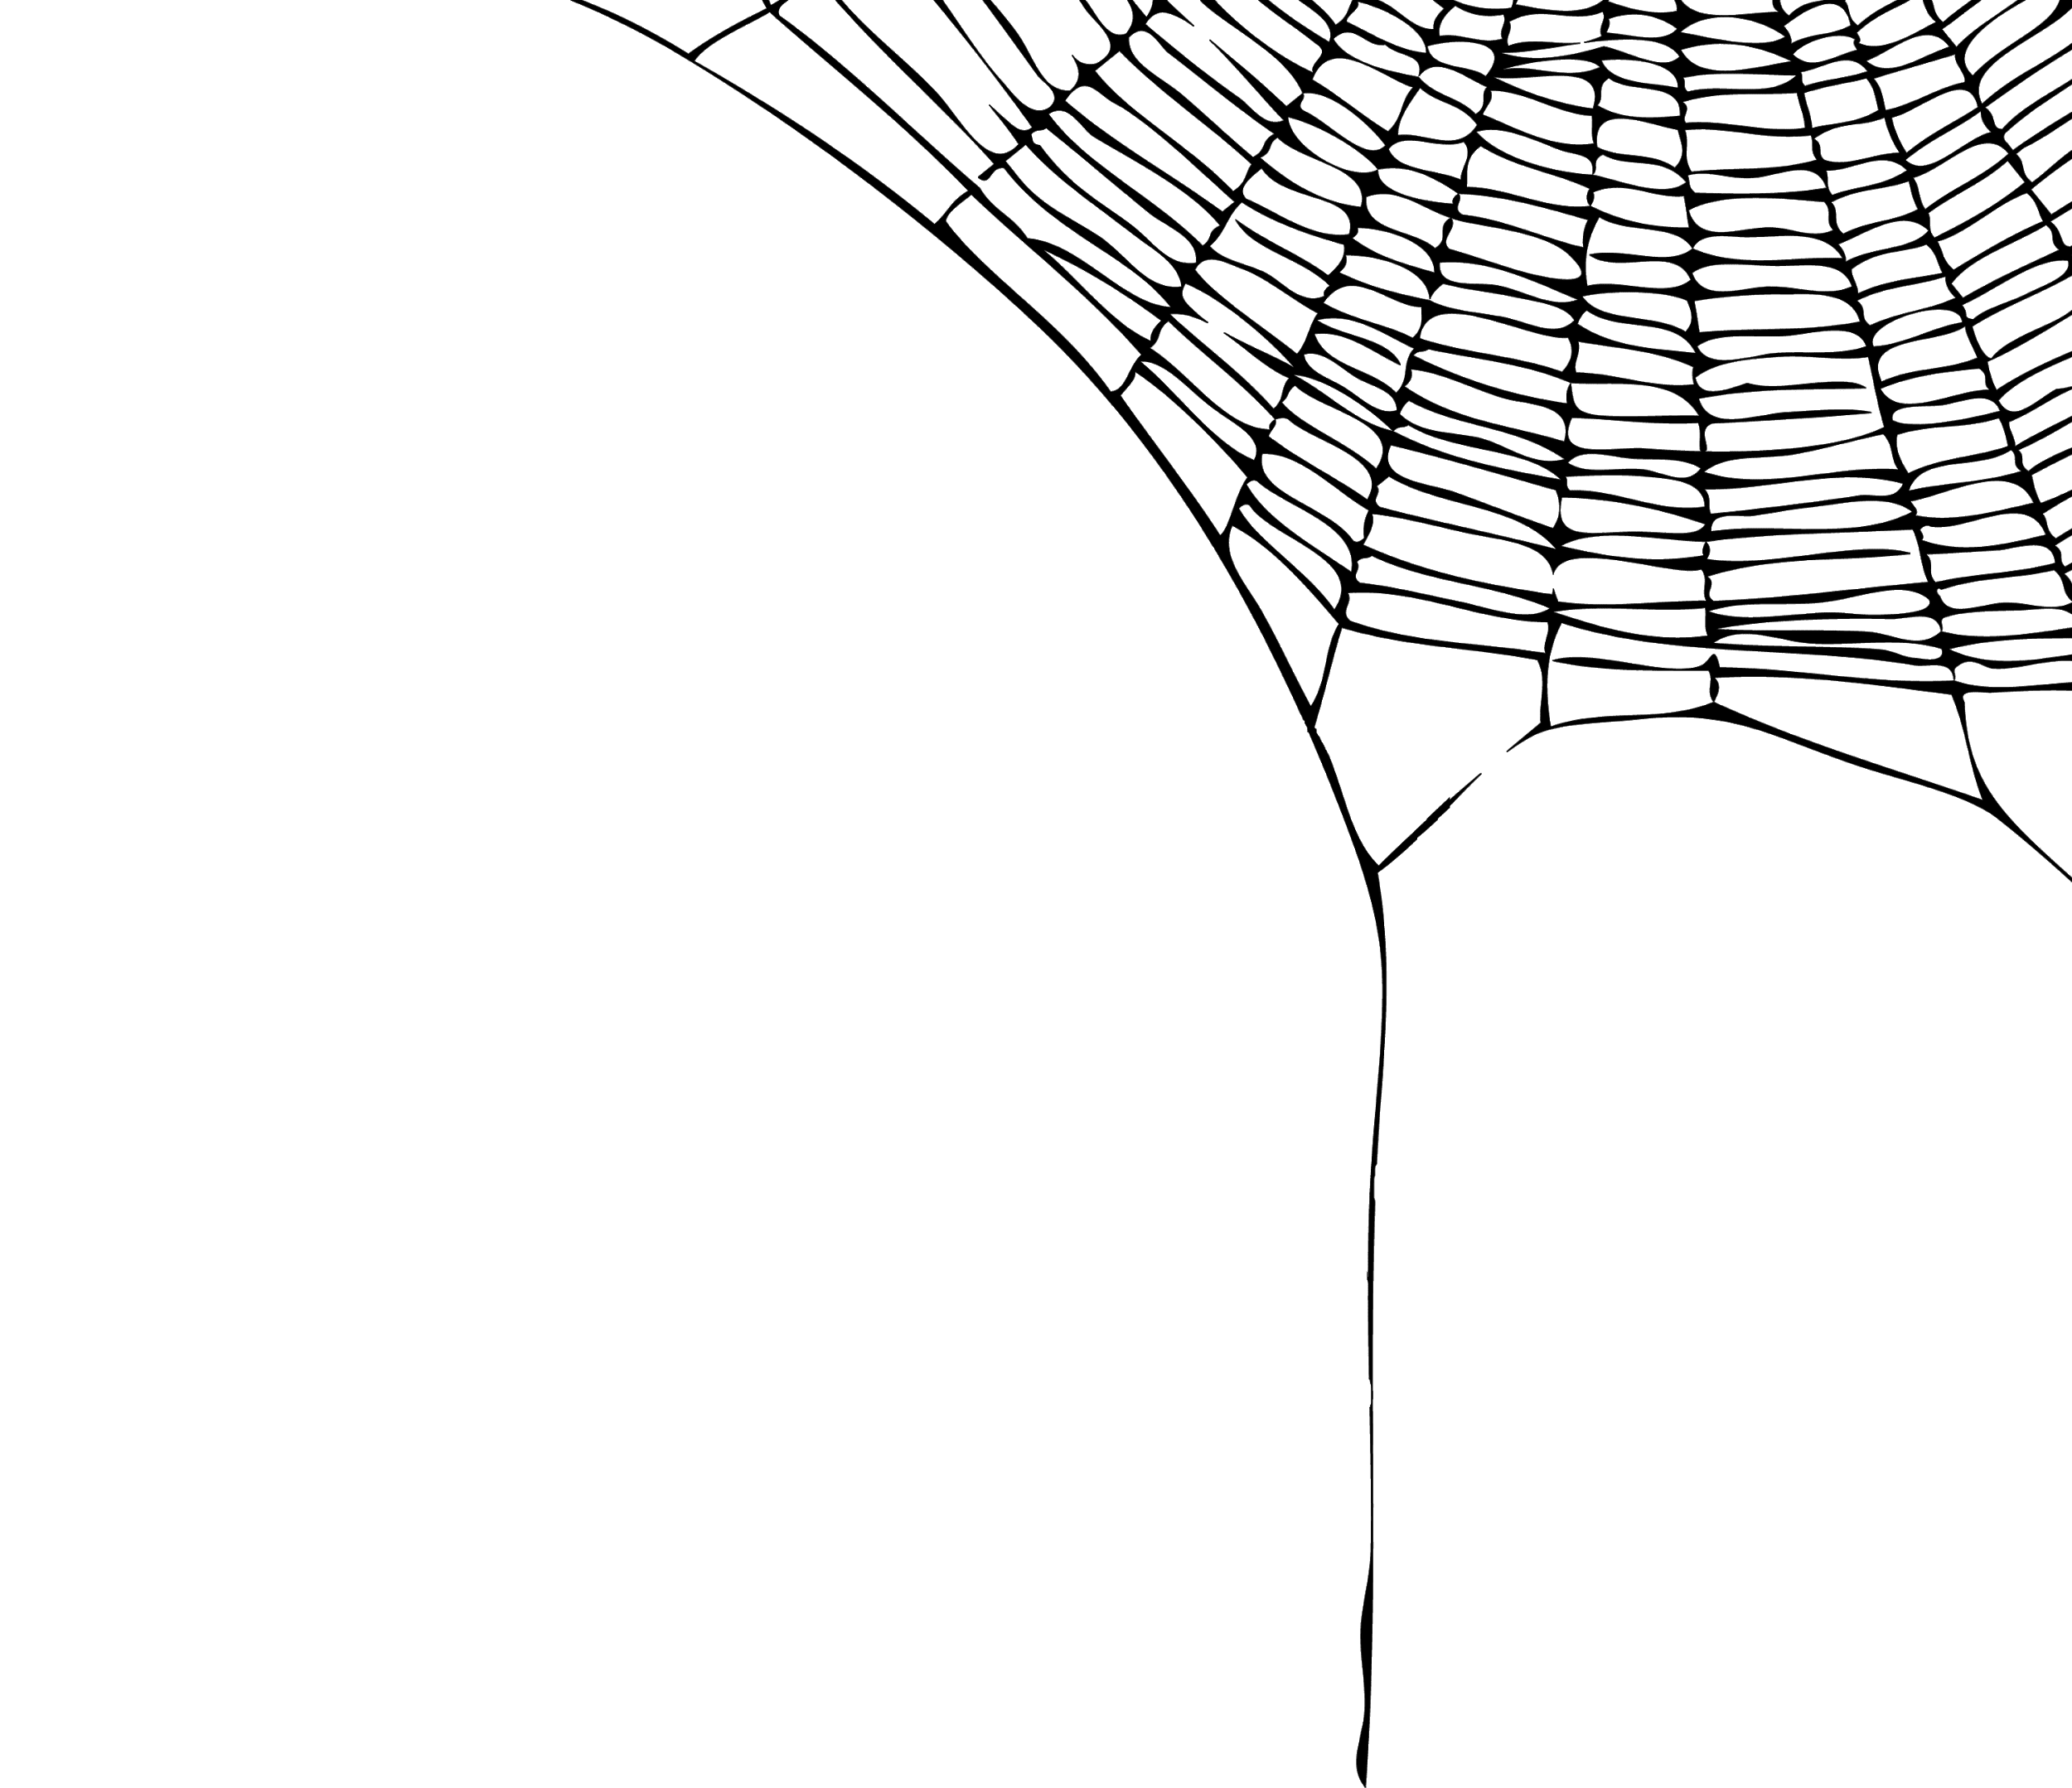
Buy one for a friend!
Halloween Candy Grams
Sold: Thurs. 25 – Tues. 30
noon
in the rotunda
Delivered: October 31st
Make someone’s day!
1 bag - 1$

Slide 6
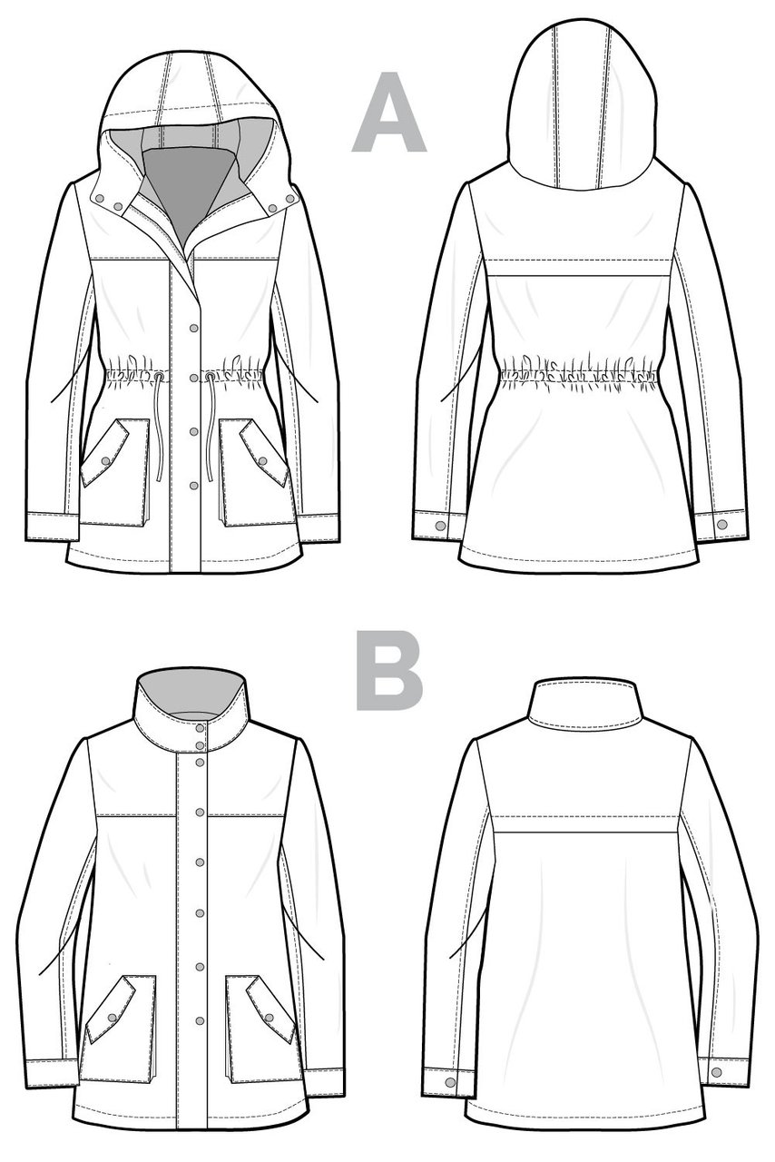
‘SEW’CIAL CLUB
MONDAYS
LUNCH
B230
MX. LAEWETZ
no experience required
*Sew-bead-knit-crochet-cross stitch and more

Slide 7
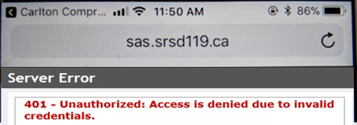
Problems signing into Students Achieve?
Check
address
Refresh and log in again.
**Forgot your password? See the Learning Commons Staff.

Slide 8
Problems signing into Students Achieve?
Check
address
Refresh and log in again.
**Forgot your password? See the Learning Commons Staff.

Slide 9
***Come out and Cheer!!!
Senior Boys Volleyball
City Finals
Game time
Monday Oct 29
7pm
Carlton
*Wear red and your Crusader gear

Slide 10
Girls of Greatness
Next meeting:
Tues. Oct. 30, 2018
Period 5
Student Lounge
Open to Grades 9-12

Slide 11
Voyagez!
Québec. Montréal. Easter 2020.
Talk to a French teacher today!

Slide 12
Grade 11 & 12 Students!
Saskatoon
Mon. Nov. 5th
Leaving Carlton 7:30 am
See Mr. Thunderchild
for info and registration
Where will I study?
Where will I live?
What scholarships are available?
What program do I require to get the job I want?

Slide 13
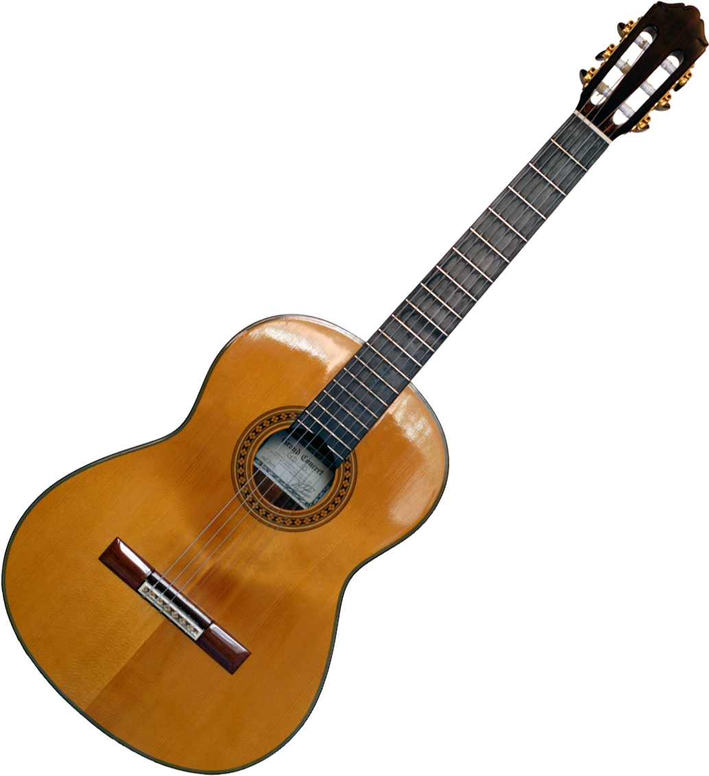
Crusader Music Club
STARTING
Thursdays, Nov. 1
Lunch time
Y101 (by the Band room)
Nov. 1

Slide 14
Game Night
Mintos vs Tisday Trojans
Wed. Oct. 31
7:00 pm
Tickets $5 at the General Office

Slide 15
4 NATIONS CUP
Pre-Tournament Game
Team Canada
Vs.
Team Finland
Sunday Nov. 4 - 6:00 pm
Art Hauser Centre
Tickets $15

Slide 16
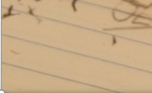
*New Date
Fridays
Lunch
B101
Check the door of B101 for a full schedule.
Everyone welcome.
Bring your lunch.

Slide 17
Outside B117 or
B212 or
In General Office
*Help keep plastic out of the landfill

Slide 18
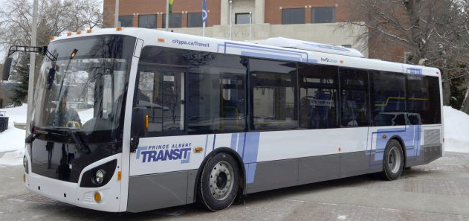
November Bus Passes are available at the General Office for $20
Passes will be available till the November 20th

