Slide 1
Carlton Comprehensive Public High School
Todays Class Times
Tuesday, Oct 23, 2018
Period 1 | 8:55 – 9:58
Period 2 | 10:03 – 11:08
Period 3 | 11:13- 12:16
Period 4 | 1:05 -2:08
Period 5 | 2:13 – 3:16

Slide 2
Tuesday, Oct. 23
Breakfast | Breakfast Skillet with Scrambled Egg | $4.50
Lunch | Cuban Sandwich with Wedges or Soup or Salad | $6.50
Soup & Salad | Beef Barley Citrus Mint Salad on Greens | $5.75
Dessert | Rhubarb Crisp | $2.00

Slide 3
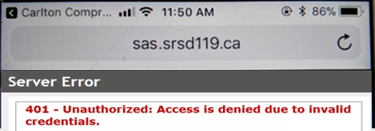
Problems signing into Students Achieve?
Check
address
Refresh and log in again.
**Forgot your password? See the Learning Commons Staff.

Slide 4
Problems signing into Students Achieve?
Check
address
Refresh and log in again.
**Forgot your password? See the Learning Commons Staff.

Slide 5
Buy one for a friend!
Halloween Candy Grams
Sold: Thursday 25th- Tuesday 30th in the the rotunda at noon
Delivered: October 31st
Make someone’s day!
1 bag - 1$

Slide 6
Next Game
TONIGHT (Tues. Oct. 23)
7 pm
Everett Silvertips

Slide 7
Game Night
Mintos vs Beardy’s Black Hawks
Wed. Oct. 24
7:00 pm
Tickets $5 at the General Office

Slide 8
Voyagez!
Québec. Montréal. Easter 2020.
Talk to a French teacher today!

Slide 9
Outside B117 or
B212 or
In General Office
*Help keep plastic out of the landfill

Slide 10
Grade 11 & 12 Students!
Saskatoon
Mon. Nov. 5th
Leaving Carlton 7:30 am
See Mr. Thunderchild
for info and registration
Where will I study?
Where will I live?
What scholarships are available?
What program do I require to get the job I want?

Slide 11
Students interested in CURLING
meeting
Thurs. Oct. 25
12:20
G109 (Machine Shop)
*Novices welcome! Training provided!
Learn a new sport!

Slide 12
Girls of Greatness
Next meeting:
Tues. Oct. 30, 2018
Period 5
Student Lounge
Open to Grades 9-12

Slide 13
Crusader Music Club
STARTING
Thursdays, Nov. 1
Lunch time
Y101 (by the Band room)

Slide 14
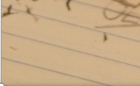
*New Date
Fridays
Lunch
B101
Check the door of B101 for a full schedule.
Everyone welcome.
Bring your lunch.

