Slide 1
Carlton Comprehensive Public High School
Todays Class Times
Thursday Oct 11, 2018
Period 1 | 8:55 – 9:58
Period 2 | 10:03 – 11:08
Period 3 | 11:13- 12:16
Period 4 | 1:05 -2:08
Period 5 | 2:13 – 3:16

Slide 3
Th
Thursday, Oct. 11
Breakfast | Buttermilk Pancakes with Sausage | $4.50
Lunch | Grilled Cheese Sandwich with Wedges or Soup or Salad | $6.50
Soup & Salad | Texas Beef Sesame Chicken Pasta Salad | $5.75
Dessert | Lemon Slice | $2.00

Slide 4
Today
is
Multi-Sport
Recognition Day
Oct. 7-13 is Sask. School Sports Week
Most professional athletes played multiple sports as kids.
Carlton has 33 teams covering 10 different sports.
Our past Athletes of the Year played at least 2 sports.
; Thursday is “Multi-Sport Participation Day”; Friday is “School Team Recognition Day”.

Slide 5
Today
is
Multi-Sport
Recognition Day
Oct. 7-13 is Sask. School Sports Week
Most professional athletes played multiple sports as kids.
Carlton has 33 teams covering 10 different sports.
Our past Athletes of the Year played at least 2 sports.
; Thursday is “Multi-Sport Participation Day”; Friday is “School Team Recognition Day”.

Slide 6
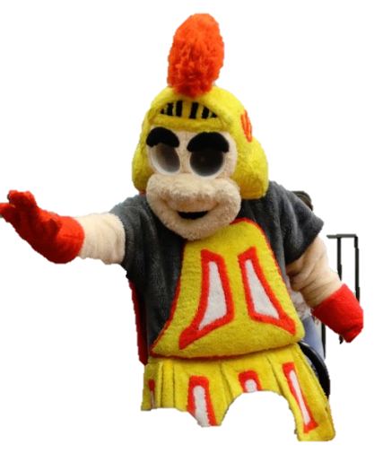
Come cheer for your Crusaders!
Crusaders
Vs
Marion Graham
Falcons
6:30 tonight
Meet Sader Sam!
Have some popcorn & hot chocolate!

Slide 7
Carbon Tax?
Trump Impeachment?
Canada and Marijuana!
Fake News-Global Warming
What global issues inspire or anger you?
United Nations Club
Thursdays
B 117 - 12:30
Or see Mr. Klassen or Mr. Fahie

Slide 8
Mondays to Wednesdays & Fridays
*Except for Friday Oct. 19&26th
12-30 – 1:10
B214
Bring your lunch!
Oct. 31

Slide 9
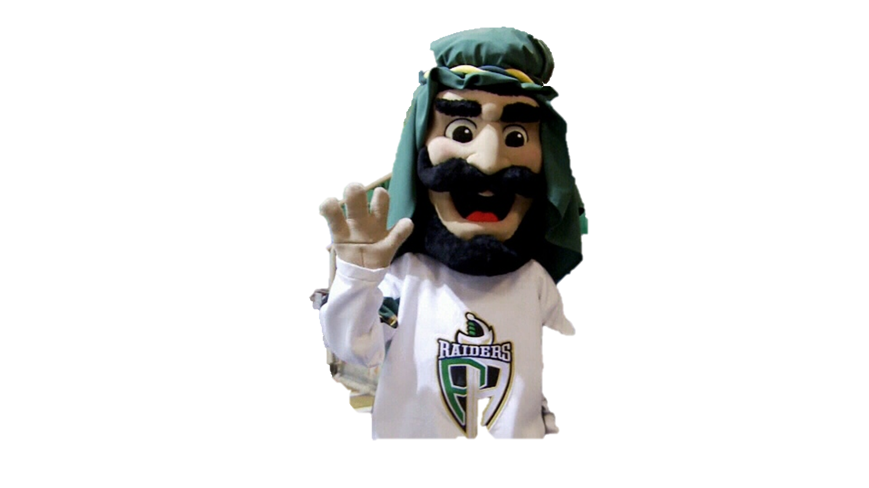
Next Game
Sat. Oct. 13
7pm
Red Deer Rebels

Slide 10
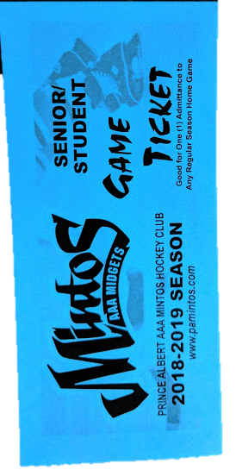
Mintos Game Tickets
For sale - $5.00
See General Office
Next Game
Oct. 18 – 7pm
Saskatoon
Contacts

Slide 11
4 NATIONS CUP
Pre-Tournament Game
Team Canada
Vs.
Team Finland
Sunday Nov. 4 - 6:00 pm
Art Hauser Centre
Tickets $15

Slide 12
Oct. 19

Slide 13
Girls of Greatness
Tues. Oct. 16, 2018
Period 4
Student Lounge
Open to Grades 9-12

