Slide 1
Carlton Comprehensive Public High School
Starting Oct. 1 Bell Schedule
*Wednesday schedule will remain the same for Homeroom
Oct 1, 2018
Period 1 | 8:55 – 9:58
Period 2 | 10:03 – 11:08
Period 3 | 11:13- 12:16
Period 4 | 1:05 -2:08
Period 5 | 2:13 – 2:16

Slide 2
Carlton Comprehensive Public High School
Wednesday 26, 2018
Period 1 | 8:55 – 9:55
Period 2 | 10:00 – 11:00
 | Homeroom 11:05 – 11:20
Period 3 | 11:25 – 12:25
Period 4 | 1:15 – 2:15
Period 5 | 2:20 – 3:20
Today’s
Bell
Schedule

Slide 3
W
Wednesday, Sept. 26
Breakfast | South-west Egg Benny with Hash browns | $4.50
Lunch | Breaded Pork Cutlet with Mashed Potato and Vegetables | $6.50
Soup & Salad | Cream of Leek Greek Salad | $5.75
Dessert | Wednesday’s sweet surprise | $2.00

Slide 4
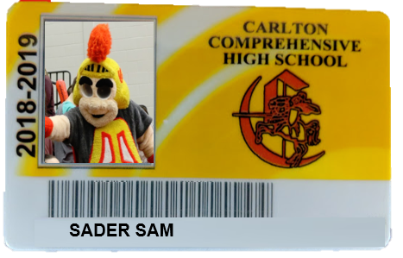
Get your student card
@Homeroom Today!
See your timetable for your advisor and meeting room.

Slide 5
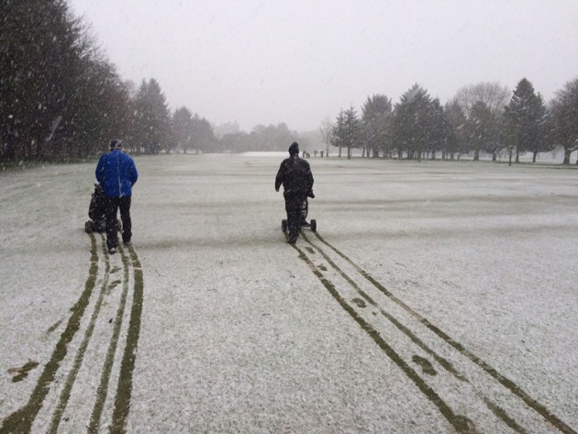
Congratulations
Carlton Golf Team
Provincial Gold Medal
Ben Zultok
Cody Huntley
Cole Jenkins
TJ Baker
Winning by 2 strokes
in snow and freezing weather

Slide 6
United Nations Club
Current events
Word Diplomacy
International affairs
Negotiation / debate
Multi cultural awareness
Wednesdays
B 117 - 12:30
For more info see Mr. Klassen or Mr. Fahie

Slide 7
Next Game
Fri. Sept. 28
7:00 pm
PA Raiders
vs
Medicine Hat Tigers

Slide 8
Thursdays
6-7:30pm
in the Learning Commons

Slide 9
WANT TO WRITE A NOVEL?
Wrimo Rangers
is the club for you!
Thursdays at lunch in R212

Slide 10
Like to argue a point?? Consider joining
The Carlton Debate Club
Tuesdays
Lunch time
Mr. Fahie’s - Room B109
*No previous debate
experience required
Sept. 28

Slide 12
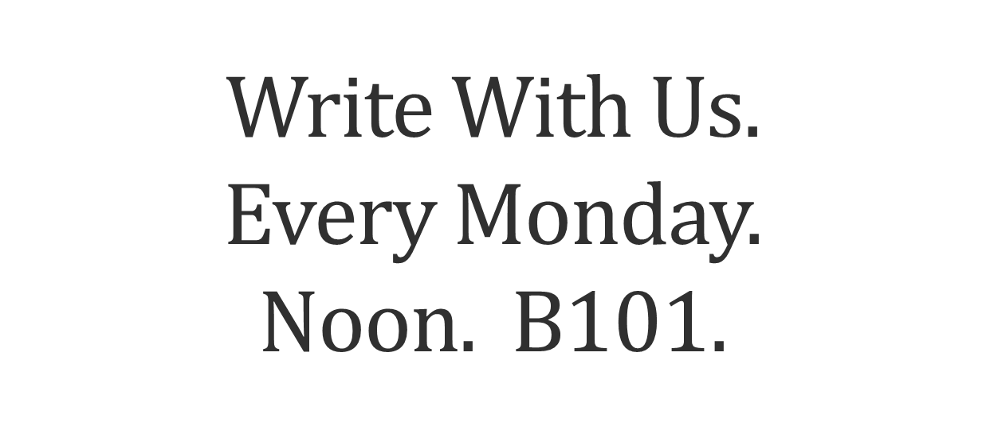
It might get gritty here.
Thanks to these websites for the images: http://expressingmotherhood.com/the-write-club/
http://www.popchix.com/write-club

