Slide 1
Carlton Comprehensive
Public High School
Tues. Sept 18 , 2018
Period 1 | 8:55 – 9:55
Period 2 | 10:00 – 11:05
 | Wellness Break 11:05 – 11:15
Period 3 | 11:20 – 12:25
Period 4 | 1:15 – 2:15
Period 5 | 2:20 – 3:20
2018 – 2019 Bell
Schedule

Slide 2
T
Tuesday, Sept. 18
Breakfast | Breakfast Skillet with Scrambled Egg | $4.50
Lunch | Philly Cheese Steak with Wedges or Soup or Salad | $6.50
Soup & Salad | Broccoli and Cheese Blueberry Chopped Chicken Salad | $5.75
Dessert | Raspberry Trifle | $2.00

Slide 3
Congratulations to the Carlton Golf Team
They finished first at District Championships!
They will represent Carlton and our District at Provincials
North Battleford Sept. 21 & 22
Good luck fellas!!!

Slide 4
Register Now for the U of S Open House on Sept 28th!
Cost is $25
Deadline to apply is Sept 25th
Pick up Permission forms and general information sheets in Students Services
Limited Space

Slide 5
9/10 Girls Intersted in playing Volleyball
There is still room on a team for you!
See Mrs. Vandale in B201
Practice is every Wednesday
- CPAC
- 3:30
See you there!!
Ig
Sept. 19

Slide 6
Write With Us Every Tuesday Noon - B101
It might get gritty here.
Thanks to these websites for the images: http://expressingmotherhood.com/the-write-club/
http://www.popchix.com/write-club

Slide 7
Starting - Monday Sept. 17
Mondays and Wednesdays in Sept.
12-30 – 1:10
B214
Bring your lunch!
Sept.17

Slide 8
Like to argue a point?? Consider joining
The Carlton Debate Club
Tuesdays
Lunch time
Mr. Fahie’s - Room B109
*No previous debate
experience required
Sept. 28

Slide 9
Girls of Greatness
Tues. Sept. 18, 2018
Period 2
Learning Commons
Open to Grades 9-12
Note room change!

Slide 10
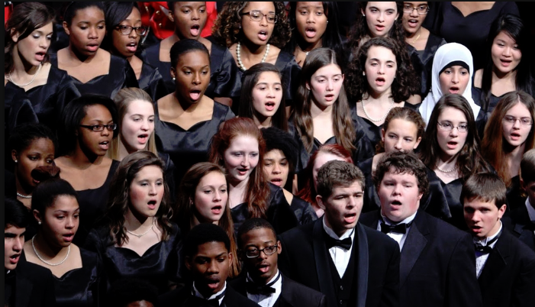
Do you like to sing?
D
Anyone interested in taking choir at noon
Meet :
Y100
Wed. Sept. 19
Lunch
Consider
Carlton Choir
Take as a club activity or as a credit.
Everyone is welcome.
Sign up in Room Y100/ Music room ASAP.
Sept 21

