Slide 1
Welcome 2018-19 Carlton School Year!

Slide 2
Carlton Comprehensive
Public High School
Thurs. Sept 13 , 2018
Period 1 | 8:55 – 9:55
Period 2 | 10:00 – 11:05
 | Wellness Break 11:05 – 11:15
Period 3 | 11:20 – 12:25
Period 4 | 1:15 – 2:15
Period 5 | 2:20 – 3:20
2018 – 2019 Bell
Schedule

Slide 3
Th
Thursday, Sept. 13
Breakfast | Buttermilk Pancakes with Sausage | $4.50
Lunch | Grilled Cheese Sandwich with Wedges or Soup or Salad | $6.50
Soup & Salad | Cream of Tomato Buffalo Chicken Caesar | $5.75
Dessert | Death by Chocolate | $2.00

Slide 4
Today Today

Slide 5
Do you enjoy doing outdoor activities?
We will be enjoying the outdoors with a
number of activities.
Everyone welcome !
*Today
Construction Shop G106
Bring your lunch!

Slide 6
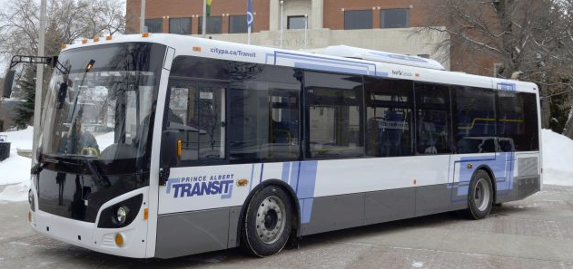
Student Bus Passes are available at the General Office for $20
Passes for the upcoming month available on the 21st. of each month

Slide 7
Register Now for the U of S Open House on Sept 28th!
Cost is $25
Deadline to apply is Sept 25th
Pick up Permission forms and general information sheets in Students Services
Limited Space

Slide 8
Starting - Monday Sept. 17
Mondays and Wednesdays in Sept.
12-30 – 1:10
B214
Bring your lunch!

Slide 9
Like to argue a point?? Consider joining
The Carlton Debate Club
Tuesdays
Lunch time
Mr. Fahie’s - Room B109
*No previous debate
experience required

Slide 10
Girls of Greatness
Tues. Sept. 18, 2018
Period 2
Learning Commons
Open to Grades 9-12
Note room change!

Slide 11
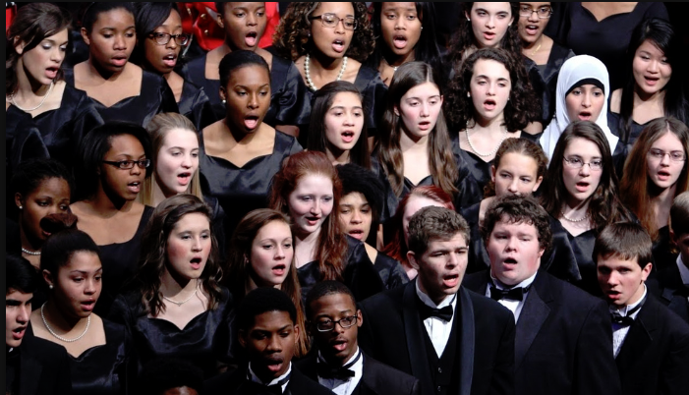
Do you like to sing?
D
Consider
Carlton Choir
Take as a club activity or as a credit.
Everyone is welcome.
Sign up in Room Y100/ Music room ASAP.

Slide 12
Volleyball Officials Needed
Tues. and Wed. evenings
Sr. B girls & Jr. girls.
If you are interested
contact Mr. Strom
PE Office.
*Knowledge of the game
rules are necessary.

Slide 13
Please Return
-textbooks
-library material
from last year,
as soon as possible.

