Slide 1

Carlton Comprehensive
Public High School
Friday, June 7, 2018
Period 1 | 8:55 – 9:55
Period 2 | 10:00 – 11:05
 | Wellness Break 11:05 – 11:15
Period 3 | 11:20 – 12:25
Period 4 | 1:15 – 2:15
Period 5 | 2:20 – 3:20
2017 – 2018 Bell
Schedule

Slide 2


F
Friday June 8, 2018
Breakfast | Single Mini | $3.50
Lunch | Chicken Fingers with Fries or Onion Rings or Soup or Salad | $5.50
Soup & Salad | Clam Chowder Thai Crunch Salad | $5.25
Dessert | New York Cheesecake with Fruit | $2.00

Slide 3


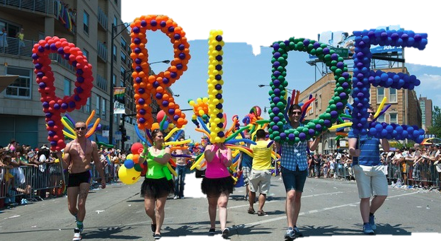
Prince Albert’s Pride Parade
June 9th
Starts at Noon
Federal
Courthouse

Slide 4


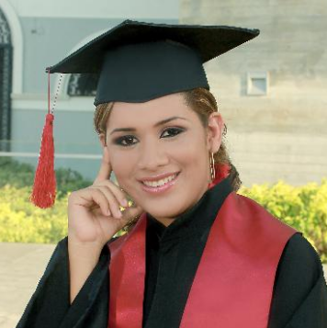
Retake
Grad Photo
Proof Packages are Here!!
Pick yours up at Student Services!

Slide 5

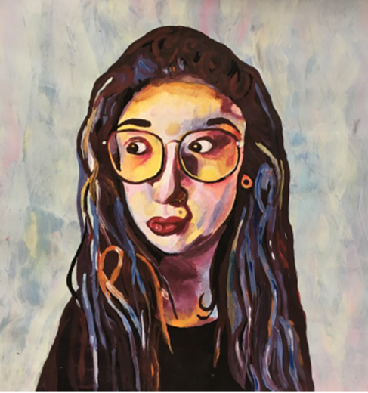
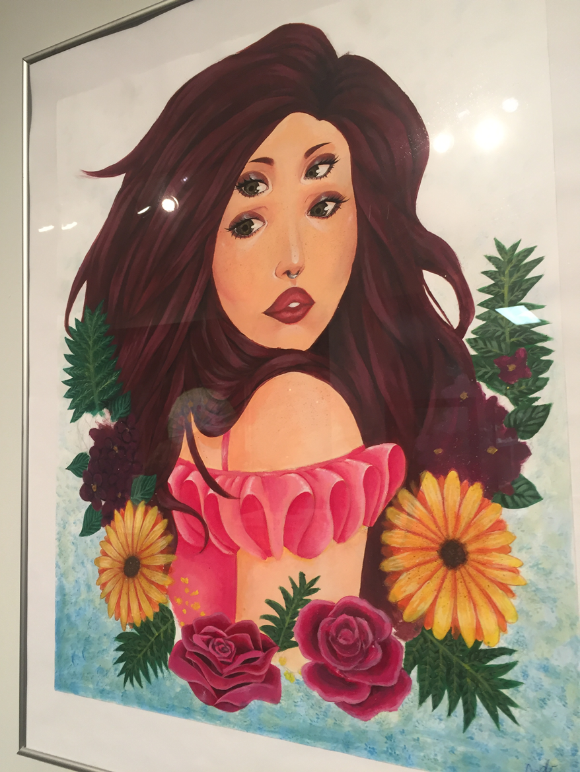
Students
Anjelo Arpia
Alexis Roy
Ailah Carpenter
Macy Charles
Rachel Bear
Brendan Earl
Jazlyn Daniels
Ryea Daniels
Hayley Loggins
Aaliyah Morin
Amanda Novotny
Haley Sanderson
Jade Sanderson
Kona Settee
Dade Standingcloud
Please pick up your art
Mrs. Anderson’s room Y200
Annual 7thHigh School
Juried Art Show

Slide 6

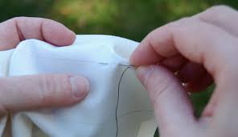
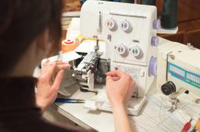



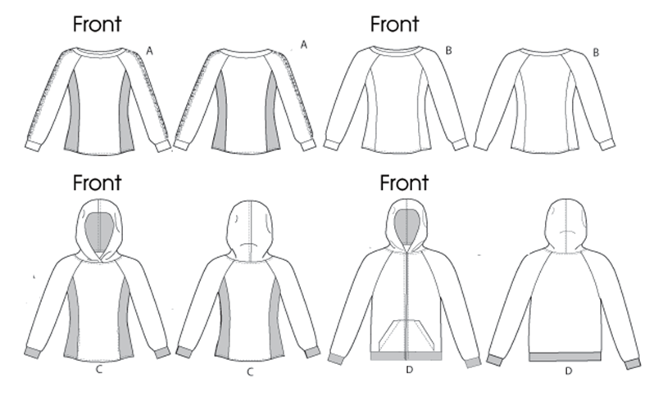

Sign up for TEXTILES 30
For fall 2018 hand sewing, machine and serger Skills
Techniques for life – maybe even a career sign up today!!
See student services

Slide 7


Slide 8


Attention Current Grade 11’s
………………………..Considering taking the
University English 100
class next year?
For more information and to register
see Student Services ASAP
08/06

Slide 9


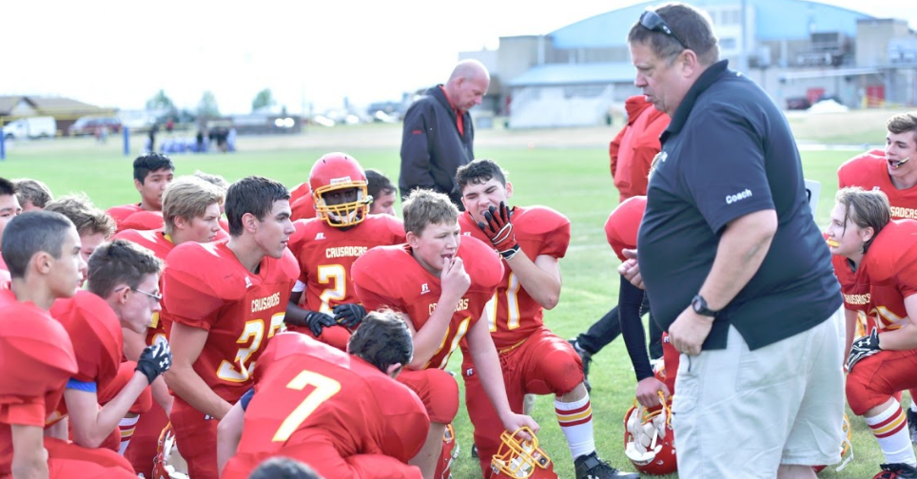
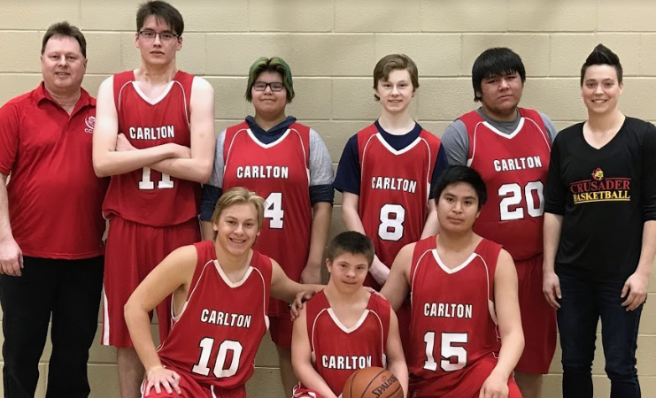
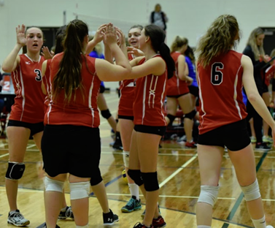

FALL SURVEY
Do you play school sports?
Less than 50% of you said YES!
We built more teams and have more
teachers coaching.
SPRING SURVEY:
More than 50% of students are playing school sports!

Slide 10
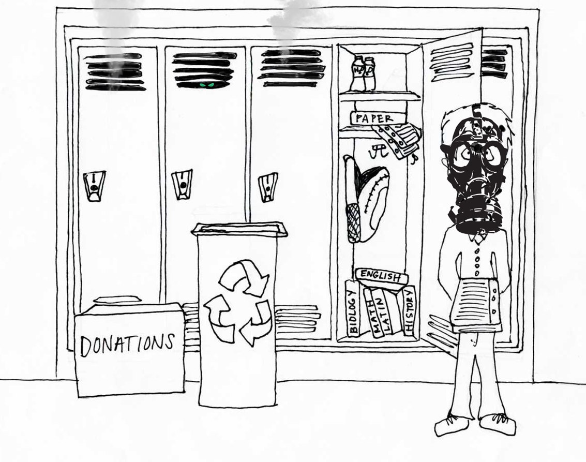

Don’t Forget Locker Clean Out
$50.00 charge for those not attending.
June 25th
1:55 pm

