Slide 1

Carlton Comprehensive
Public High School
Friday June 15 , 2018
Period 1 | 8:55 – 9:55
Period 2 | 10:00 – 11:05
 | Wellness Break 11:05 – 11:15
Period 3 | 11:20 – 12:25
Period 4 | 1:15 – 2:15
Period 5 | 2:20 – 3:20
2017 – 2018 Bell
Schedule

Slide 2


F
Friday, June 15, 2018
Breakfast | Single Mini | $3.50
Lunch | Cheddar Burger Fries or Soup or Salad or Onion Rings | $5.50
Soup & Salad | Coconut Curry Cream Citrus Mint on Greens | $5.25
Dessert | Pumpkin Cheesecake | $2.00

Slide 3

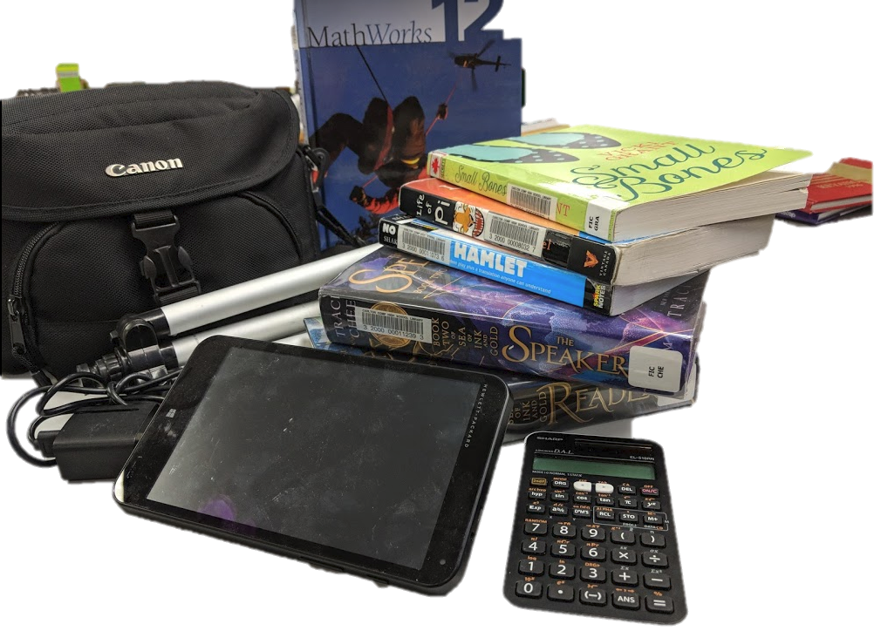
All Library Material Due
Monday June 18th
including books, HP tablets,
cameras, tripods, calculators
*Current semester textbooks excluded

Slide 4

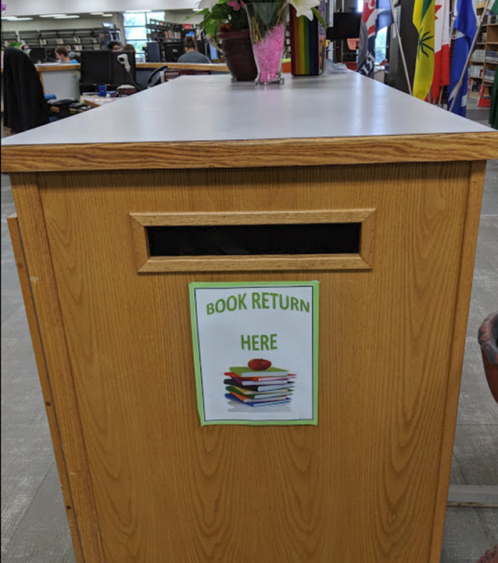
PLEASE! Return ALL
TEXTBOOKS in the
BOOK RETURN
as soon as you are
finished with them.

Slide 5

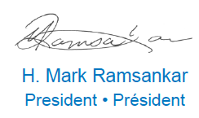
A social justice program of the Canadian Teachers’ Federation
Congratulates
Carlton Comprehensive Public High School
Alt Ed Grade 11 & 12 students
For completing the project
Speaking Our Truth:
Student Reconciliation Event
2017-2018

Slide 6
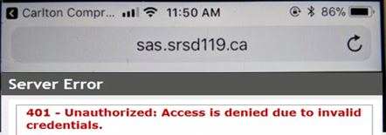

Getting an error message logging into Students Achieve on your phone?
Refresh and log in again.
**Forgot your password? See the Learning Commons Staff.

Slide 7


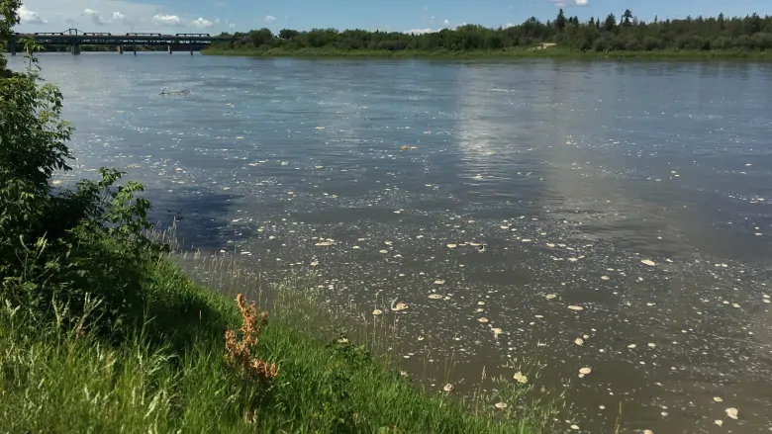
Husky Oil Spill
Impact Results and Questions Answered
Carlton’s Canadian Light Source
Research Team
Friday June 15th
5 – 6 pm
Learning Commons

Slide 8




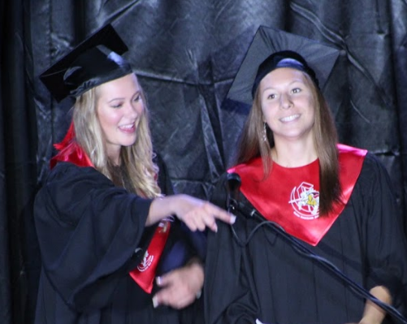
FALL SURVEY
Do you want to graduate?
75% of grad 11’s said Yes!
Homeroom
Individualized Student Plans
Positive Relationships
School Involvement
SPRING SURVEY:
85% of Grade 11’s ……..want to graduate next year.

Slide 9
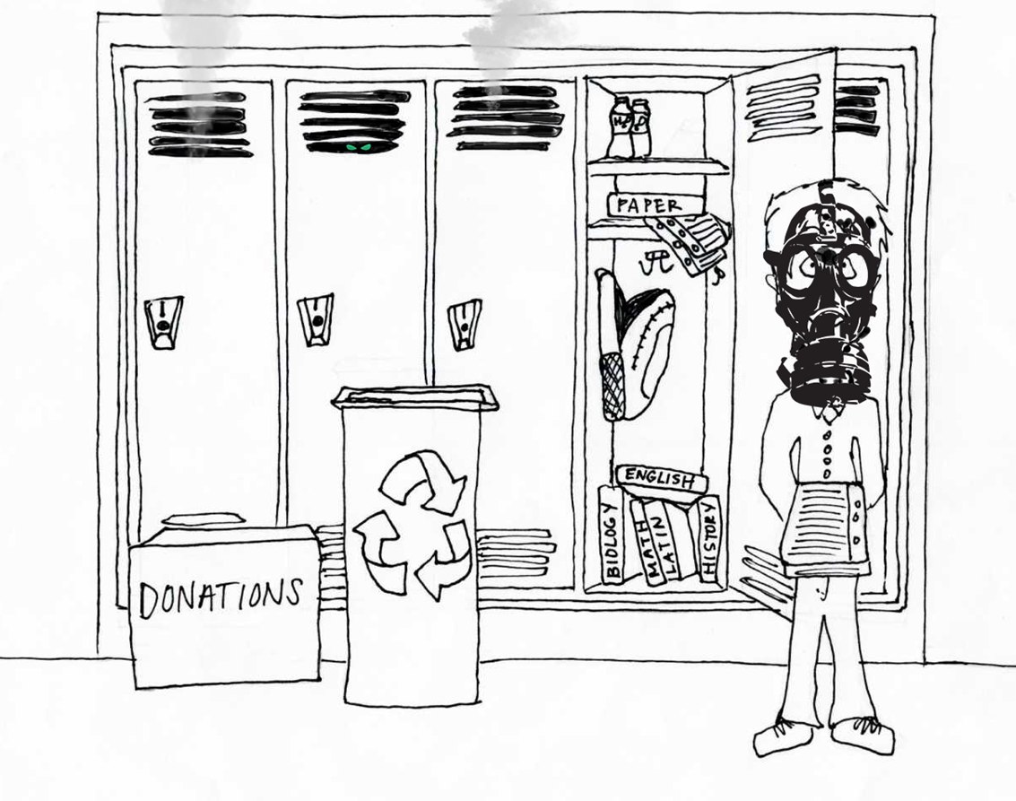

Don’t Forget Locker Clean Out
$50.00 charge for those not attending.
June 25th
1:55 pm

Slide 10

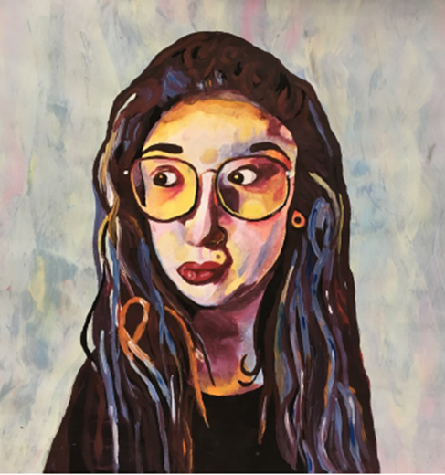
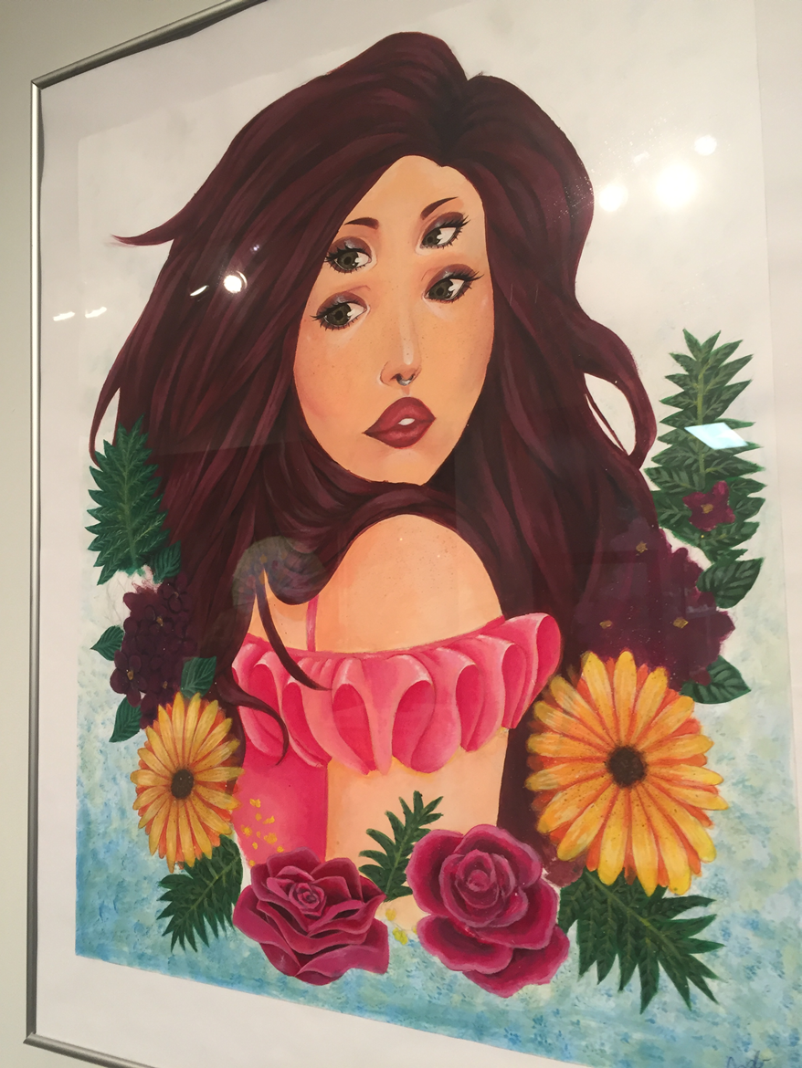
Students
Anjelo Arpia
Alexis Roy
Ailah Carpenter
Macy Charles
Rachel Bear
Brendan Earl
Jazlyn Daniels
Ryea Daniels
Hayley Loggins
Aaliyah Morin
Amanda Novotny
Haley Sanderson
Jade Sanderson
Kona Settee
Dade Standingcloud
Please pick up your art
Mrs. Anderson’s room Y200
Annual 7thHigh School
Juried Art Show

Slide 11

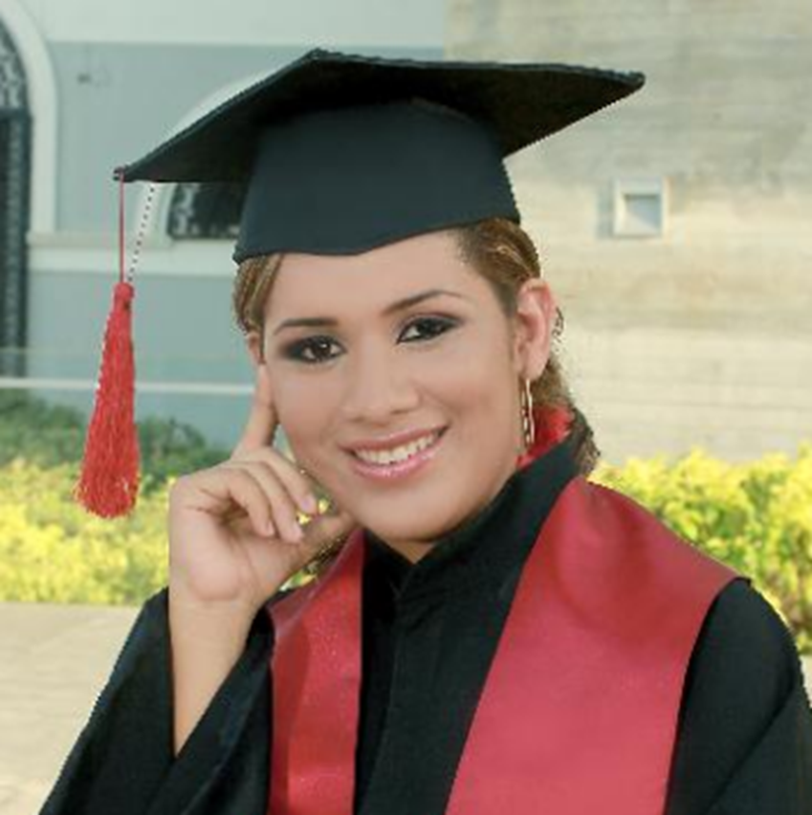
at
Student Services!

Slide 12

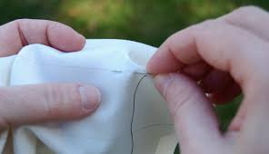
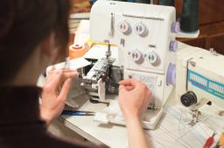



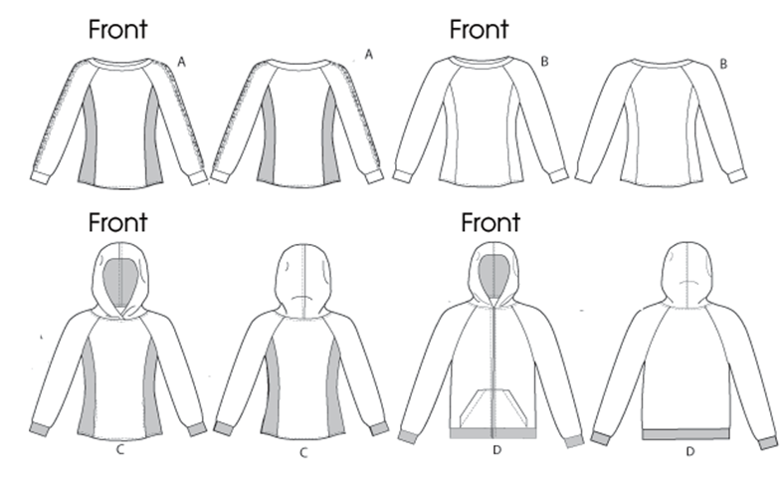

Sign up for TEXTILES 30
For fall 2018 hand sewing, machine and serger Skills
Techniques for life – maybe even a career sign up today!!
See student services

Slide 13

Carlton Cafetorium
Last Day June 22

