Slide 1
Carlton Comprehensive Public High School 2017 – 2018 Bell Schedule
 | Monday, Tuesday, Thursday and Friday | Wednesday
Period 1 | 8:55 – 9:55 | 8:55 – 9:55
Period 2 | 10:00 – 11:05 | 10:00 – 11:00
 | Wellness Break 11:05 – 11:15 | Homeroom 11:05 – 11:20
Period 3 | 11:20 – 12:25 | 11:25 – 12:25
Period 4 | 1:15 – 2:15 | 1:15 – 2:15
Period 5 | 2:20 – 3:20 | 2:20 – 3:20

Slide 2
Monday, April 30
Breakfast | Kaiser with Hash browns | $3.50
Lunch | BCLT on Kaiser with Wedges or Soup or Salad | $5.50
Soup & Salad | Chicken Noodle Tossed Green Salad with Breast of Chicken | $5.25
Dessert | Made Fresh Daily | $2.00

Slide 3
Graduates!
Interested in performing at your
graduation ceremonies?
See Mrs. Bernath Room Y100
Before April 30.
Auditions will take place in May.

Slide 4
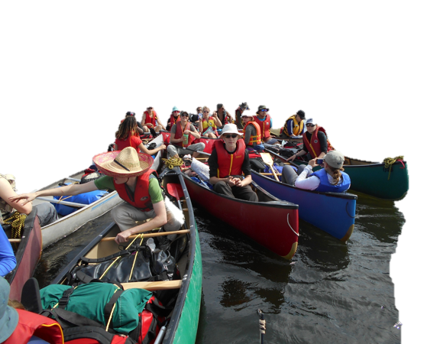
Watch for Upcoming …………………Meeting Date
Carlton Outdoor Ed
Canoe Trip

Slide 5
Cancelled this week! ………………………………………………Join us next Tues. May 8, B101 at lunch!
NOTE
It might get gritty here.
Thanks to these websites for the images: http://expressingmotherhood.com/the-write-club/
http://www.popchix.com/write-club

Slide 6
Photography Club
Note Room Change
Monday, April 30
-Lunch time
-Room B106
-Bring your lunch
New Members Welcome

Slide 7
Volunteers Needed!
SSHA Provincial Track and Field
Championships
@ our own
HARRY JEROME TRACK
June 1 & 2
See Mr. Michalchuk in Student Services
May 25

Slide 8
Carlton Football Spring Camp
Sign up
Thursday, May 3
12:30 – CPAC
All Boys and Girls invited!
No previous experience required
Information on conditioning
available

