Slide 1

Carlton Comprehensive Public High School
2017 – 2018 Bell Schedule
 | Monday, Tuesday, Thursday and Friday | Wednesday
Period 1 | 8:55 – 9:55 | 8:55 – 9:55
Period 2 | 10:00 – 11:05 | 10:00 – 11:00
 | Wellness Break 11:05 – 11:15 | Homeroom 11:05 – 11:20
Period 3 | 11:20 – 12:25 | 11:25 – 12:25
Period 4 | 1:15 – 2:15 | 1:15 – 2:15
Period 5 | 2:20 – 3:20 | 2:20 – 3:20

Slide 2


Wednesday, April 18
Breakfast | South-west Egg Benny with Hash browns | $3.50
Lunch | Pork Souvlaki with Lemon Potatoes and Vegetables | $5.50
Soup & Salad | Beef Noodle Spinach Salad | $5.25
Dessert | Pineapple Delight | $2.00

Slide 3



Graduates!
Interested in performing at your
graduation ceremonies?
See Mrs. Bernath Room Y100
Before April 30.
Auditions will take place in May.

Slide 4
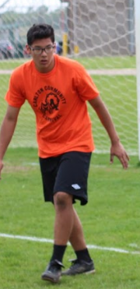
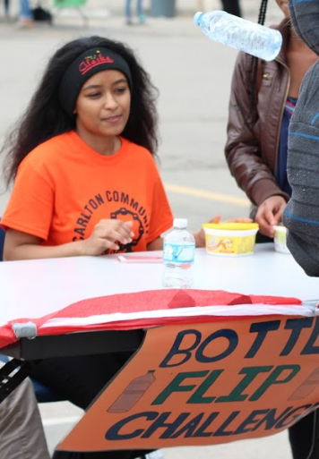
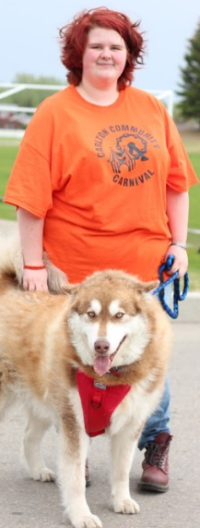
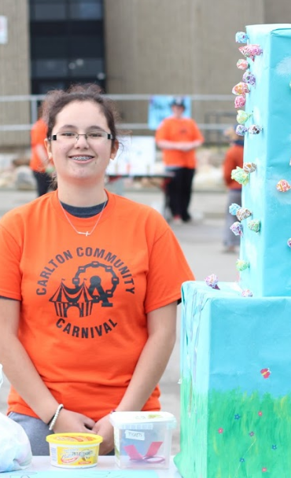
Come join the fun!
Mon. April 23, Noon
Room R212
Wanted!
School Spirit Volunteers
to run booths, etc. @
Carlton
Community Carnival

Slide 5


Friday @ Lunch Time
B116
Bring Your lunch
Express your opinion or theory on any topic.
Discussions, Debates, Documentaries.
Everyone Welcome!

Slide 6
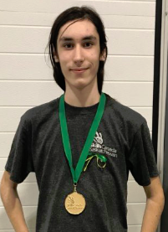
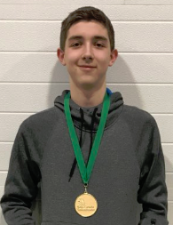
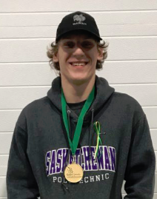
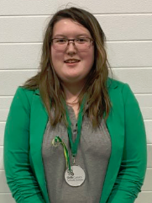

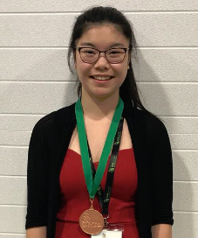
Keaton Lair
IT Networking and Software
Kyle Nelson
Electronics
Zach Tretiak
Electrical Instillation
Winners
Kelly Lam
Public Speaking
Razina Zhou
Architectural Drafting

Slide 7






Slide 8
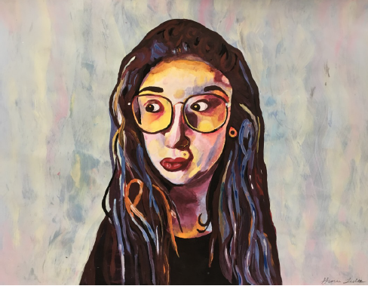
2018 Carlton Winners: ………………………………………………Ailah Carpenter
…………. Heidi Lundell
…………Hayley Loggins
7th Annual High School
Juried Art Show
April 13-May 23
Vote for the 7th winner
@ Mann Art Gallery
to be announced in May.
Juror’s Choice 2017
Gracie Lester, Other Side Carlton

Slide 9


CREATOR CLUB
Thursdays
Learning Commons
i
6-7:30
New Members always welcome!

Slide 10


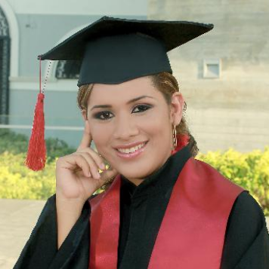
Grad Photos This Week! Gold Gym
Times posted in
The Learning Commons
Proof packages $30.00 -
due at sitting time.

