Slide 1
Carlton Comprehensive Public High School 2017 – 2018 Bell Schedule
 | Monday, Tuesday, Thursday and Friday | Wednesday
Period 1 | 8:55 – 9:55 | 8:55 – 9:55
Period 2 | 10:00 – 11:05 | 10:00 – 11:00
 | Wellness Break 11:05 – 11:15 | Homeroom 11:05 – 11:20
Period 3 | 11:20 – 12:25 | 11:25 – 12:25
Period 4 | 1:15 – 2:15 | 1:15 – 2:15
Period 5 | 2:20 – 3:20 | 2:20 – 3:20

Slide 2
Tuesday, April 10
Breakfast | Breakfast Skillet with Scrambled Egg | $3.50
Lunch | Chili Cheese Dog with Wedges Or Soup or Salad | $5.50
Soup & Salad | Dill Pickle Cream Buffalo chicken Caesar | $5.25
Dessert | Death by Chocolate | $2.00

Slide 3
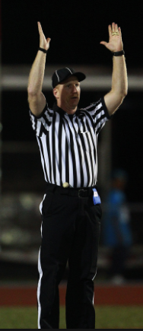
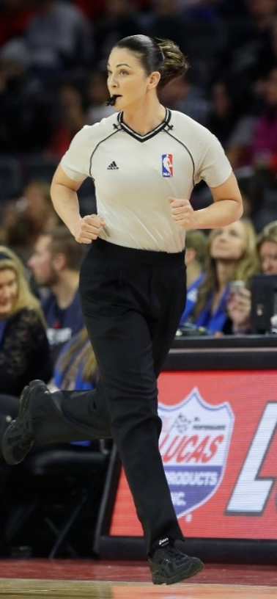
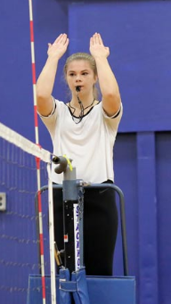
SHSAA Youth Officials
Conference
June 8th - 9th
Connect - Socialize –
Improve skills & Knowledge
i Beginner – Intermediate Levels
k
See Mr. Strom - CPAC
Basketball
Football
Soccer
Volleyball

Slide 4
Skills Canada Meeting
for All Students in Regina
Competition
Wed. April 11th Lunch Bell
Electrical Shop G107
.

Slide 5
CREATOR CLUB Cancelled this week Back April 19 in the Learning Commons
i 6-7:30
New Members always welcome!

Slide 6
Cancelled Today Returning next week, Tues. April 17 Noon B10 New members always welcome!
Thanks to these websites for the images: http://expressingmotherhood.com/the-write-club/
http://www.popchix.com/write-club

Slide 7
Grad Photos Schedule
Posted in the Learning Commons
April 16th to 20^{th ~} Gold Gym
Proof packages are $30.00 -
due at sitting time.

Slide 8
Girls of Greatness
Next meeting:
April 11, 2018
Period 3
Student Lounge
Open to Grades 9-12

