Slide 1
Carlton Comprehensive Public High School 2017 – 2018 Bell Schedule
 | Monday, Tuesday, Thursday and Friday | Wednesday
Period 1 | 8:55 – 9:55 | 8:55 – 9:55
Period 2 | 10:00 – 11:05 | 10:00 – 11:00
 | Wellness Break 11:05 – 11:15 | Homeroom 11:05 – 11:20
Period 3 | 11:20 – 12:25 | 11:25 – 12:25
Period 4 | 1:15 – 2:15 | 1:15 – 2:15
Period 5 | 2:20 – 3:20 | 2:20 – 3:20

Slide 2
Friday, March 23
Breakfast | Single Mini | $3.50
Lunch | Chicken Fingers w/ Fries or Soup or Salad or Onion Rings | $5.50
Soup & Salad | Clam Chowder Chicken Noodle Broccoli Salad w/ Chicken | $5.25
Dessert | New York Cheesecake | $2.00

Slide 3
Track and Field Sign UP
Wed. March 28
CPAC 12:30
Bring some friends
Get some info
No experience necessary!
Carlton is hosting Provincials this year!

Slide 4
Photography Club
Members who signed up for
Hoopla pictures see Mrs. Sigrist or Mrs. Toporwski
For schedule
Monday
-Lunch time
-Lunch Room B203
-Bring your lunch
New Members Welcome

Slide 5
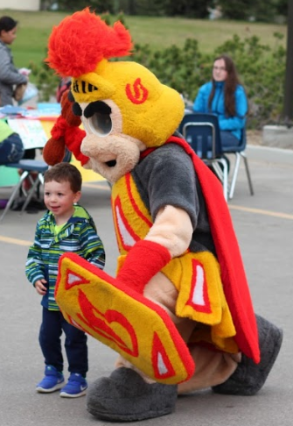
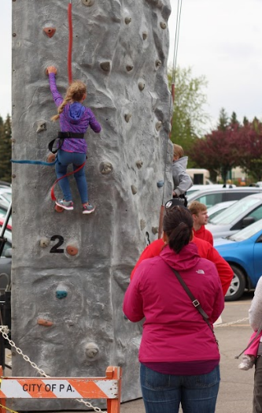
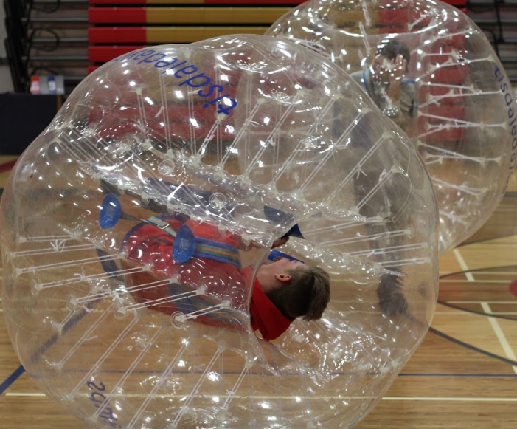
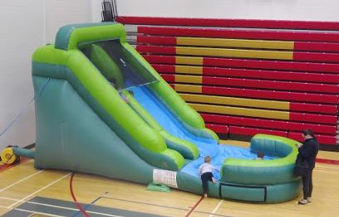
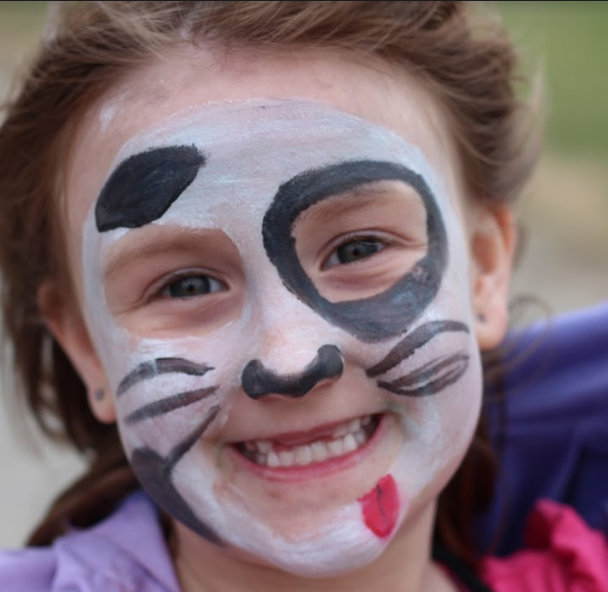
Carlton Community Carnival Planning Meeting Monday March 26 - Lunch time Room 212 Everyone Welcome!

Slide 6
*Please remove valuables from change rooms.
Closed - Learning Commons &
Red Gym/CPAC Change Rooms
Thurs. Mar. 22nd to
Mon. Mar. 26th

Slide 7
CPAC Closed
Tues. Mar. 20th 3:30– Mon. Mar. 26th
-All of CPAC and area – including Fitness Centre.
-NO access to CPAC from outside.

Slide 8
Closed -The Entire East ……….Parking Lot
& Electric Stalls
Fri. Mar. 23
-

