Slide 1
Carlton Comprehensive Public High School 2017 – 2018 Bell Schedule
 | Monday, Tuesday, Thursday and Friday | Wednesday
Period 1 | 8:55 – 9:55 | 8:55 – 9:55
Period 2 | 10:00 – 11:05 | 10:00 – 11:00
 | Wellness Break 11:05 – 11:15 | Homeroom 11:05 – 11:20
Period 3 | 11:20 – 12:25 | 11:25 – 12:25
Period 4 | 1:15 – 2:15 | 1:15 – 2:15
Period 5 | 2:20 – 3:20 | 2:20 – 3:20

Slide 2
Wednesday, March 21
Breakfast | South-west Egg Benny with Hash browns | $3.50
Lunch | Sweet and Sour Pork with Rice and Vegetables | $5.50
Soup & Salad | Borscht Tomato Macaroni Spinach Salad with Beets | $5.25
Dessert | Mocha Mud Dessert | $2.00

Slide 3
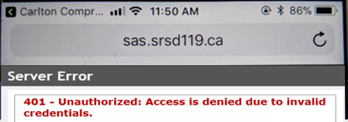
Getting an error message logging into Students Achieve on your phone?
Refresh and log in again.
**Forgot your password? See the Learning Commons Staff.

Slide 4
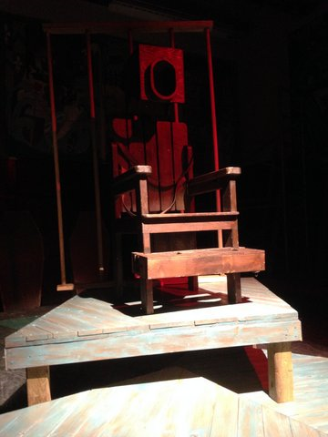
MAD HATTER THEATRE COMPANY
PRESENTS
The Insanity of Mary Girard
Wednesday March 21
Cartlon Cafetorium 7:30
Admission $5

Slide 5
*Please remove valuables from change rooms.
Closed - Learning Commons &
Red Gym/CPAC Change Rooms
Thurs. Mar. 22nd to
Mon. Mar. 26th

Slide 6
CPAC Closed
Tues. Mar. 20th 3:30– Mon. Mar. 26th
-All of CPAC and area – including Fitness Centre.
-NO access to CPAC from outside.

Slide 7
Closed -The Entire East Parking Lot
& Electric Stalls
Fri. Mar. 23
-

