Slide 1
Carlton Comprehensive Public High School 2017 – 2018 Bell Schedule
 | Monday, Tuesday, Thursday and Friday | Wednesday
Period 1 | 8:55 – 9:55 | 8:55 – 9:55
Period 2 | 10:00 – 11:05 | 10:00 – 11:00
 | Wellness Break 11:05 – 11:15 | Homeroom 11:05 – 11:20
Period 3 | 11:20 – 12:25 | 11:25 – 12:25
Period 4 | 1:15 – 2:15 | 1:15 – 2:15
Period 5 | 2:20 – 3:20 | 2:20 – 3:20

Slide 2
Thursday, March 1
Breakfast | French Toast with Sausage | $3.50
Lunch | Grilled Cheese Sandwich with Wedges or Soup or Salad | $5.50
Soup & Salad | Cream of Tomato Beef Noodle Crunchy Detox Salad | $5.25
Dessert | Raspberry Jell-O | $2.00

Slide 3
Homeroom Day Today!
Earn Credits
Life Transitions 20 & 30
11:05-11:20
Home
School
Employment
Health
Money
Relationships
See your timetable for your advisor and room # to meet.

Slide 4
Hoopla Volunteer Meeting
Thursday, March 1
12:30 – CPAC
Host/Hostess
Scorekeepers
Video Crew
See Mr. Strom if you cannot attend

Slide 5
Attention Badminton Players!!
Information meeting:
Thursday, March 1st
Noon
CPAC

Slide 6
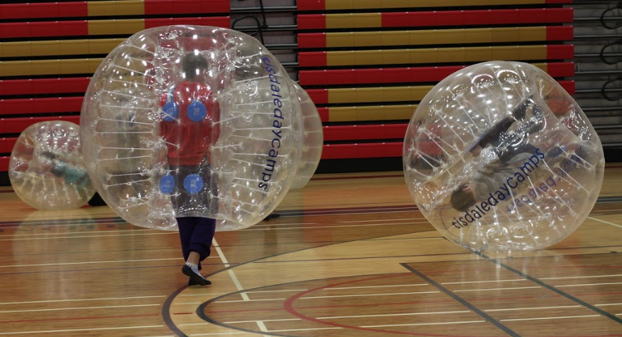
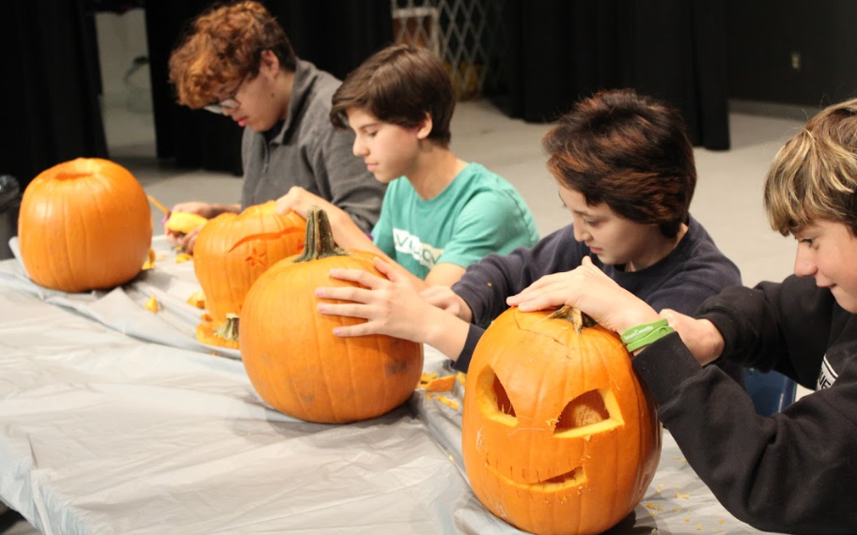
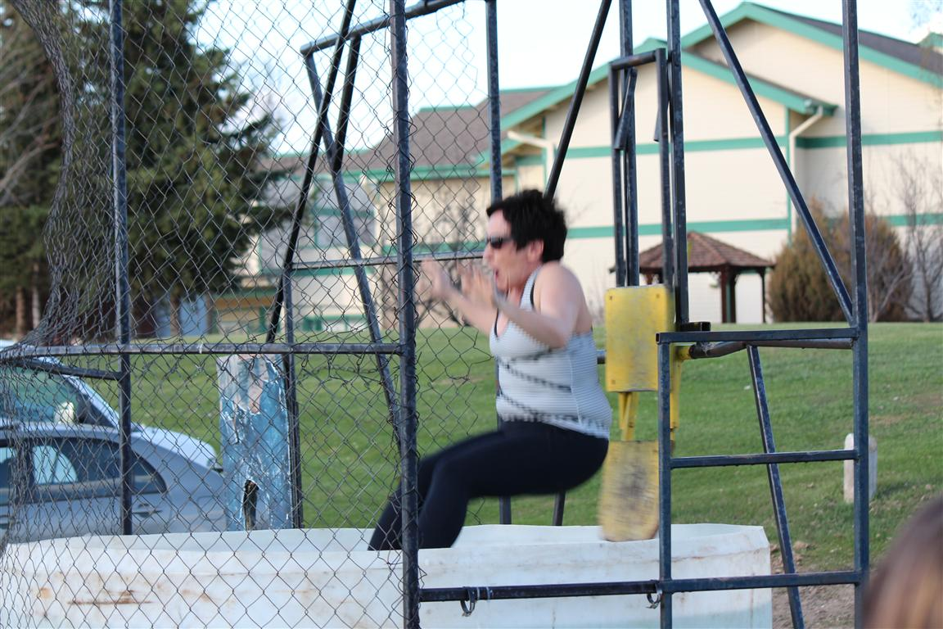
Making the ordinary – EXTRAORDINARY!
Check the board near B101 for more info!
The Student Leadership Council is looking for
New Council members & Spirit Volunteers
Mrs. Wilkie - Student Services
Mr. Hecht - Learning Commons
Mr. Armitage - R203

Slide 7
Stay up to date with Sader Snaps!
Follow Carlton’s Snapchat @CCPHS Saders
Snap codes will be posted throughout the school
until March 5, 2018!

Slide 8
Carlton Mobile Store
NEW CLOTHING!
February 26th - March 9th
Buy your Crusader Clothing at Lunch in the Rotunda
or
Visit the General Office
Payments are available with cheques, debit, credit and cash

Slide 9
Girls of Greatness
Next meeting:
February 28, 2018
Period 2
Student Lounge
Open to Grades 9-12

