Slide 1
Carlton Comprehensive Public High School 2017 – 2018 Bell Schedule
 | Monday, Tuesday, Thursday and Friday | Wednesday
Period 1 | 8:55 – 9:55 | 8:55 – 9:55
Period 2 | 10:00 – 11:05 | 10:00 – 11:00
 | Wellness Break 11:05 – 11:15 | Homeroom 11:05 – 11:20
Period 3 | 11:20 – 12:25 | 11:25 – 12:25
Period 4 | 1:15 – 2:15 | 1:15 – 2:15
Period 5 | 2:20 – 3:20 | 2:20 – 3:20

Slide 2
Monday, March 19
Breakfast | Kaiser with Hash browns | $3.50
Lunch | Chicken and Mushroom Tetrazzini | $5.50
Soup & Salad | Cream of Broccoli Minestrone Tossed Green Salad | $5.25
Dessert | Chocolate Zucchini Cake | $2.00

Slide 3
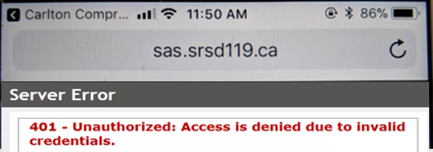
Getting an error message logging into Students Achieve on your phone?
Refresh and log in again.
**Forgot your password? See the Learning Commons Staff.

Slide 4
Girls of Greatness
Next meeting:
March 20, 2018
Period 4
Student Lounge
Open to Grades 9-12

Slide 5
Photography Club
Monday
-Lunch time
-Lunch Room B203
-Bring your lunch
New Members Welcome

Slide 6
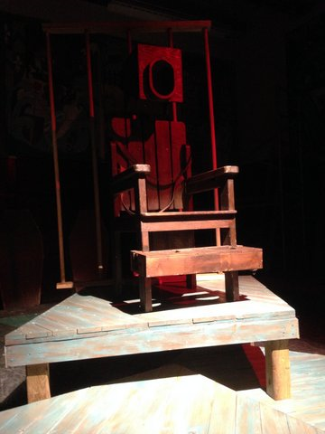
MAD HATTER THEATRE COMPANY
PRESENTS
The Insanity of Mary Girard
Wednesday March 21
Cartlon Cafetorium 7:30
Admission $5

Slide 7
Note Closures for Hoopla
-
* Tues. 20th – Mon. 26th
-All of CPAC and area – including Fitness Centre.
-NO access to CPAC from outside.
* Thurs. 22nd - Fri. 23rd
Red Gym Change Rooms,
please remove your valuables.
Learning Commons..
*Fri. 23rd
-East parking lot.

