Slide 1
Carlton Comprehensive Public High School 2017 – 2018 Bell Schedule
 | Monday, Tuesday, Thursday and Friday | Wednesday
Period 1 | 8:55 – 9:55 | 8:55 – 9:55
Period 2 | 10:00 – 11:05 | 10:00 – 11:00
 | Wellness Break 11:05 – 11:15 | Homeroom 11:05 – 11:20
Period 3 | 11:20 – 12:25 | 11:25 – 12:25
Period 4 | 1:15 – 2:15 | 1:15 – 2:15
Period 5 | 2:20 – 3:20 | 2:20 – 3:20

Slide 2
Wednesday, March 14
Breakfast | South-west Egg Benny with Hash browns | $3.50
Lunch | BBQ 1/4 Chicken with Rice Pilaf and Vegetables | $5.50
Soup & Salad | Chicken Gumbo Dutch Meatball Mediterranean Salmon Salad | $5.25
Dessert | Death By Chocolate | $2.00

Slide 3
Spring Football Information
Football Sask. Camps etc.
Carlton Football
Tues. March 13
12:30 - CPAC

Slide 5
NO
HOMEROOM TODAY!
11:05-11:20

Slide 6
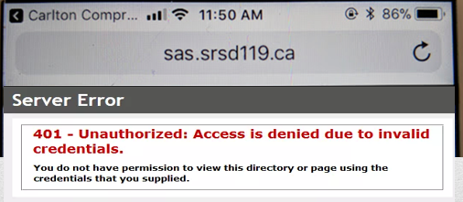
Getting an error message logging into Students Achieve on your phone?
Refresh and log in again.
**Forgot your password? See the Learning Commons Staff.

Slide 7
Hoopla Volunteer Meeting
Thursday, March 15
Lunchtime
CPAC
……………Everyone must attend!!

Slide 8
Girls of Greatness
Next meeting:
March 20, 2018
Period 4
Student Lounge
Open to Grades 9-12

Slide 9
Provincial High School Wrestling Champions
Saskatoon Competition
Kaylin Anderson Samantha Paradis
Maggie Tiessen Shannon Spademan

Slide 10
**NEW SADER GEAR!**
For Sale Until March 16th
Rotunda at noon
or
General Office
**Cheque, debit, credit and cash

Slide 11
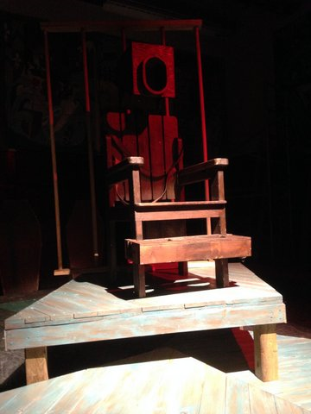
MAD HATTER THEATRE COMPANY
PRESENTS
The Insanity of Mary Girard
Wednesday March 21
Cartlon Cafetorium 7:30
Admission $5

